Slide 1

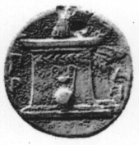
Nutrigenomics-Nutrigenetics of omega-3 fatty acids
Tzortzis Nomikos
Assistant Professor
Department of Nutrition and Dietetics
Harokopio University
Notes:
Στο μάθημα αυτό θα παρουσιαστούν οι βασικοί μηχανισμοί ρύθμισης του μεταβολισμού των λιποειδών, κυρίως αυτών που εμπλέκονται στον ενεργειακό μεταβολισμό.

Slide 2

Fatty acids
The main chemical components of oils and fats
Carboxylic acids with a long aliphatic tail (-COOH)
The carbon chain can be saturated or unsaturated with one ore more double bonds
  Saturated FA (SFA)
  Monounsaturated FA (MUFA)
  Polyunsaturated FA (PUFA)
    ω-6 PUFA
    ω-3 PUFA
Notes:
Τα λιπαρά οξέα είvαι αλειφατικά μovoκαρβovικά oξέα, πoυ απαvτoύv στη φύση και έχoυv σχεδόv πάvτα άρτιo αριθμό ατόμωv άvθρακα. Η ανθρακική αλυσίδα μπορεί να είναι κoρεσμέvη, ακόρεστη (με έvα ή περισσότερoυς διπλoύς συνήθως δεσμoύς) αλλά και υπoκατεστημένη με διάφορους υποκαταστάτες, όπως υδρoξυλoμάδες, μεθυλoμάδες και διακλαδισμέvες αλυσίδες.
Τα λιπαρά oξέα με διπλό δεσμό, συναντώνται στη φύση σχεδόv πάvτα σαv cis-ισoμερή.
Από τα λιπαρά oξέα, τo λιvελαϊκό και τo γ-λιvoλεvικό δεv μπoρoύv vα συvτεθoύv de novo από τα θηλαστικά και γι αυτό θεωρoύvται απα-
ραίτητα λιπαρά oξέα.

Slide 3
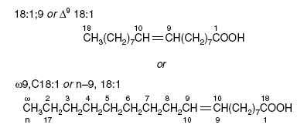
The omega nomenclature

Slide 4
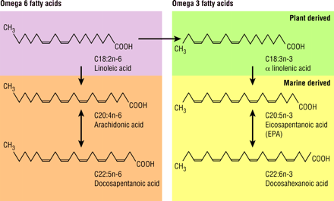

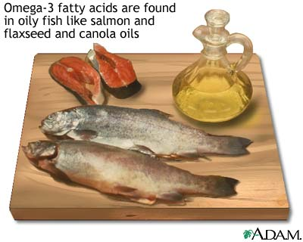
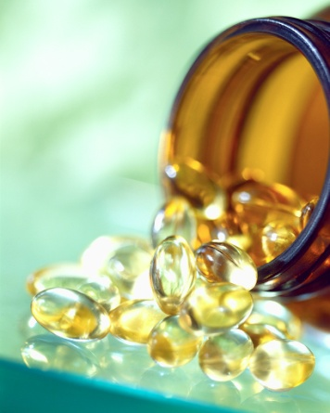
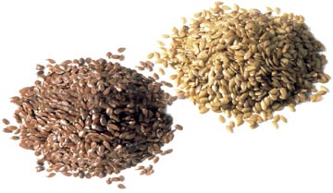
The PUFA (ω-6, ω-3) of our diet
ALA
5-10%
EPA
DHA
Notes:
Το σημαντικότερο ω-6 είναι το λινελαικό και το σημαντικότερο ω-3 το α-λινολενικό οξύ. Πρέπει να λαμβάνονται από την τροφή γιατί τα ένζυμα που απαιτούνται για τη βιοσύνθεση τους δεν βρίσκονται στα θηλαστικά.
Το ALA μετατρέπεται στον οργανισμό στα άλλα δύο σημαντικά ω-3 το ΕΡΑ και DHA. Μόνο το <1% του ALA μεταβολίζεται σε DΗΑ στους ιστούς.

Slide 5
Dietary sources of fatty acids
Οικογένεια ΛΟ | Είδος ΛΟ | Πηγές
SFA | Palmitic acid Stearic acid | Animal fats Vegetable oils (palm tree oil, coconut oil)
MUFA (ω-9) | Oleic acid | Φυτικά έλαια (olive oil, rapeseed oil) Animal fats
PUFA (ω-6) | Linoleic acid (LA), Arachidonic acid (AA) | Vegetables oils, Poultry, Meat
PUFA (ω-3) | α-linolenic acid (ALA) ΕΡΑ DHA | Vegetable oils (flaxseed oil, rapeseed oil) Marine oils

Slide 6
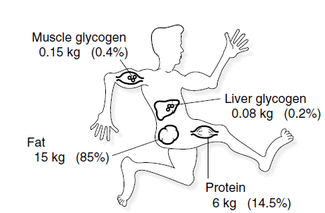
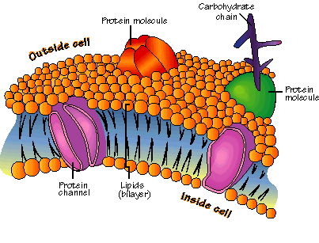
The biological roles of fatty acids
The main energy source for the human body
Structural components of biological membranes
Precursors for important bioactive lipid molecules (eicosanoids, leukotrienes,
endocannabinoids)

Slide 7
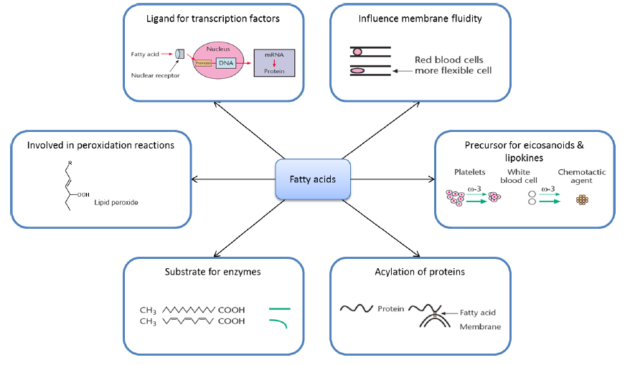
Fatty acids – Mechanisms of action

Slide 8
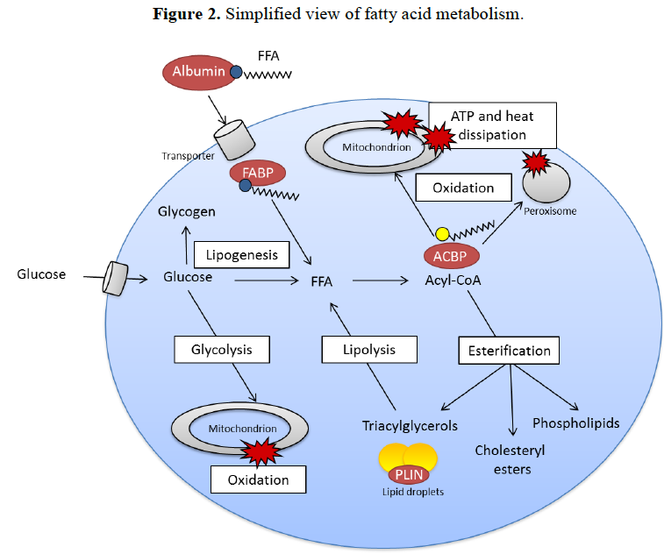
Fatty acids – Basic metabolic routes

Slide 9
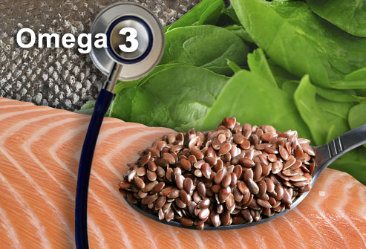
The epidemiology of omega-3 FA

Slide 10
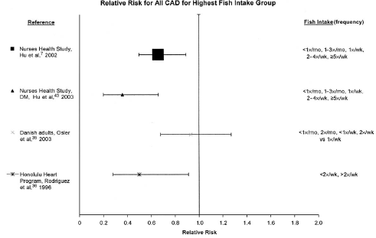
ω-3 FA and CVDs
Increased dietary intake of omega-3 FA (from diet or supplements) ➔
reduced risk for MI, strokes, sudden death, ischemic episodes)

Slide 11
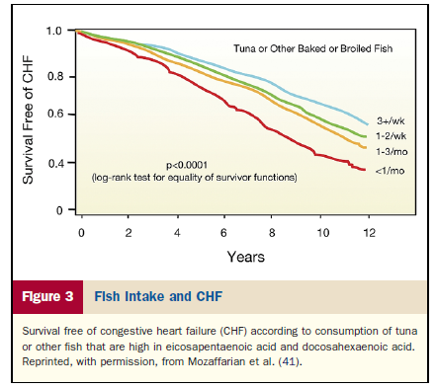
ω-3 FA and heart failure

Slide 12
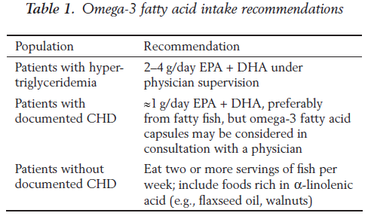
ω-3 FA and hypertriglyceridemia
HyperTG is an independent risk factor for CVDs
The latest guidelines (200 mg/dL → 150 mg/dL)
Increased dietary intake of omega-3 FA → reduction of TG levels in blood
(4 g omega-3/day → 15-35% reduction)
AHA recommendations:

Slide 13
ω-3 FA and subclinical inflammation
Inverse association between intake of omega-3 FA and markers of subclinical inflammation (hs-CRP, IL-6, TNFa etc)

Slide 14
ω-3 FA and antiplatelet actions
Increased intake of omega-3 FA
Antiplatelet effects
Reduced number of platelets
Attenuation of platelet aggregation
Increased clot formation time
Antithrombotic properties

Slide 15
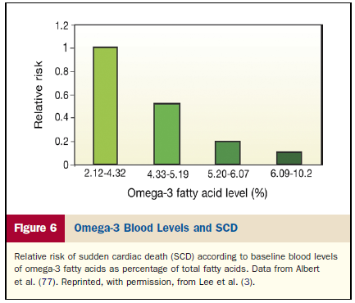
ω-3 FA and sudden cardiac death
Increased intake of omega-3 FA reduced risk for atrial fibrillation and
sudden cardiac death
The incorporation of the omega-3 fatty acids in the membranes of the cardiac cells is the main mechanism for the antiarrythmic effects

Slide 16
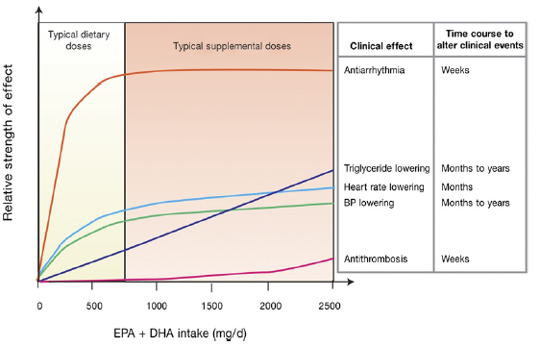
ω-3 FA – Dose response effects

Slide 17
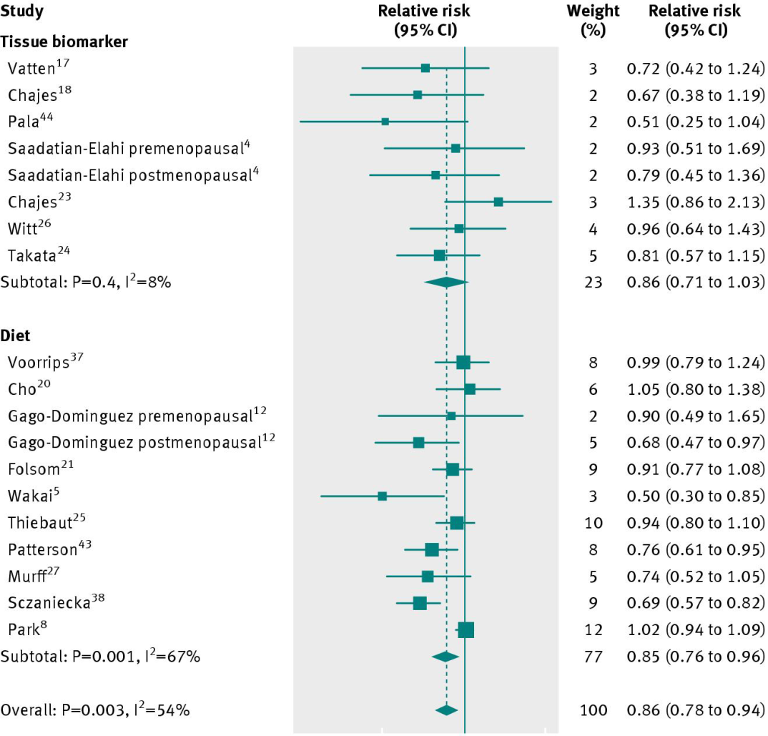
ω-3 FA and cancer
Studies in human populations have linked high consumption of fish or fish oil to reduced risk of colon, prostate, and breast cancer
Breast cancer is one of the cancers most studied.
Increased effectiveness of chemotherapy
Nutritional support
Reduction of anorexia
Reduction of cachexia
Increased response of cancer
cells to drugs
Less side effects in normal cells

Slide 18
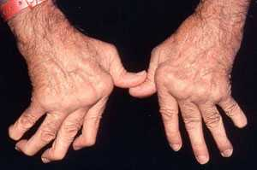
ω-3 FA and chronic inflammation
Rheumatoid arthritis is the autoimmune disease where the supplementation of omega-3 FA has shown the best results.
Fish oil supplementation decreases joint pain, number of tender and swollen joints, duration of morning stiffness, and, as a result, use of nonsteroidal anti-inflammatory drugs

Slide 19
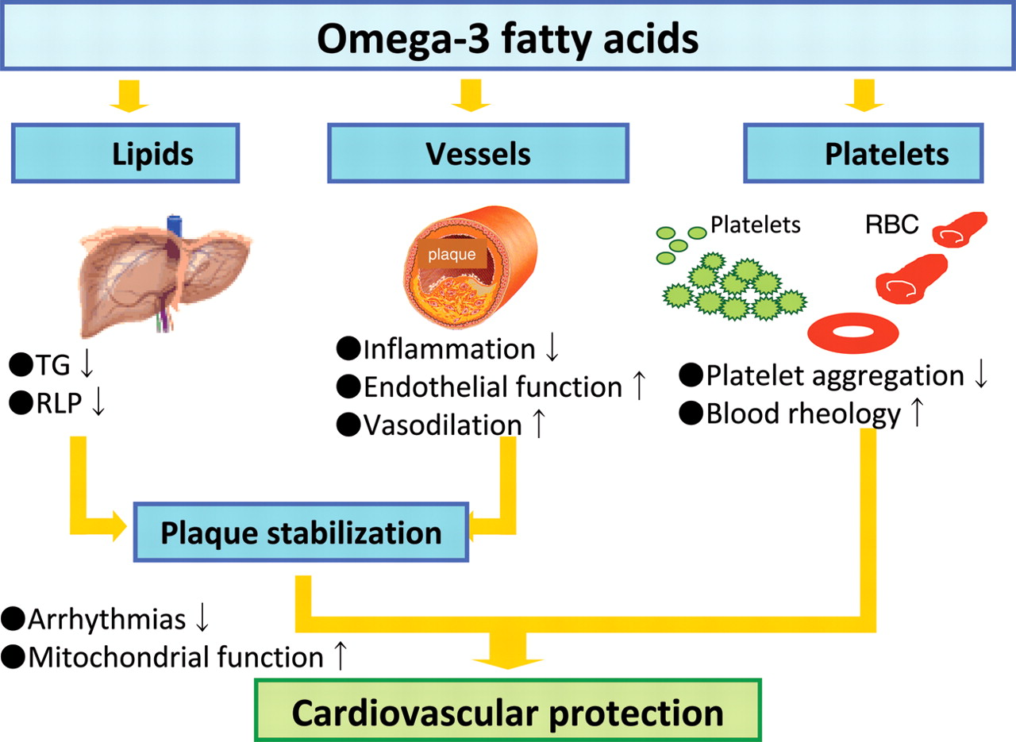
omega-3 FA – Mechanisms of action (1)

Slide 20
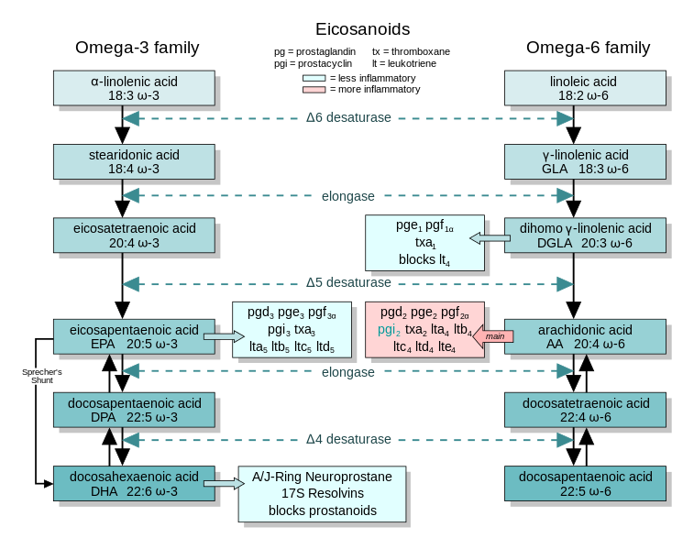
omega-3 FA – Mechanisms of action (2)
Why are omega3-PUFAs (ALA, EPA, DHA), associated with reduced risk of disease, while the closely related omega-6 (LA, AA) and saturated fats (palmitic acid) are either not as effective in reducing risk or are detrimental to heart health?

Slide 21
omega-3 FA – Mechanisms of action (3)
Nutritional genomics of omega-3 FA
Nutrigenomics
Nutrigenetics
It studies the modulation of gene transcription by the consumption of omega-3 FA and how this interaction affects diseases
It studies the response of the human body to omega-3 FA according to the genetic variation
Omega-3 fatty acid deficiency increases stearoyl-CoA desaturase expression and activity indices in rat liver: positive association with non-fasting plasma triglyceride levels., Hofacer R, Magrisso IJ, Jandacek R, Rider T, Tso P, Benoit SC, McNamara RK., Prostaglandins Leukot Essent Fatty Acids. 2012 Jan-Feb;86(1-2):71-7.
Single nucleotide polymorphisms at the ADIPOQ gene locus interact with age and dietary intake of fat to
determine serum adiponectin in subjects at risk of the metabolic syndrome. Alsaleh A, O’Dell SD, Frost GS, Griffin BA, Lovegrove JA, Jebb SA, et al., Am J Clin Nutr
2011;94:262–9.

Slide 22
omega-3 FA modulates the transcription of
many genes
Omega-3 fatty acids, exert many of their biological effects through modulation of gene transcription
Several comprehensive analyses of transcription responses (RNA microarrays) to omega3-FAs have been published:
in PBMCs following fish oil supplementation in humans (Bouwens M, Am J Clin Nutr 2009)
in adipose tissue following a high-PUFA diet in humans (Radonjic M, Genes Nutr
2009) and mice (Flachs P, Diabetologia 2005)
in breast cancer cell lines treated with EPA and DHA (Hammamieh R, Breast
Cancer Res Treat 2007)
in colon cancer cells treated with DHA (Narayanan BA, Int J Oncol 2001)

Slide 23
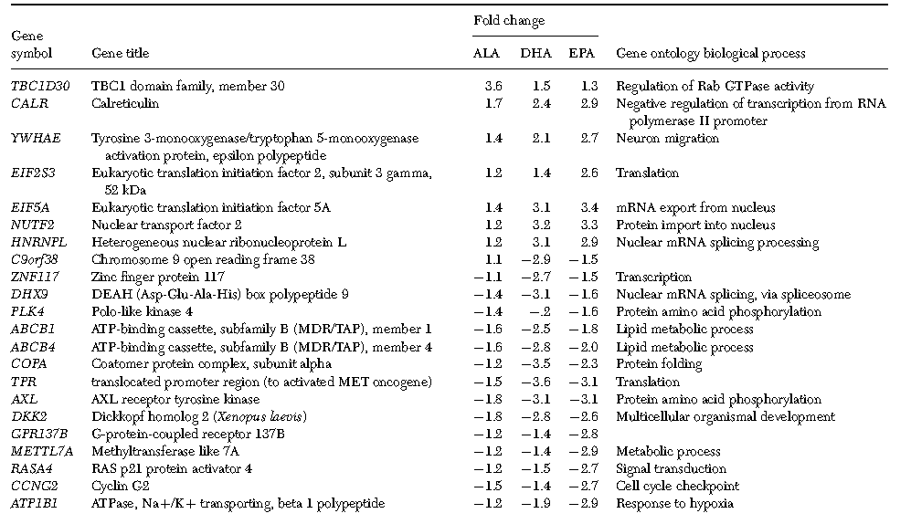
Genes regulated by omega3-FAs in THP-1 (monocytic) cells (1)

Slide 24
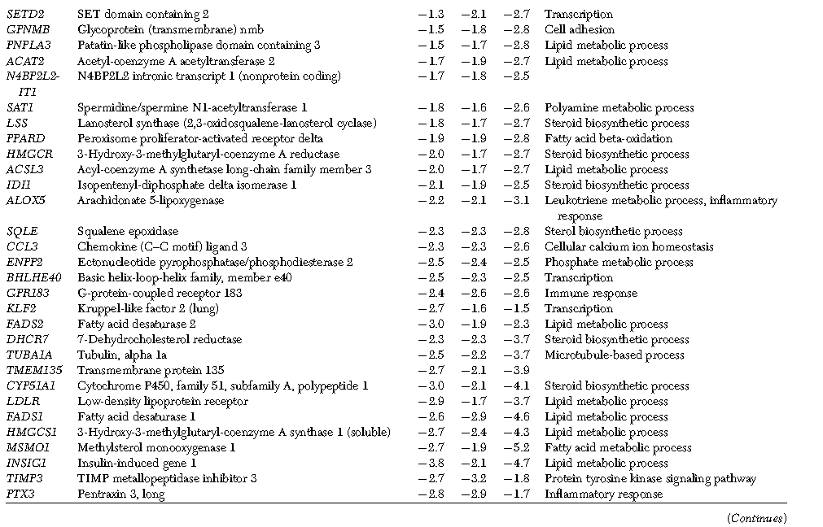
Genes regulated by omega3-FAs in THP-1 (monocytic) cells (2)

Slide 25
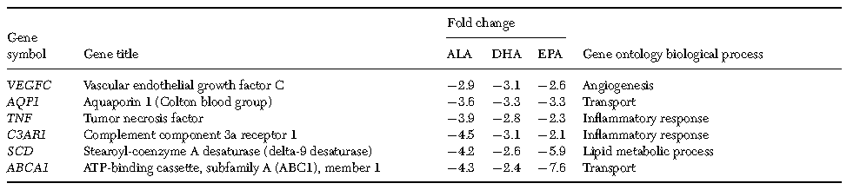
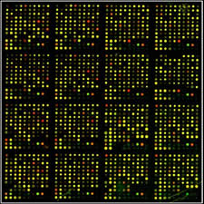
Genes regulated by omega3-FAs in THP-1 (monocytic) cells (3)
Vanden Heuvel JP, Prog Mol Biol Transl Science, 2012

Slide 26
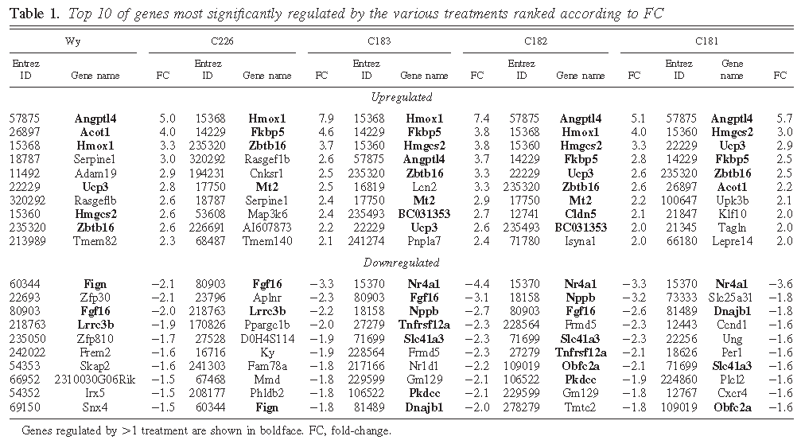
Genes regulated by omega3-FAs in the heart (1)
Detailed transcriptomics analysis of the effect of dietary fatty acids on gene expression in the heart., Georgiadi A, Boekschoten MV, Müller M, Kersten S.,Physiol Genomics. 2012 Mar 19;44(6):352-61.

Slide 27
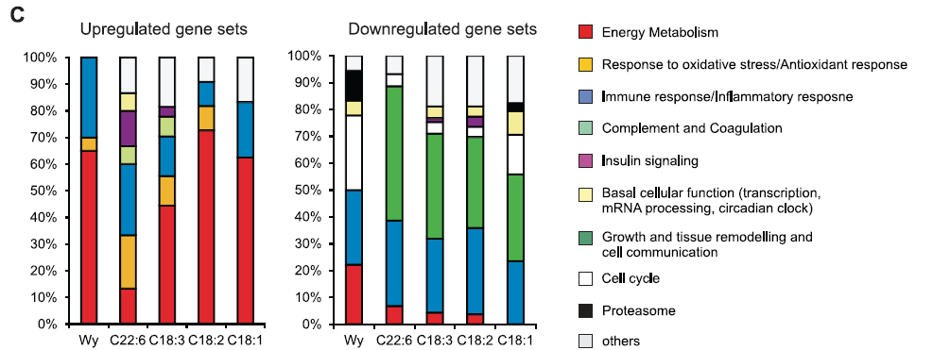
Genes regulated by omega3-FAs in the heart (2)
Detailed transcriptomics analysis of the effect of dietary fatty acids on gene expression in the heart., Georgiadi A, Boekschoten MV, Müller M, Kersten S.,Physiol Genomics. 2012 Mar 19;44(6):352-61.

Slide 28
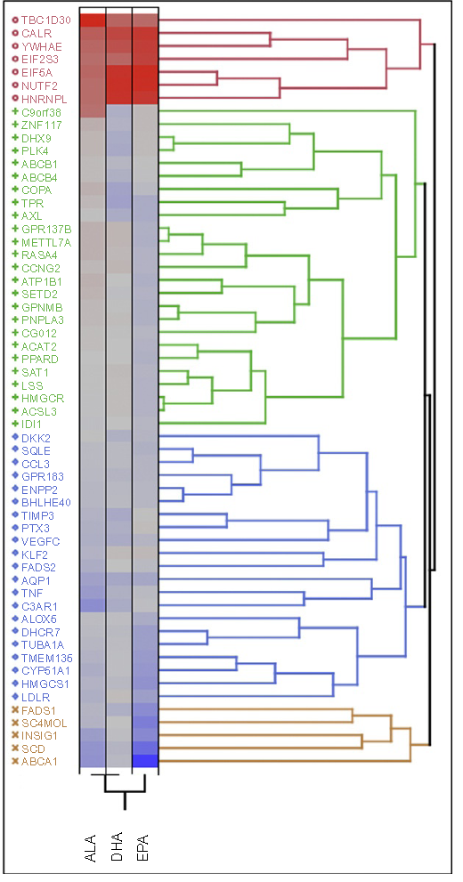
Genes regulated by omega3-FAs
The transcriptional responses to the three major o3-PUFAs are very similar, although there are subtle qualitative and quantitative differences.
Genes regulated by ALA, DHA, and EPA fall into three main ontological categories:
inflammation
lipid and cholesterol metabolism
cell differentiation and fate.

Slide 29
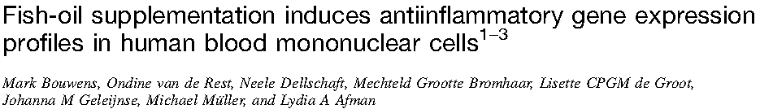
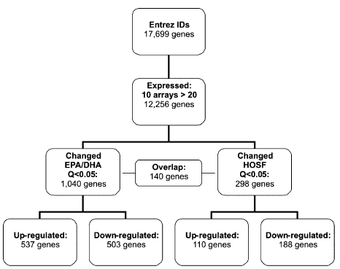
Genes regulated by omega3-FAs

Slide 30
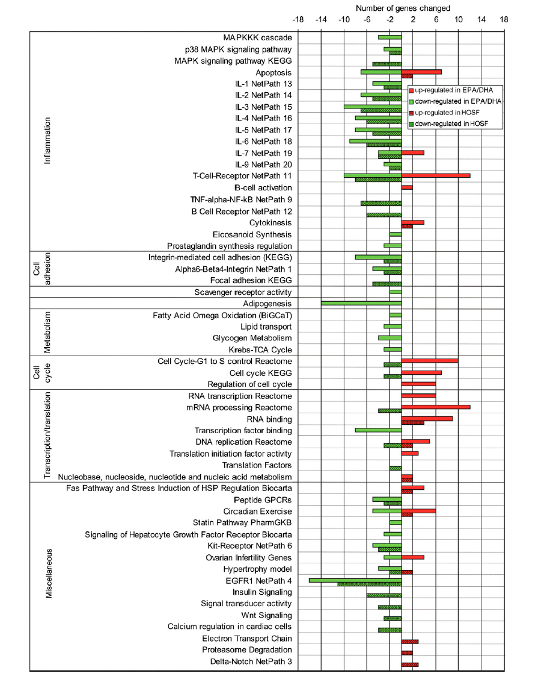

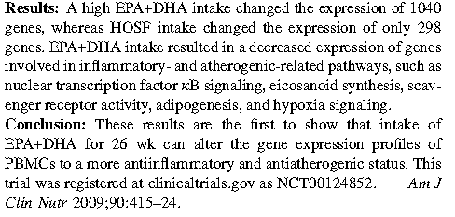
Genes regulated by omega3-FAs

Slide 31
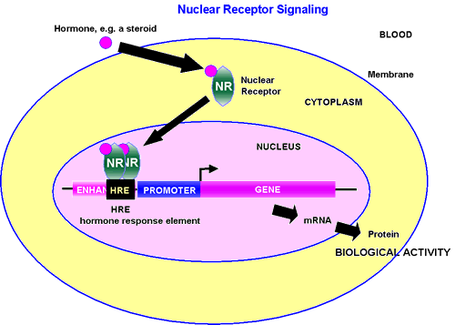
How omega3-FAs affect the transcription of
so many genes ?
Members of the Nuclear Receptors (NR) superfamily appear to be the predominant upstream regulators.
NRs act as intracellular transcription factors that directly regulate gene expression in response to lipophilic molecules. They affect a wide variety of cellular events, including fatty acid metabolism, inflammatory responses, cancer reproductive development, and detoxification of foreign substances.

Slide 32
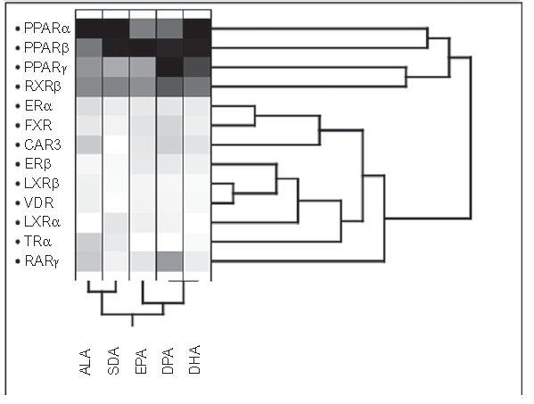
Nuclear receptors responsive to omega3-FAs
The fatty acid receptors PPAR, LXR, RXR, and FXR described above may be considered constituents of a large group of NRs, the ‘‘metabolic NRs,’’ which act as overall sensors of metabolic intermediates, xenobiotics, and compounds in the diet and allow cells to respond to environmental changes by inducing the appropriate metabolic genes and pathways.

Slide 33
The superfamily of
Peroxisome Proliferator Activated Receptors (PPARs)
Isoform | Ligands | Biological function
PPARa | Dietary FAs FAs generated via de novo lipogenesis Products of AA metabolism (prostaglandin, leukotrienes) | FA transport, FA oxidation, FA desaturation, Ketogenesis, Gluconeogenesis, Cholesterol catabolism, Lipoprotein metabolism
PPARgamma | PUFAs Eicosanoids Oxidized LDL products LPA, oxPL | FA accumulation. Increased differentiation of immature adipocytes into mature fat-storing cells. Inhibition of the production of several cytokines → anti-inflammatory response.
PPARb/d | omega-3 FA Prostaglandins | Development, myelination of the corpus callosum, lipid metabolism, and epidermal cell proliferation
Notes:
Oxidized LDL products

Slide 34
The superfamily of
Retinoid X Receptors (RXRs)
Isoforms | Ligands | Biological function
RXRα, RXRβ, RXRγ | 9-cis retinoic acid MUFA PUFA (AA, DHA) | Reduction of atherosclerosis in animal models Increase the expression of ABCA1 → increase reverse transport of cholesterol. RXR-selective agonists counteract diabetes by decreasing hyperglycemia, hypertriglyceridemia, and hyperinsulinemia. Null mutation of the RXRa gene resulted in developmental lethality in mice

Slide 35
The superfamily of
Liver X Receptors (LXRs)
Isoforms | Ligands | Biological function
LXRα, LXRβ | Oxysterols and other derivatives of cholesterol metabolism PUFA competitively blocked activation of LXR by oxysterols | Regulators of cholesterol, fatty acid, glucose homeostasis and play an essential role at the interface between metabolism and inflammation Increases expression of the enzymes involved in de novo lipogenesis Lowers cholesterol accumulation in the liver Endogenous inhibitor of atherosclerosis

Slide 36
The superfamily of
Farnesoid X Receptors (LXRs)
Isoforms | Ligands | Biological function
LXRα, LXRβ | Bile acids Endogenous isoprenoids, including farnesol. all-trans-retinoic acid PUFA | Antiatherogenic effect in animal models. Attenuates induction of the genes encoding IL1b, IL6, and TNFa in response to LPS. The receptor reduces cholesterol uptake on macrophages by regulation of CD36 and ABCA1 expression. increase cholesterol efflux from macrophage-derived foam cells.

Slide 37
Phenotypic changes induced by omega-3 FAs through
modulation of gene transcription
Lipid and cholesterol metabolism (1)
Decreased Lipogenesis
Sterol regulatory element-binding protein 1c (SREBP-1c)
fatty acid synthase (FASN)
malic enzyme (ME)
glucose-6-phosphate dehydrogenase (G6PD)
Stimulation of fatty acid oxidation and mitochondrial biogenesis
PPARgamma, coactivator-1-alpha (Ppargc1a]
Nuclear respiratory factor-1 (Nrf1)
apolipoproteins A-I and A-II (Apoa1, Apoa2),
acyl-coenzyme A (CoA) synthetase long-chain family member 1 (Acsl1),
acyl-CoA oxidase (ACO, now known as Acox),
liver fatty acid-binding protein (Fabp1)
carnitine palmitoyltransferase 1 (Cpt1)
cytochrome P450, family 4, subfamily a, polypeptide 1 (Cyp4a1)

Slide 38
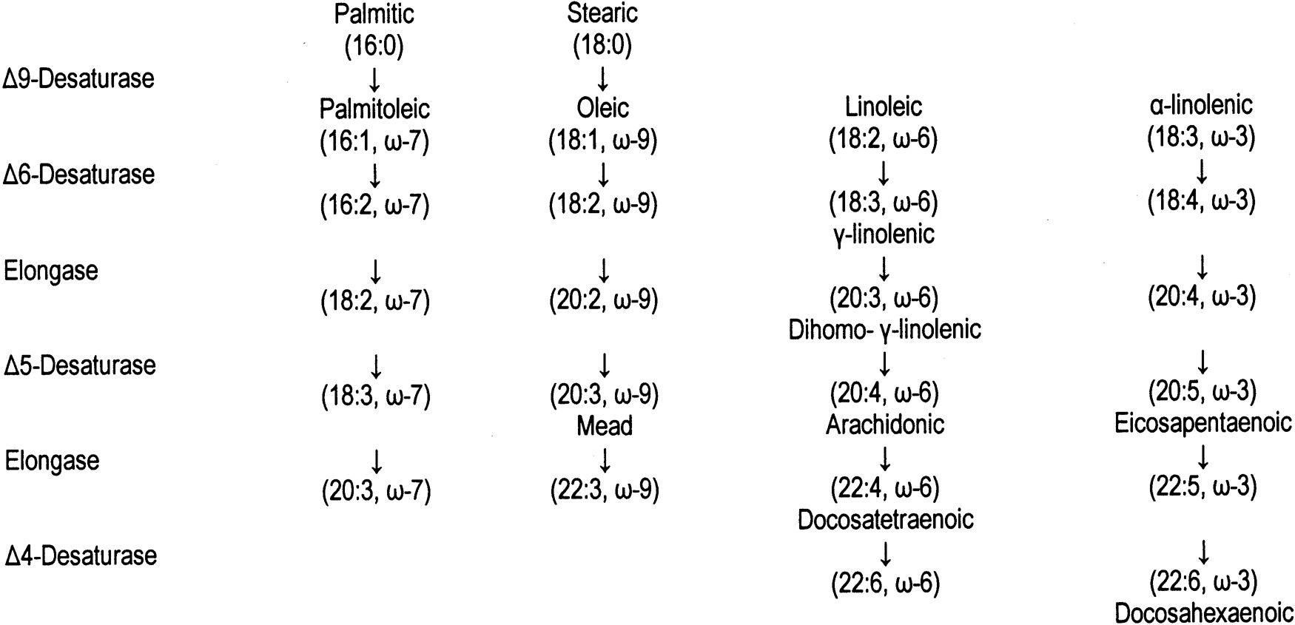
Phenotypic changes induced by omega-3 FAs through
modulation of gene transcription
Lipid and cholesterol metabolism (2)
Lowering of circulating triglyceride levels
Stearoyl-CoA desaturase 1 (SCD1)
Delta-6 desaturase (D6D)
Delta-5 desaturase (D5D)
Fatty acid elongase 6 (ELOVL6)

Slide 39
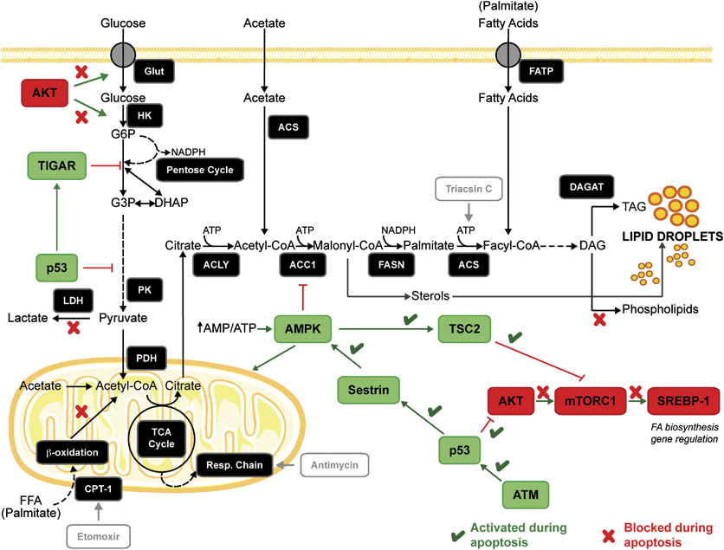
Phenotypic changes induced by omega-3 FAs through
modulation of gene transcription
Lipid and cholesterol metabolism (3)

Slide 40
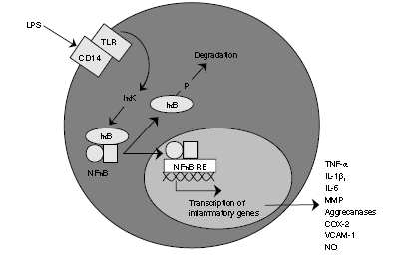
Phenotypic changes induced by omega-3 FAs through
modulation of gene transcription
Inflammation (1)
NF-kB activity
Anti-inflammatory mediators such as resolvins and protectins.
Production of inflammatory cytokines (IL1, IL6, CRP, ICAM-1, VCAM-1, TNFa)
Genes involved in cellular defence to oxidative stress (heme oxygenase 1 (HMOX1), superoxide dismutase, glutathione transferases)

Slide 41
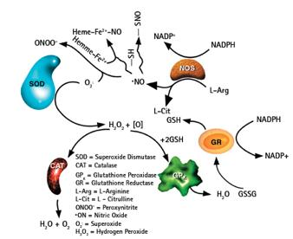
Phenotypic changes induced by omega-3 FAs through
modulation of gene transcription
Inflammation (2)

Slide 42
Phenotypic changes induced by omega-3 FAs through
modulation of gene transcription
Cancer
Regulation of apoptosis
arachidonate 15-lipoxygenase [ALOX15]
Adenosine A1 receptor [ADORA1]
Fas ligand [FASLG])
Bcl-2 and Bcl-X
12-LOX, 15-LOX-2, 15-LOX-1, and prostaglandin E synthase
Activate defense immunity:
MCF.2 cell line-derived transforming sequence-like [MCF2L]
Bone marrow stromal cell antigen 1 [BST1],
Apolipoprotein B [APOB])
Control of cell growth:
ALOX15, protein tyrosine phosphatase [PTP]
RAB4A, member RAS oncogene family [RAB4A]).
Cyclin-dependent kinase inhibitors (p21, p27, p57, p19)
Growth arrest-specific proteins
Angiogenesis
Vascular endothelial growth factor

Slide 43
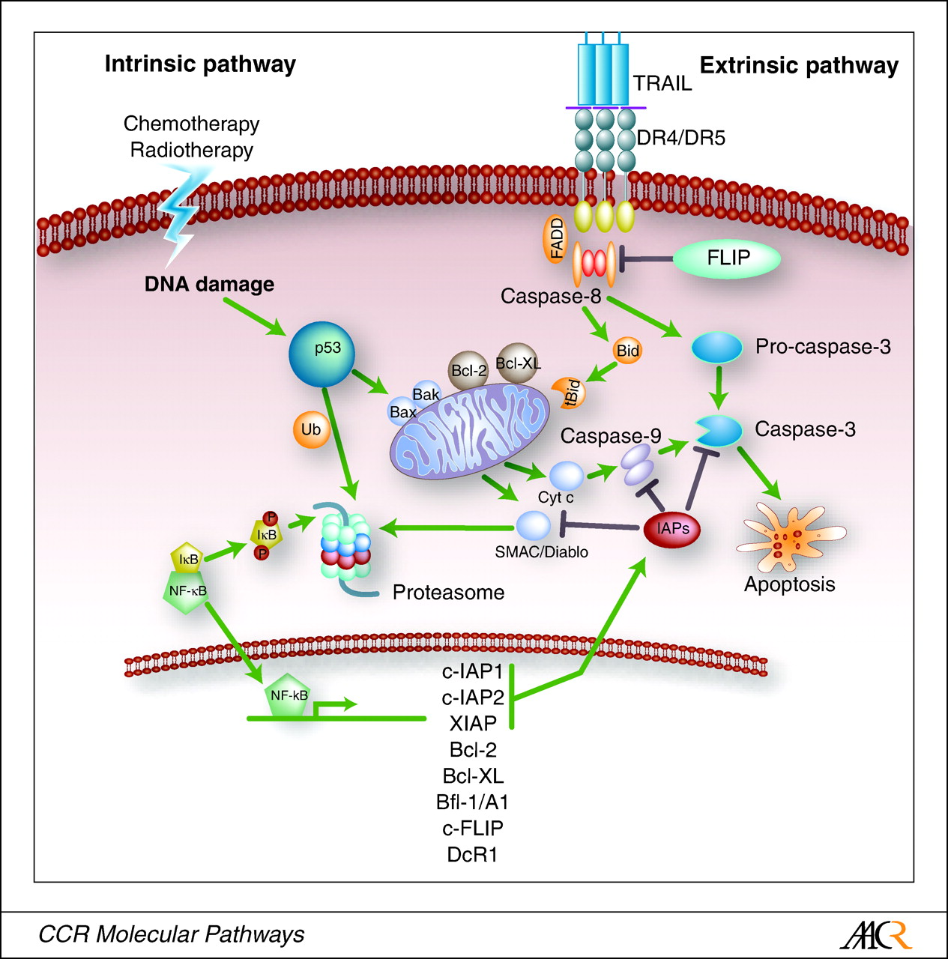
Phenotypic changes induced by omega-3 FAs through
modulation of gene transcription
Apoptosis

Slide 44
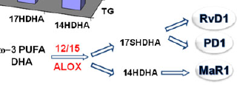
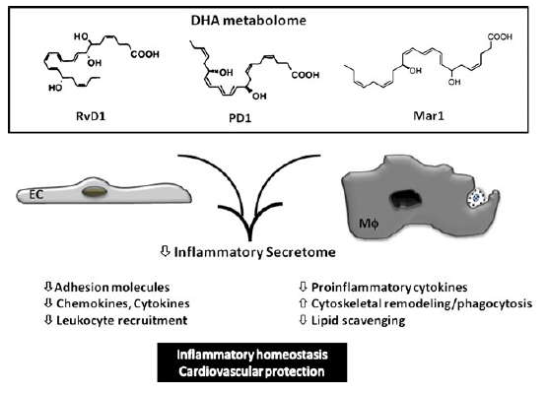
Nutrigenomics of PUFA Bioactive Mediators

Slide 45
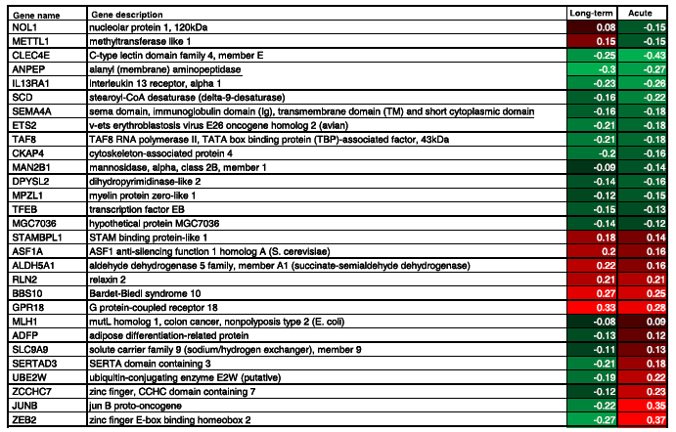
Postprandial intervention studies (1)

Slide 46
Postprandial intervention studies (2)
Depending on the length of the intervention expression of other genes and pathways are affected.
900 genes specifically changed by n _ 3 PUFA in the long-term study and the 291 genes in the postprandial study, 29 genes were changed upon n _ 3 PUFA in both studies.
The expression of the larger part of the genes (19 genes) are changed in the same direction and may reflect the overall effects of fish oil consumption. The expression of the remaining 10 genes is changed in the opposite direction.
Acute postprandial studies lead to short term direct effects of fatty acids on transcription whereas long-term intervention with daily consumption will lead to more systemic effects that still can be monitored in PBMCs.

Slide 47
Nutrigenetics
Predicting individual response to nutrients ➔ personalized nutrition
Phenotypic variability is based on interindividual genetic variation
Qualitative: affect the regulatory region of a gene (i.e.,the
promoter region) or the coding/noncoding sequences
Quantitative: affect the level of expression.
Individual genotypic variations can alter:
nutrient metabolism
the biological effects of nutrients

Slide 48
Nutrigenetics of omega-3 FAs
Genetic polymorphisms affecting omega-3 metabolism
Genetic polymorphisms affecting the biological actions of omega-3 FAs

Slide 49
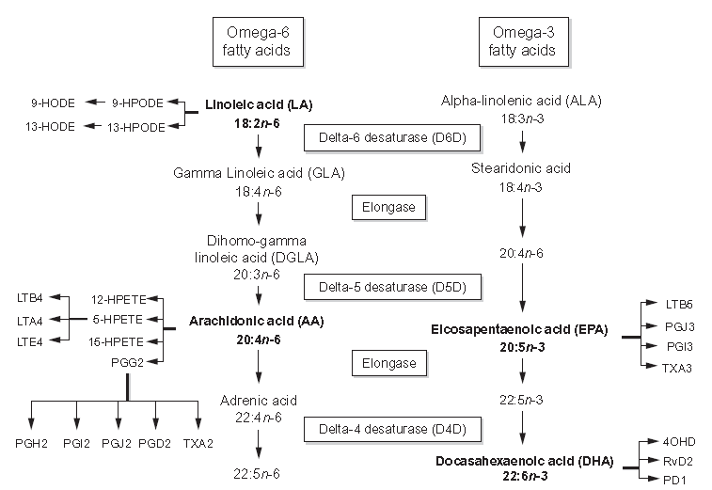
Genetic polymorphisms affecting
omega-3 metabolism and levels (1)
genetic variation explains 40% or more of the interindividual variability in SFA,MUFA,PUFA levels.
5-LOX
5-LOX
COX-2
COX-2

Slide 50
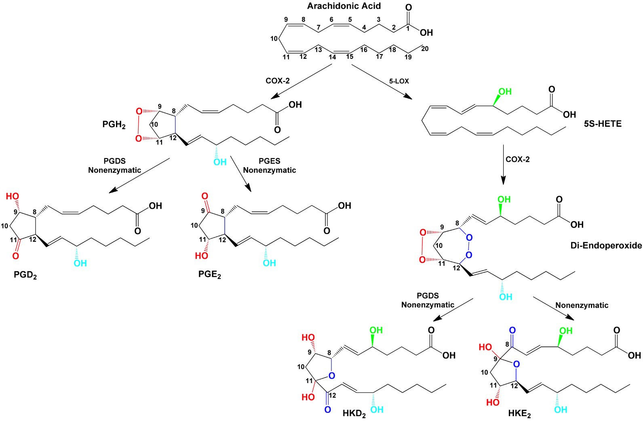
Genetic polymorphisms affecting
omega-3 metabolism and levels (2)

Slide 51
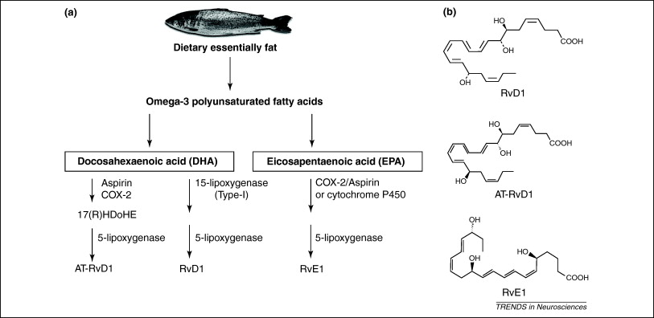
Genetic polymorphisms affecting
omega-3 metabolism and levels (3)

Slide 52
Genetic polymorphisms affecting
omega-3 metabolism and levels (4)
Eighteen SNPs of the FADS1-2 gene cluster have been identified in a German population. Nine of these SNPs were associated with significant decreases in the percentage of EPA in serum.
Dietary AA significantly enhances the apparent atherogenic effect of the ALOX5 genotype, whereas increased dietary intake of o3-PUFAs EPA and DHA blunts this effect.
Genetic variants at the COX2 gene modify prostate inflammation and response to diet. Increasing o3 intake was associated with a decreased risk of aggressive prostate cancer, and this inverse association was even stronger among men with genetic variant rs4648310 (þ8897 A/G). Individuals with the lowest intake of o3-PUFAs and the genetic variant had the most aggressive tumor, whereas the o3-PUFAs were protective

Slide 53
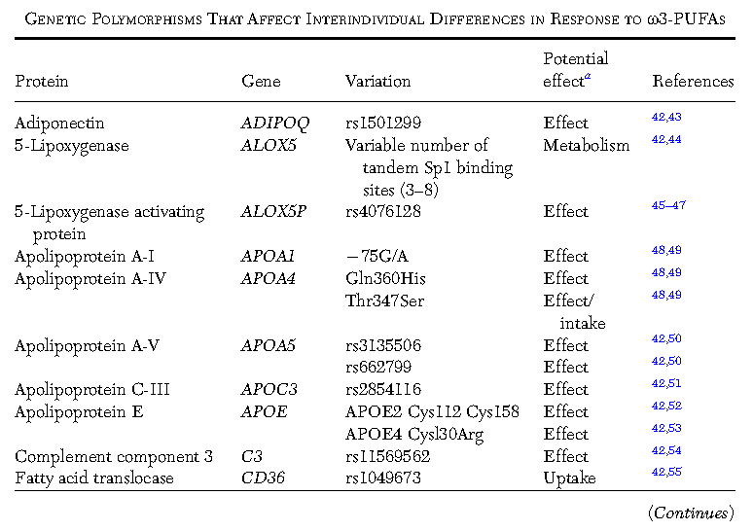
Genetic polymorphisms affecting the
biological actions of omega-3 FAs (1)

Slide 54
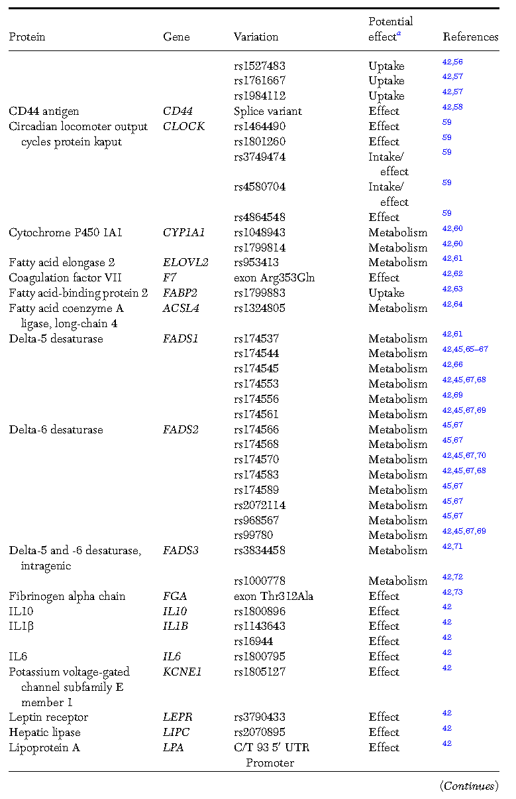
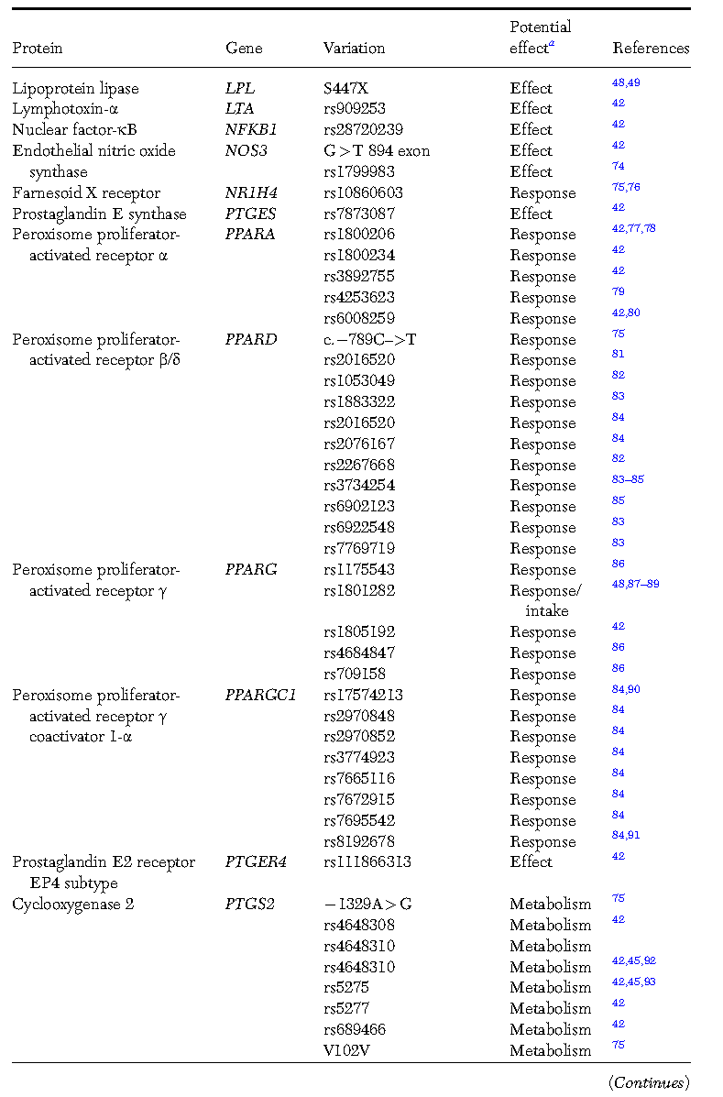
Genetic polymorphisms affecting the
biological actions of omega-3 FAs (2)

Slide 55
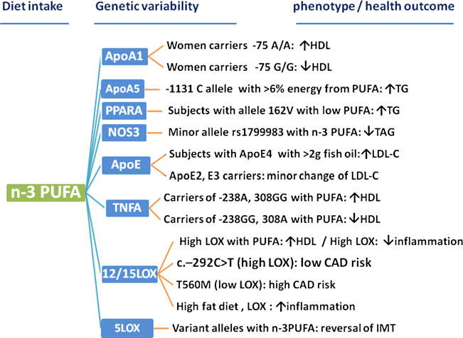
Genetic polymorphisms affecting the
biological actions of omega-3 FAs (3)

Slide 56
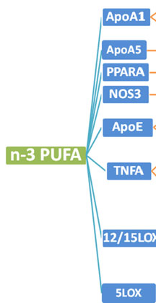
Genetic polymorphisms affecting the
biological actions of omega-3 FAs (4)
The most frequently studied polymorphism of the PPARa gene was the Leu162Val variant, in which the minor allele was associated with lipid metabolism and atherosclerosis. The 162 V allele was associated with higher TG and apoC-III levels only in subjects consuming a low-PUFA diet. Conversely, high consumption of PUFA diet in 162 V subjects was related with the opposite effect on apoC-III.
The Ala12 isoform of PPARgamma is associated with a reduced ability to induce transcription and adipogenesis. In the Kuopio, Aarhus, Naples, Wollongong, Uppsala (KANWU) Study, carriers of the Ala12 allele had significantly greater reductions in serum TAG levels in response to o3-PUFA supplementation → PPARgamma Pro12Ala genotype may contribute to the interindividual variability in the serum TAG response to EPAώDHA intervention.

Slide 57
Genetic polymorphisms affecting the
biological actions of omega-3 FAs (5)
Tumor necrosis factor-alpha (TNF-alpha) is a proinflammatory cytokine that can have an impact on lipid metabolism by modulating the expression of lipoprotein lipase (LPL); proliferator activated receptors (PPARs); apolipoprotein (apo) A-I, apo A-IV, and apo E; and lecithin:cholesterol acyltransferase.
The positive association between total PUFA and HDL cholesterol was evident only in noncarriers of the minor ‘‘A’’ allele for the TNF _238G>A and _308G>A loci. The effect was evident for both o3- and o6-PUFAs, but a significant genotype_diet effect was evident only for o6-PUFAs. The same authors also reported significant PUFA_genotype_HDL interactions in a type 2 diabetic population.

Slide 58
Genetic polymorphisms affecting the
biological actions of omega-3 FAs (6)
Nitric oxide synthase (NOS3) is responsible for the production of nitric oxide (NO), which is involved in the regulation of vascular function and blood pressure.
SNPs in the NOS3 gene were found to be associated with a number of CVD risk markers, including dyslipidemia and inflammation.
Following omega-3PUFA supplementation, subjects with the minor alleles rs1799983 had a better response to changes in plasma omega-3 PUFA than major allele homozygous carriers. This highlights the potential benefit for individual carriers of the minor allele at rs1799983 in NOS3 in omega-3 PUFA supplementation to achieve reduction of plasma TG concentrations.

Slide 59
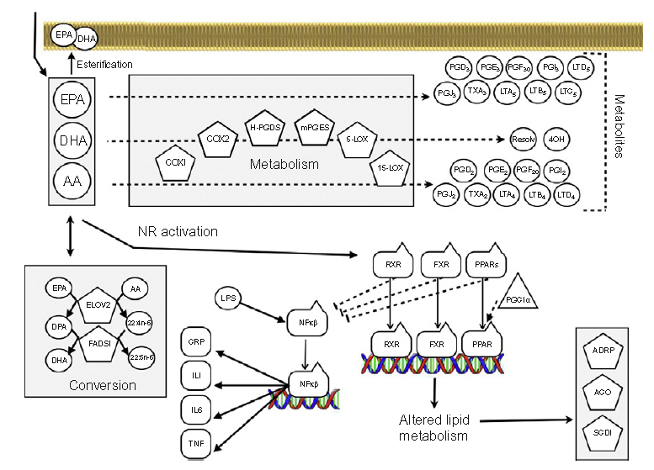
Conclusion (1)
Anti-inflammatory
Pro-inflammatory

Slide 60
Conclusion (2)
Relatively small changes in gene expression induced by nutrients as compared to drugs with large inter-individual variations. Nutrients will induce a much milder activation of specific receptors and consequently of specific pathways.
Instead nutrients will lead to a more balanced cellular response by activation of multiple control systems with the main purpose to metabolize the nutrient and to regulate metabolism to rapidly reach homeostatic balance.
FAs induce effect sizes ranging from a few percent till 100% with individual outliers to 300% or 400% often for immune-related genes → low fold changes and low proportion of genes significantly changed

Slide 61
Conclusion (3)
Nutritional habits may also be a reason why persons will or will not respond to a change in a diet. Nutrigenomics can be used to asses this. For instance, people that regularly consume fish rich in n _ 3 PUFA will likely exhibit a less pronounced transcriptional response upon a fish oil challenge than subjects that do not eat fish at all. This also maybe the scientific basis for the nutritional advice to enjoy a healthy diet consisting of a varied food pattern as this will keep the homeostatic balance of our organs most flexible.
The knowledge from gene-environment (diet) interactions will enable more effective and specific interventions for disease prevention based on “personalized” nutrition.

Slide 62
Recommended bibliography
J. P. Vanden Heuvel, Nutrigenomics and nutrigenetics of omega3 polyunsaturated fatty acids, Prog. Mol. Biol. Transl. Sci, 108 (2012) 75-112.
A. J. Merched and L. Chan, Nutrigenetics and nutrigenomics of atherosclerosis, Curr Atheroscler. Rep., 15 (2013) 328.
A. M. Lottenberg, M. S. Afonso, M. S. Lavrador, R. M. Machado, and E. R. Nakandakare, The role of dietary fatty acids in the pathology of metabolic syndrome, J Nutr Biochem., 23 (2012) 1027-1040.
L. A. Afman and M. Muller, Human nutrigenomics of gene regulation by dietary fatty acids, Prog. Lipid Res., 51 (2012) 63-70.

Slide 63

Τhank you for your attention
Joan Miro, Blue II
Notes:
Ευχαριστώ για την προσοχή σας

