Slide 1
Irritable Bowel Syndrome– Genetic & Molecular Background
M Gazouli, Associate Professor
Medical School, NKUA

Slide 2
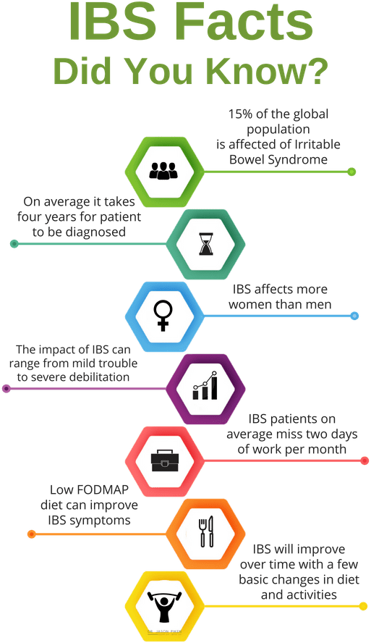
Irritable Bowel Syndrome(IBS)
IBS is the most prevalent functional gastrointestinal disorder and phenotypically characterized by chronic abdominal discomfort, pain and altered defecation patterns.
Unknown etiology, related to stress and female to male ratio = 3/1

Slide 3
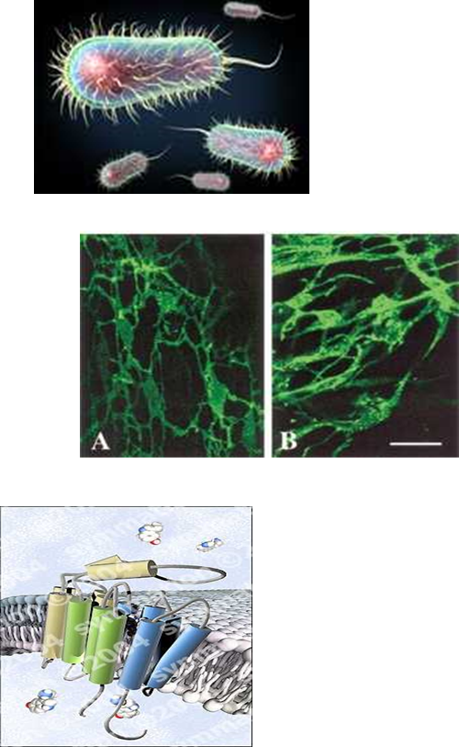
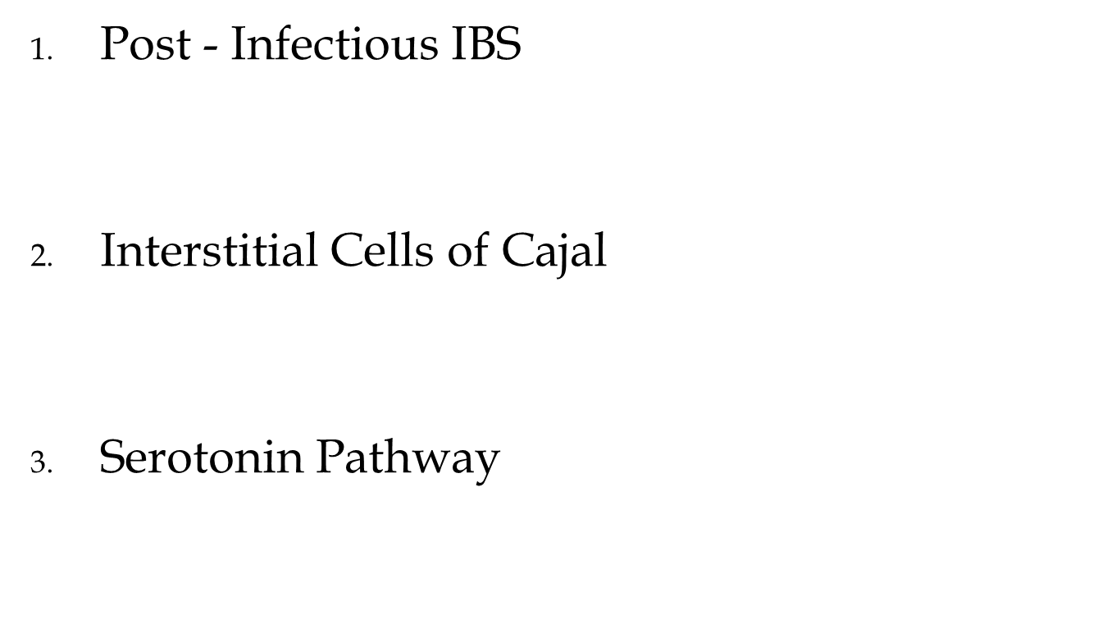

Slide 4
Key points
Genetic studies in IBS range from family and twin studies to candidate gene approaches and genome-wide association studies
Despite enlarged sample sizes, increased statistical power and meta-analyses, positive associations between gene variations and IBS subtypes are still scarce and many have not been reproduced
Epigenetic and pharmacogenetic approaches are in their infancy
A major pitfall in IBS research is the lack of large homogenized case–control cohorts recruited according to standardized and harmonized criteria

Slide 5
Hereditary
one-third of patients had a relative with IBS, even in patients without a concurrent psychiatric diagnosis
the existence of a first-degree relative with IBS can be predictive of IBS and that an increased risk of IBS is evident among first-degree (OR 1.75), second-degree (OR 1.82) and third-degree relatives (OR 1.11), in the absence of an interaction of gender or age at the onset of symptoms
family history of IBS is a potential predictor of individual IBS risk, with a twofold to threefold risk increase for relatives of patients with IBS
Twin studies also support the notion that IBS might be a multifactorial disorder with genetic as well as environmental contributors. To date, at least five twin studies estimated the genetic heritability in IBS as ~22–57%

Slide 6
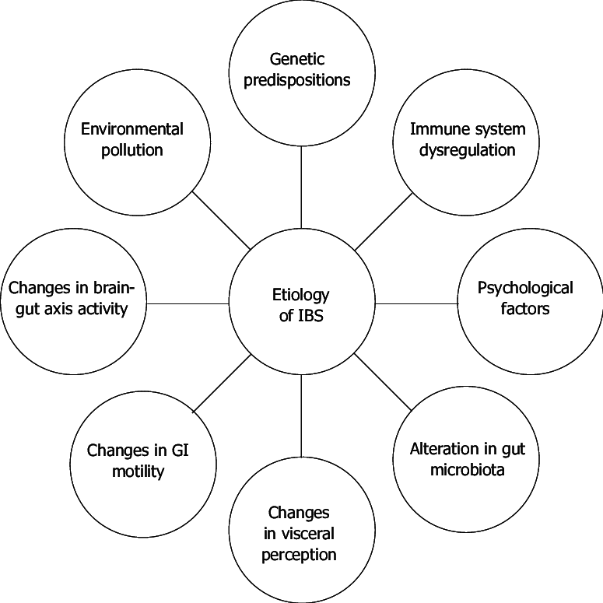
Etiopathogenesis

Slide 7
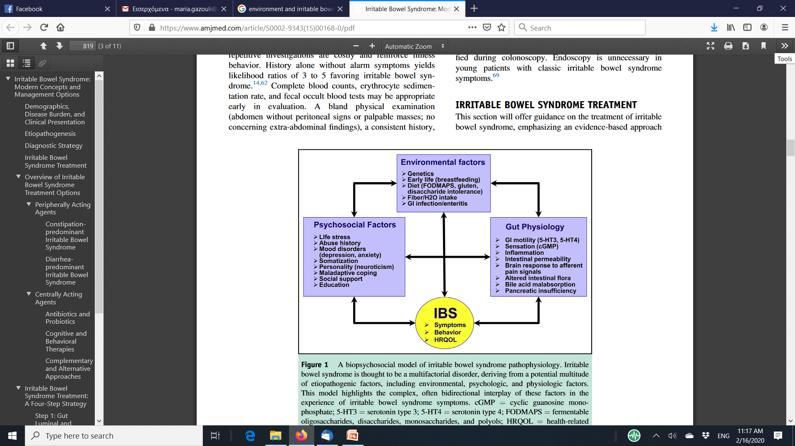

Slide 8
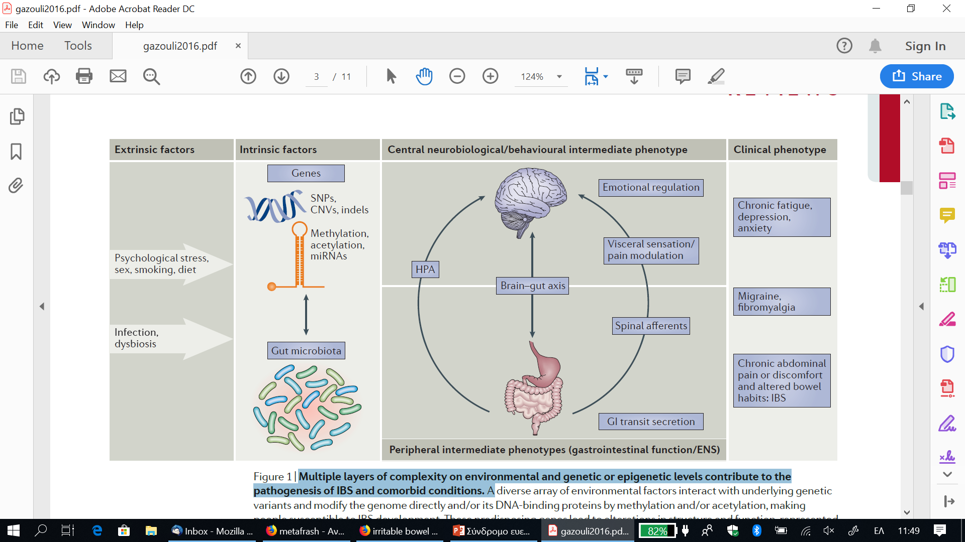
Multiple layers of complexity on environmental and genetic or epigenetic levels contribute to the pathogenesis of IBS and comorbid conditions
Nat Rev Gastroenterol Hepatol. 2016;13(2):77-87

Slide 9
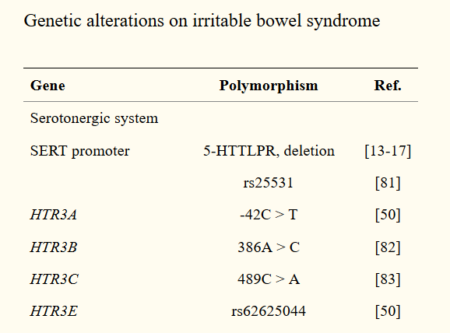
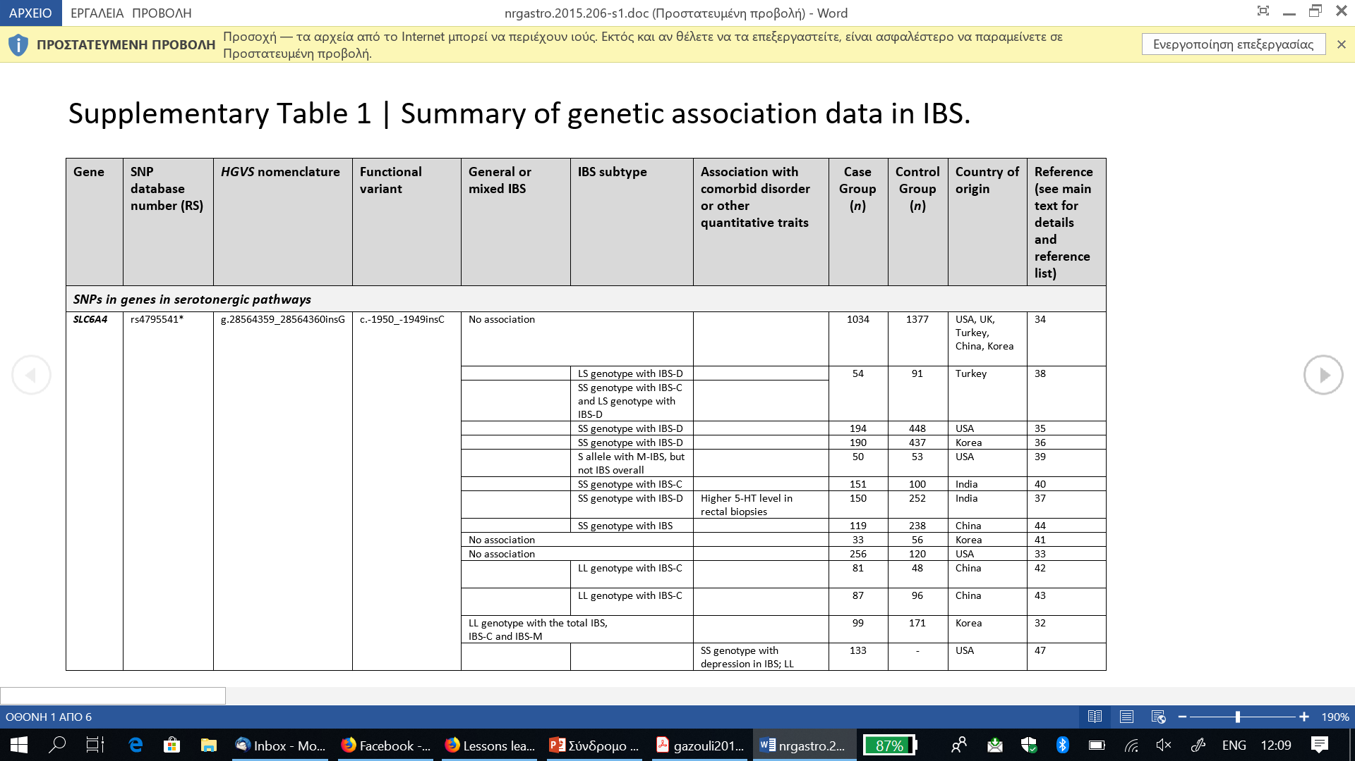
Genetic polymorphisms on serotonergic system
Is it “irritable brain” or “irritable bowel”?
World J Gastroenterol. 2014; 20(2): 376–383

Slide 10
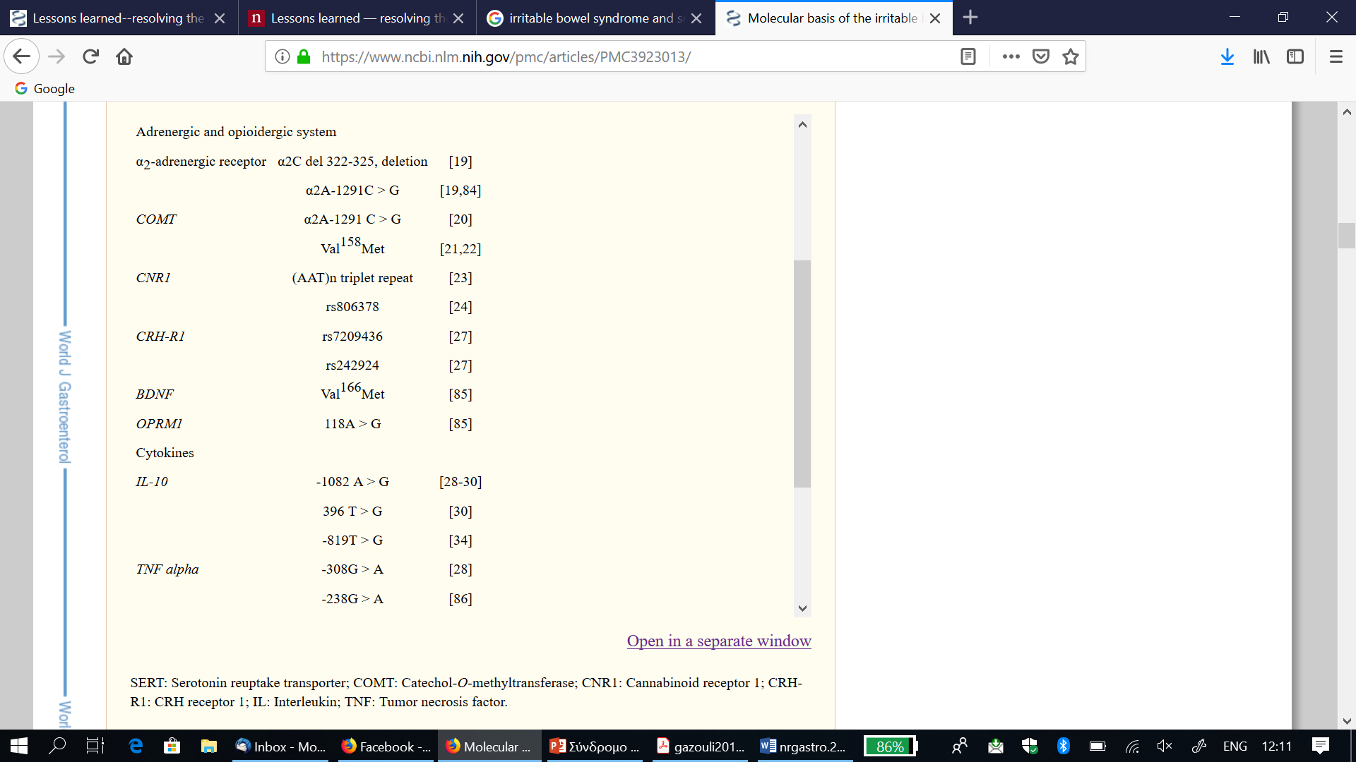
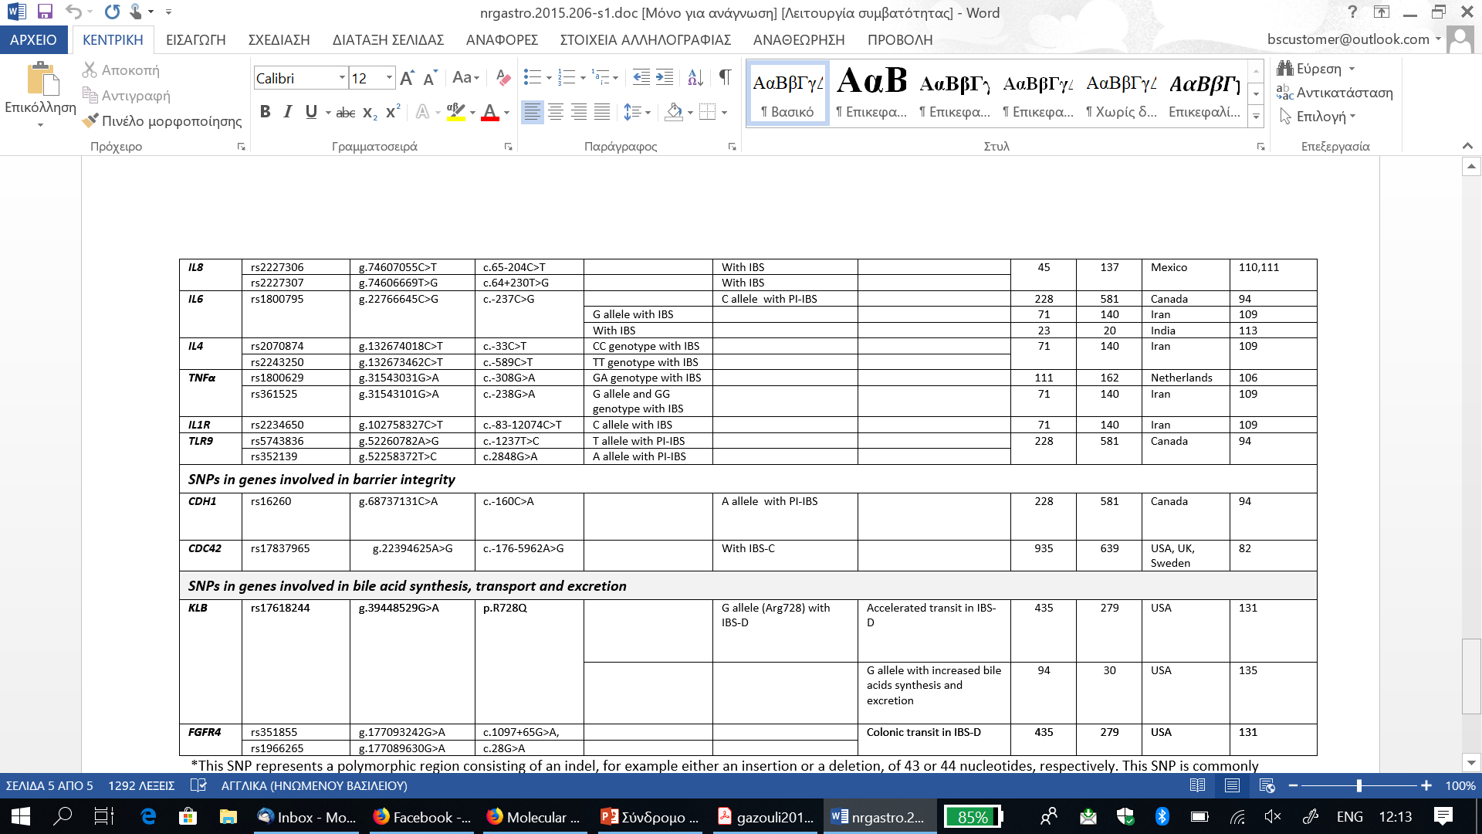
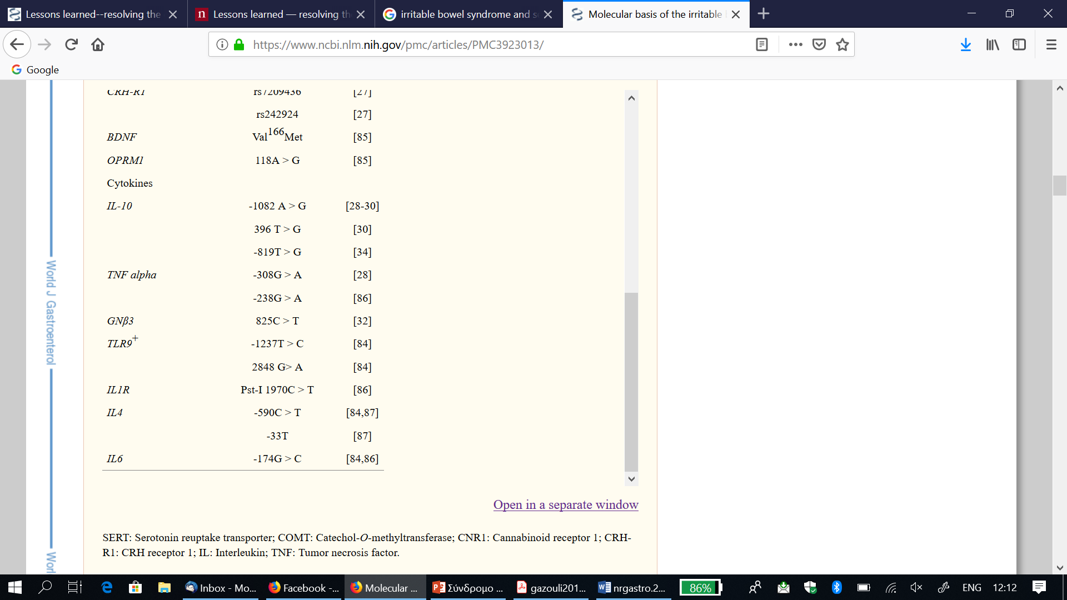

Slide 11
GWAS
The pathophysiology of irritable bowel syndrome (IBS) is complex and is still poorly understood. It is known that there is a hereditary component, but gene-hunting efforts have not yet identified the clear genetic locus of risk for IBS.
Seven genomic regions that host 64 candidate genes have been identified. Functional analysis of these genes has shown that regulation of ion channel activity is the most likely pathway affecting IBS risk.

Slide 12
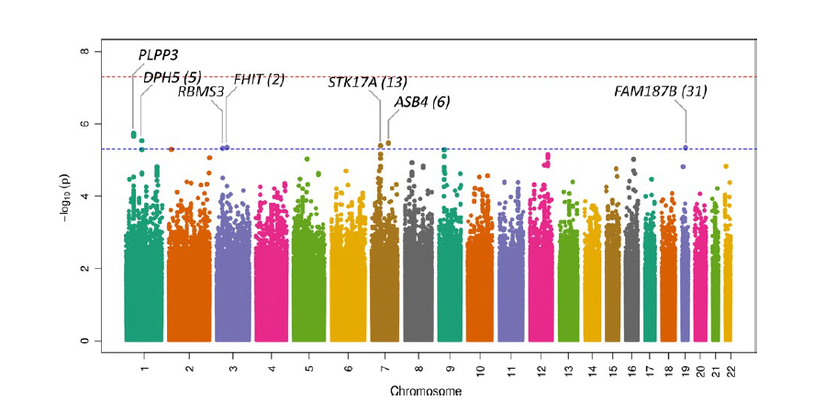

Slide 13
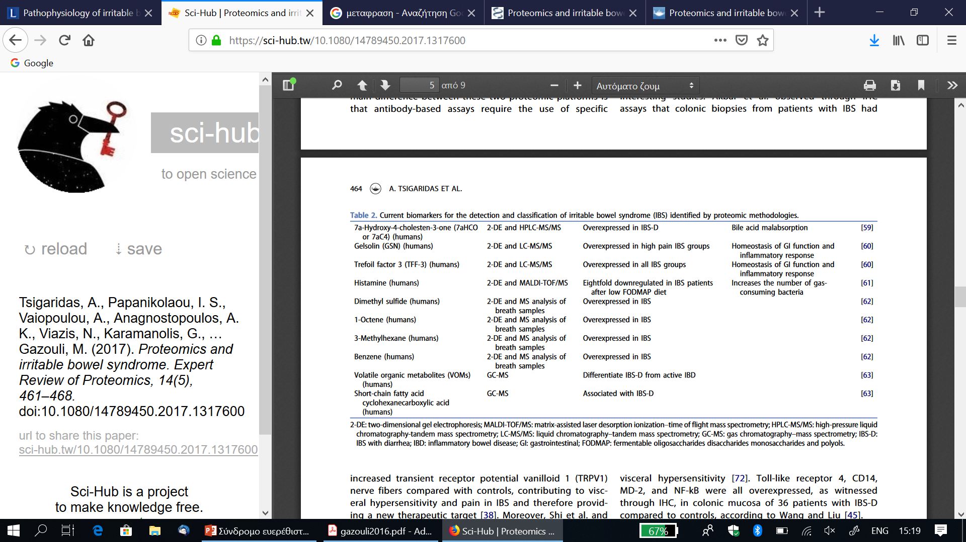
Proteomics

Slide 14
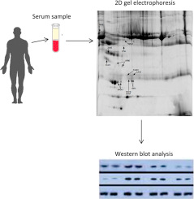
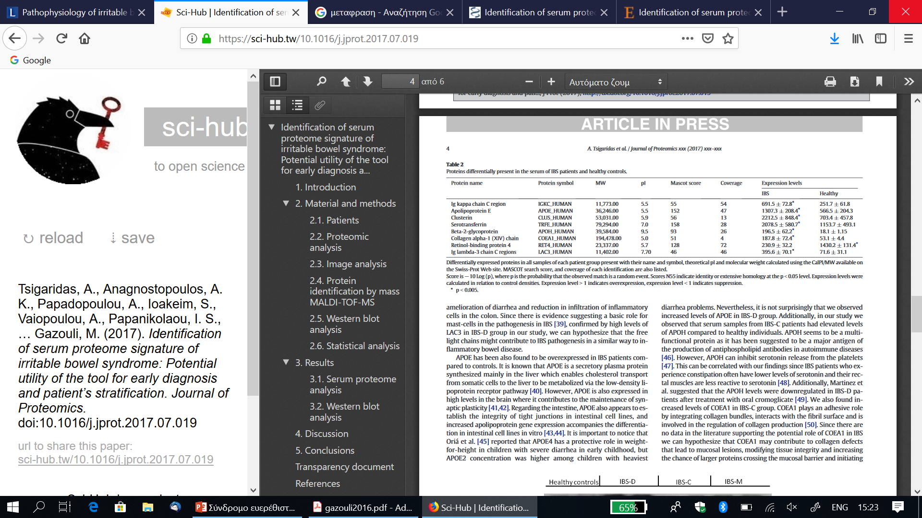
J Proteomics. 2018;188:167-172

Slide 15
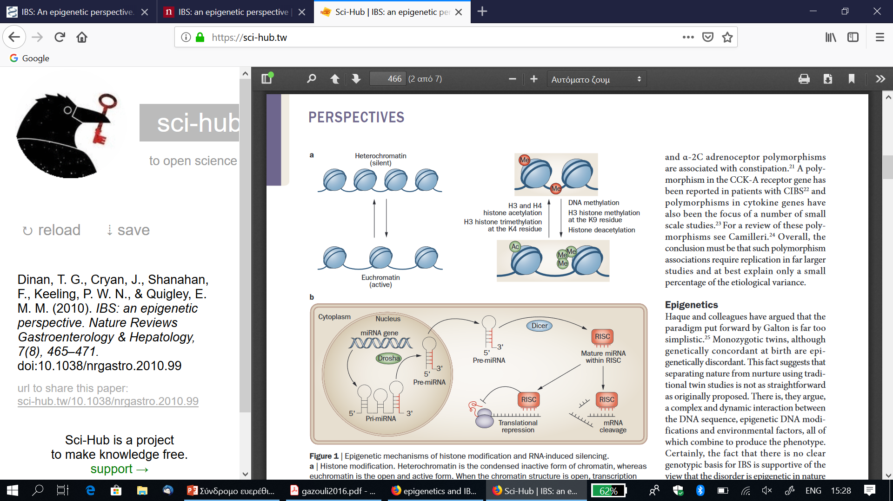
Epigenetic analysis
Nat Rev Gastroenterol Hepatol. 2010;7(8):465-71.

Slide 16
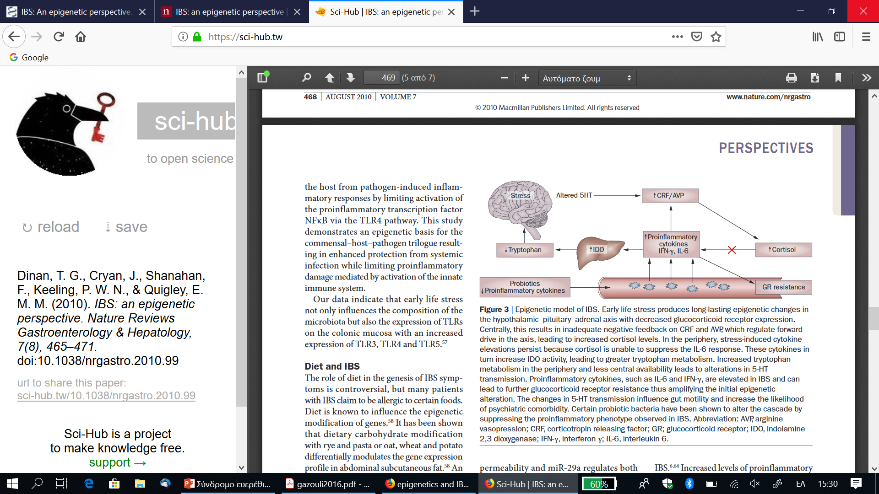
Epigenetic model of IBS

Slide 17
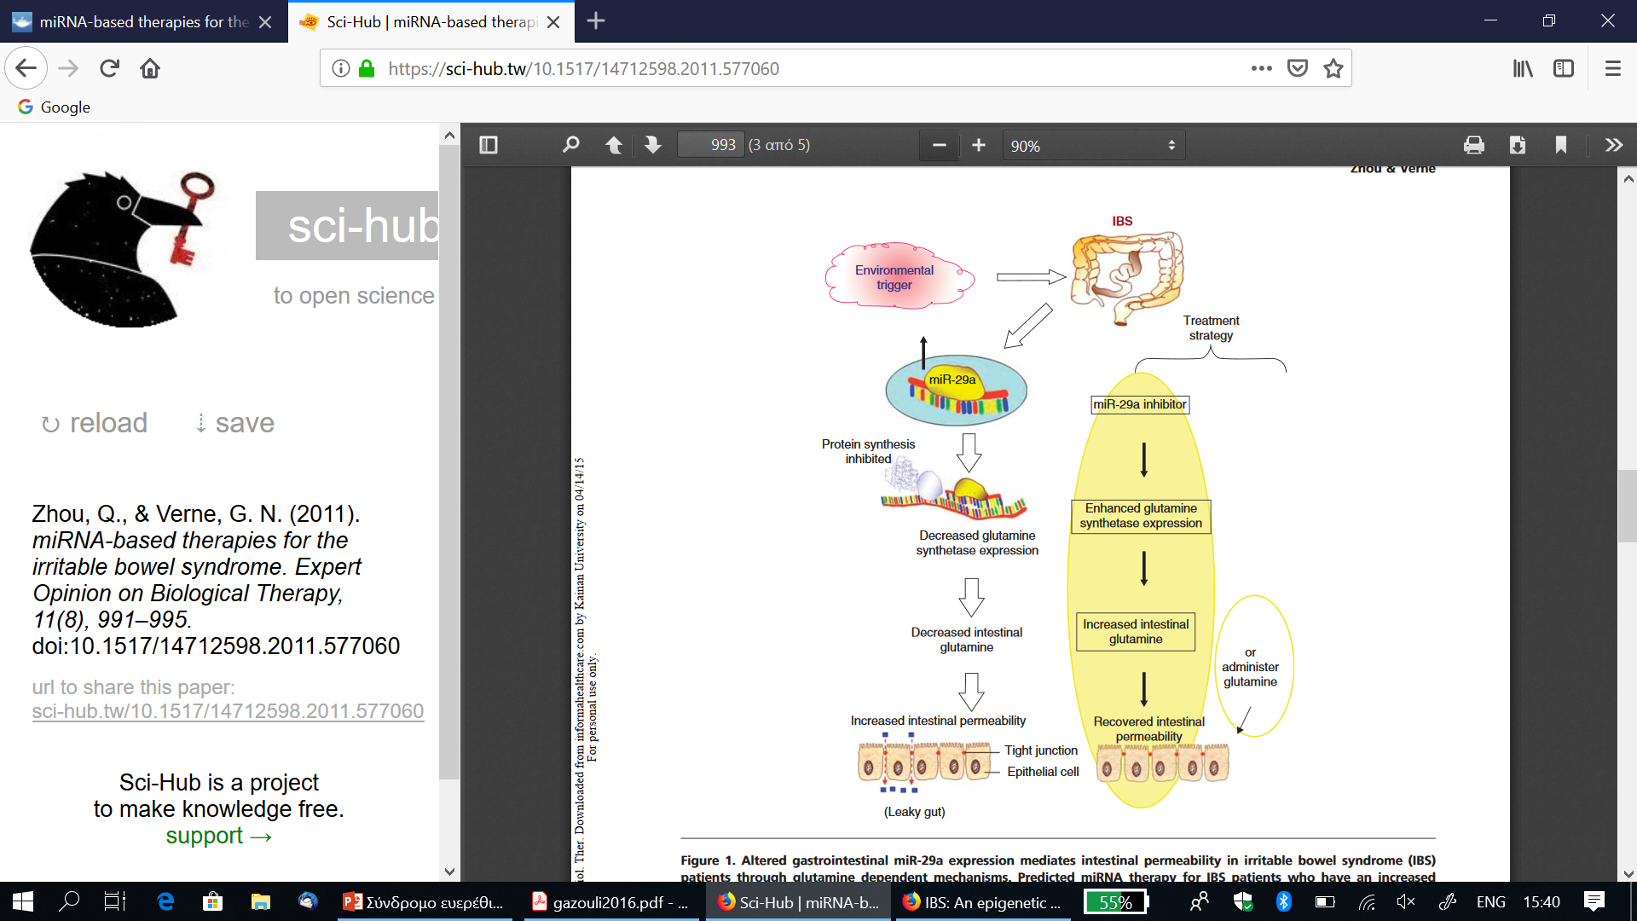
miRNAs
Expert Opin. Biol. Ther. (2011)11(8):991-995

Slide 18
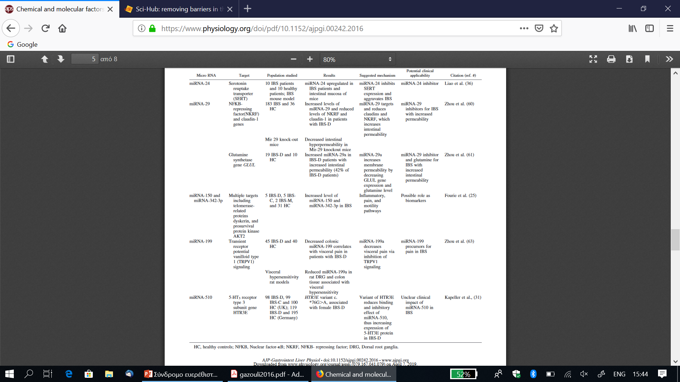

Slide 19
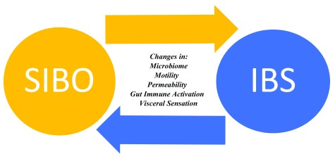
Microbiome
F1000Res. 2018; 7: F1000 Faculty Rev-1029

Slide 20
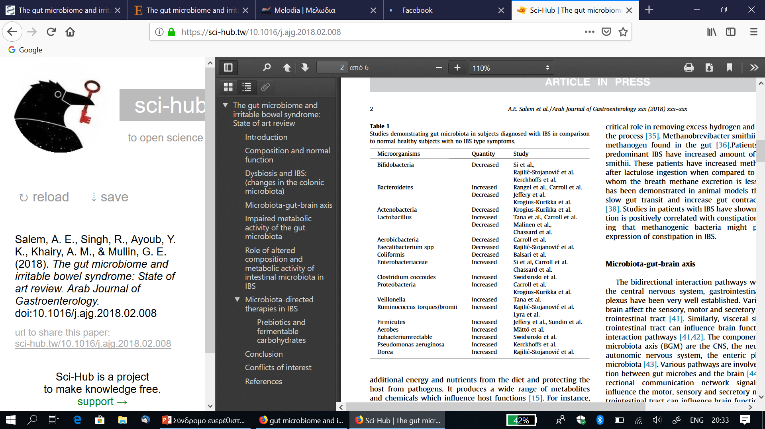

Slide 21
Do Bacteria Play a Role in IBS?
This evidence from observations or studies can be summarized as follows:
Antibiotic use, well known to disturb the flora, may predispose individuals to IBS
Some people may develop IBS suddenly following an episode of stomach or intestinal infection (gastroenteritis) caused by bacteria (a condition called post-infectious IBS or PI-IBS)
A very low level of inflammation may be present in the bowel wall of some IBS patients, which could have resulted from an abnormal interaction with bacteria in the gut
Small intestinal bacterial overgrowth (SIBO) may be associated with IBS
Altering the bacteria in the gut, by antibiotics or probiotics, may improve symptoms in IBS
In PI-IBS some people who were previously well develop IBS-type symptoms following an episode of gastroenteritis, while most others recover completely. PI-IBS represents a clear link between exposure to a bacterial infection (such as from contaminated food or water) and IBS in those who seem especially at risk.

Slide 22
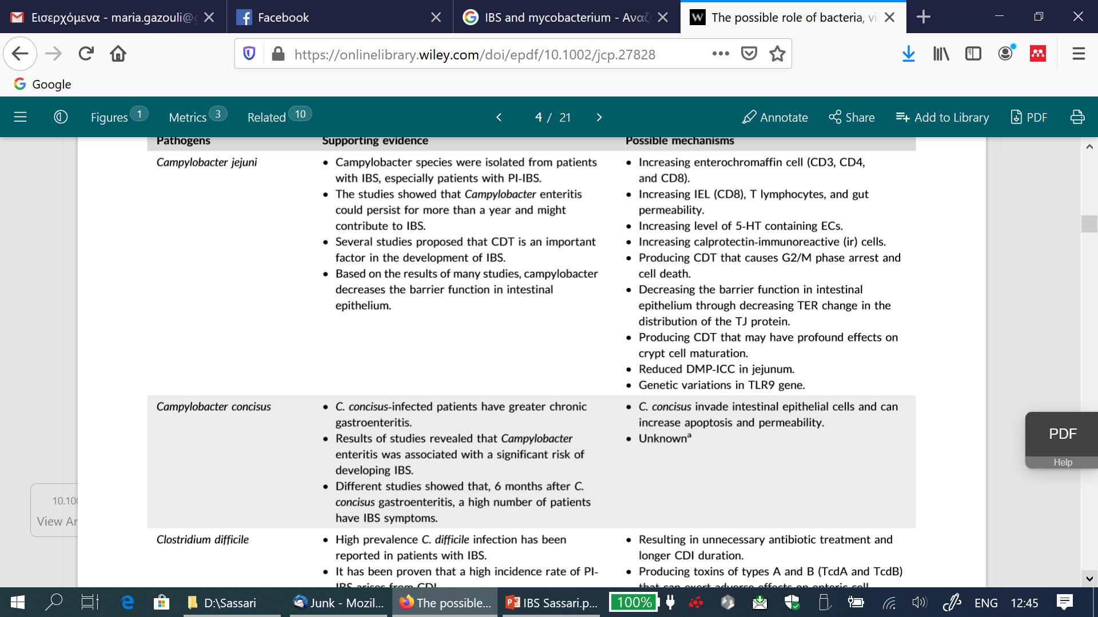

Slide 23
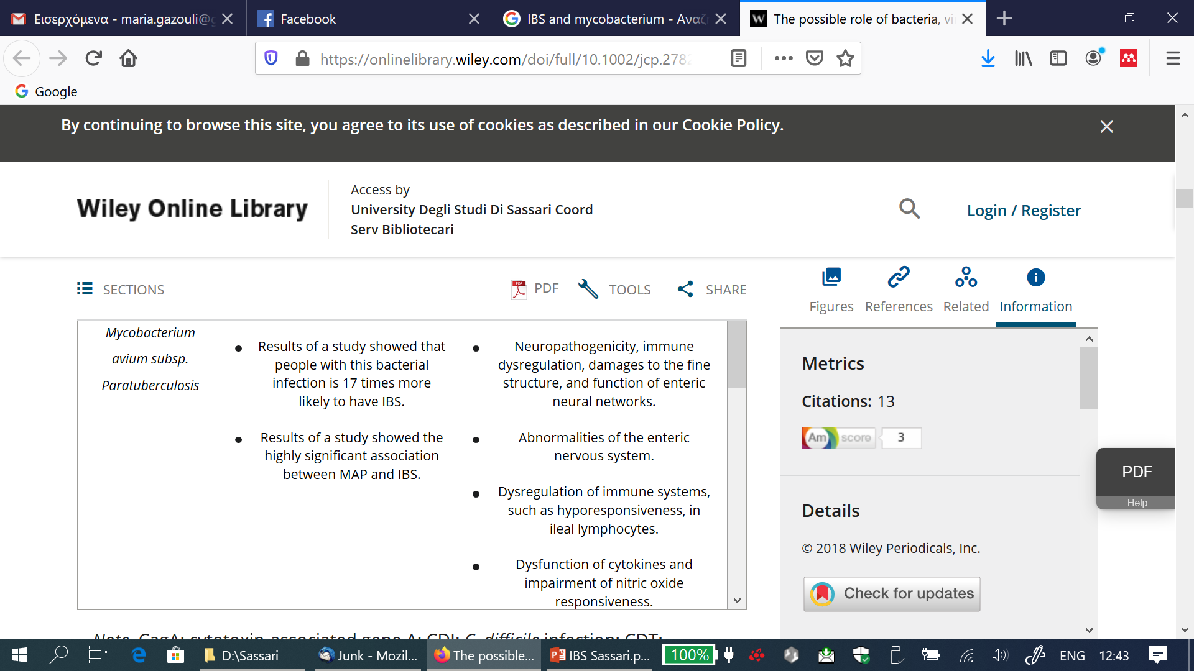

Slide 24
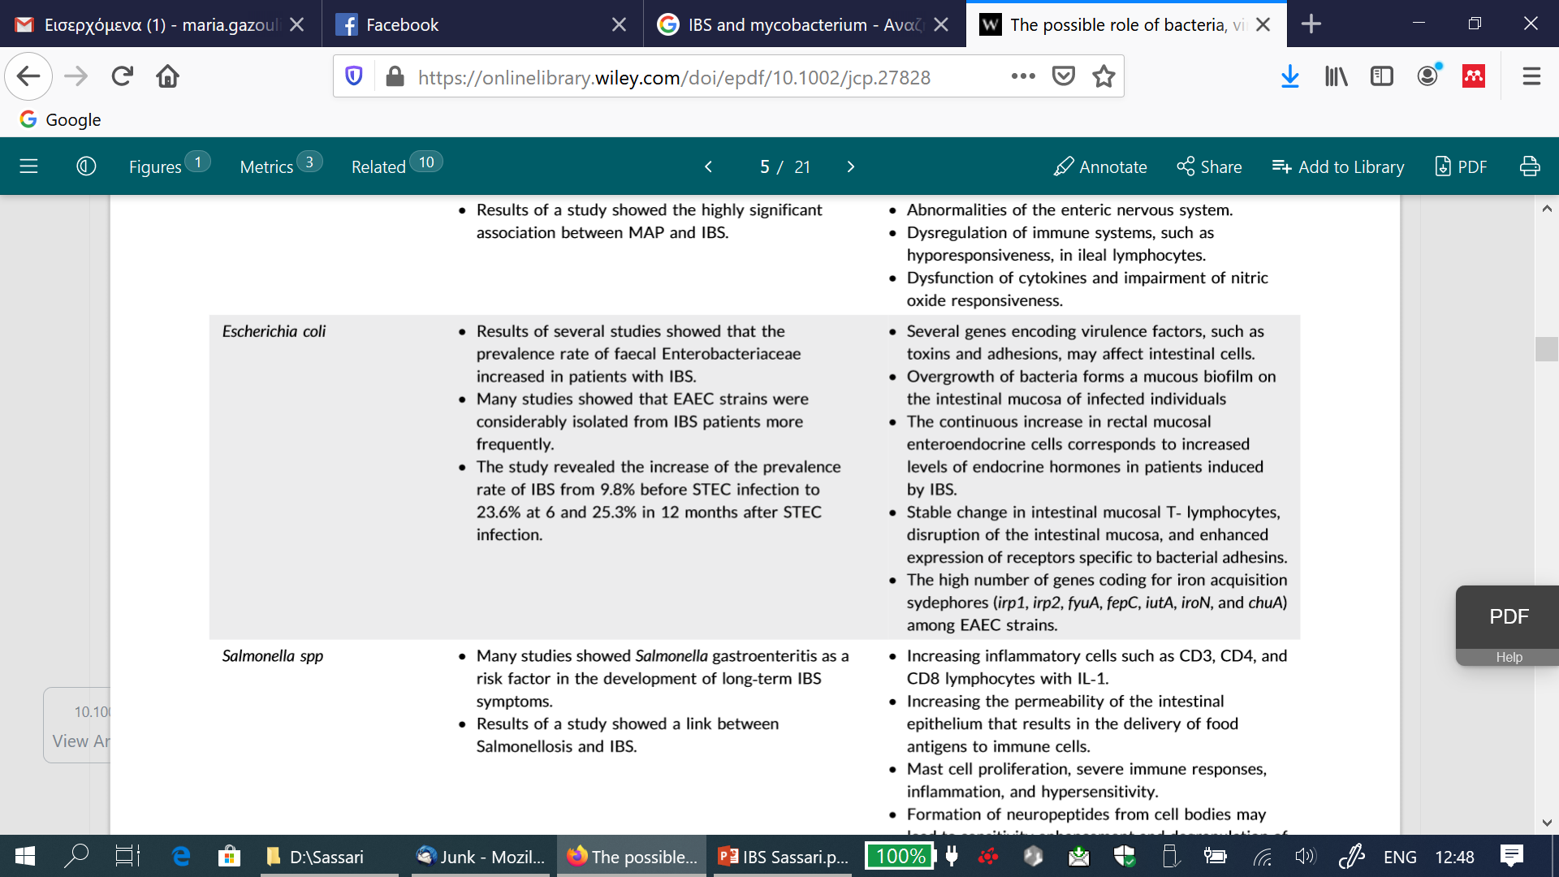

Slide 25
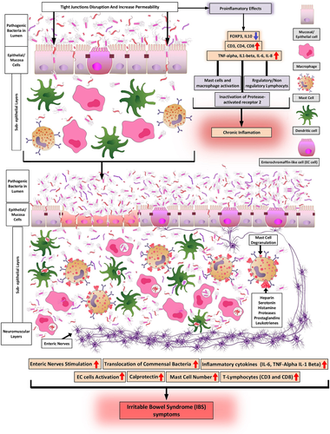

Slide 26
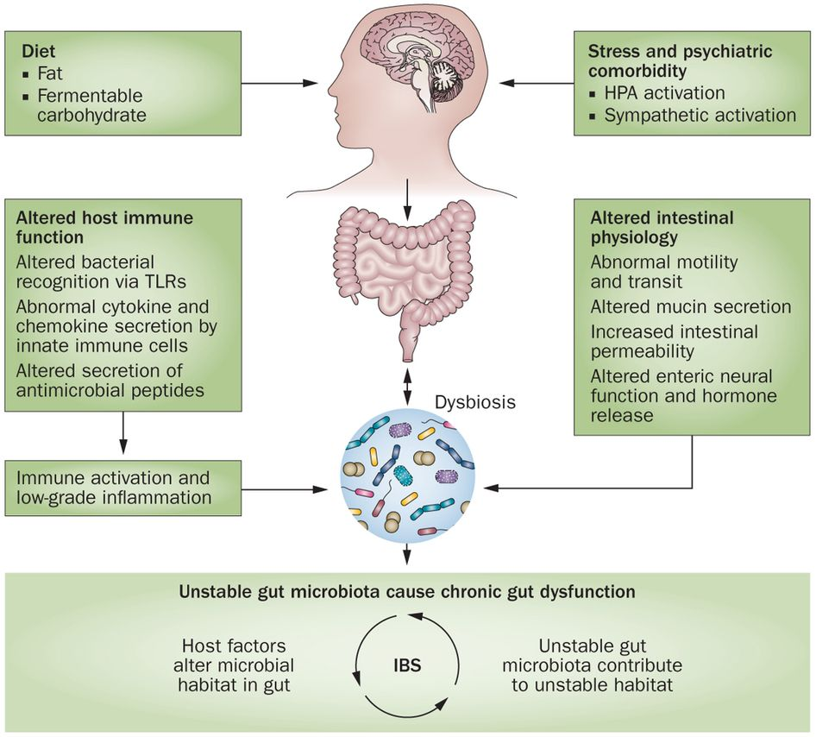

Slide 27
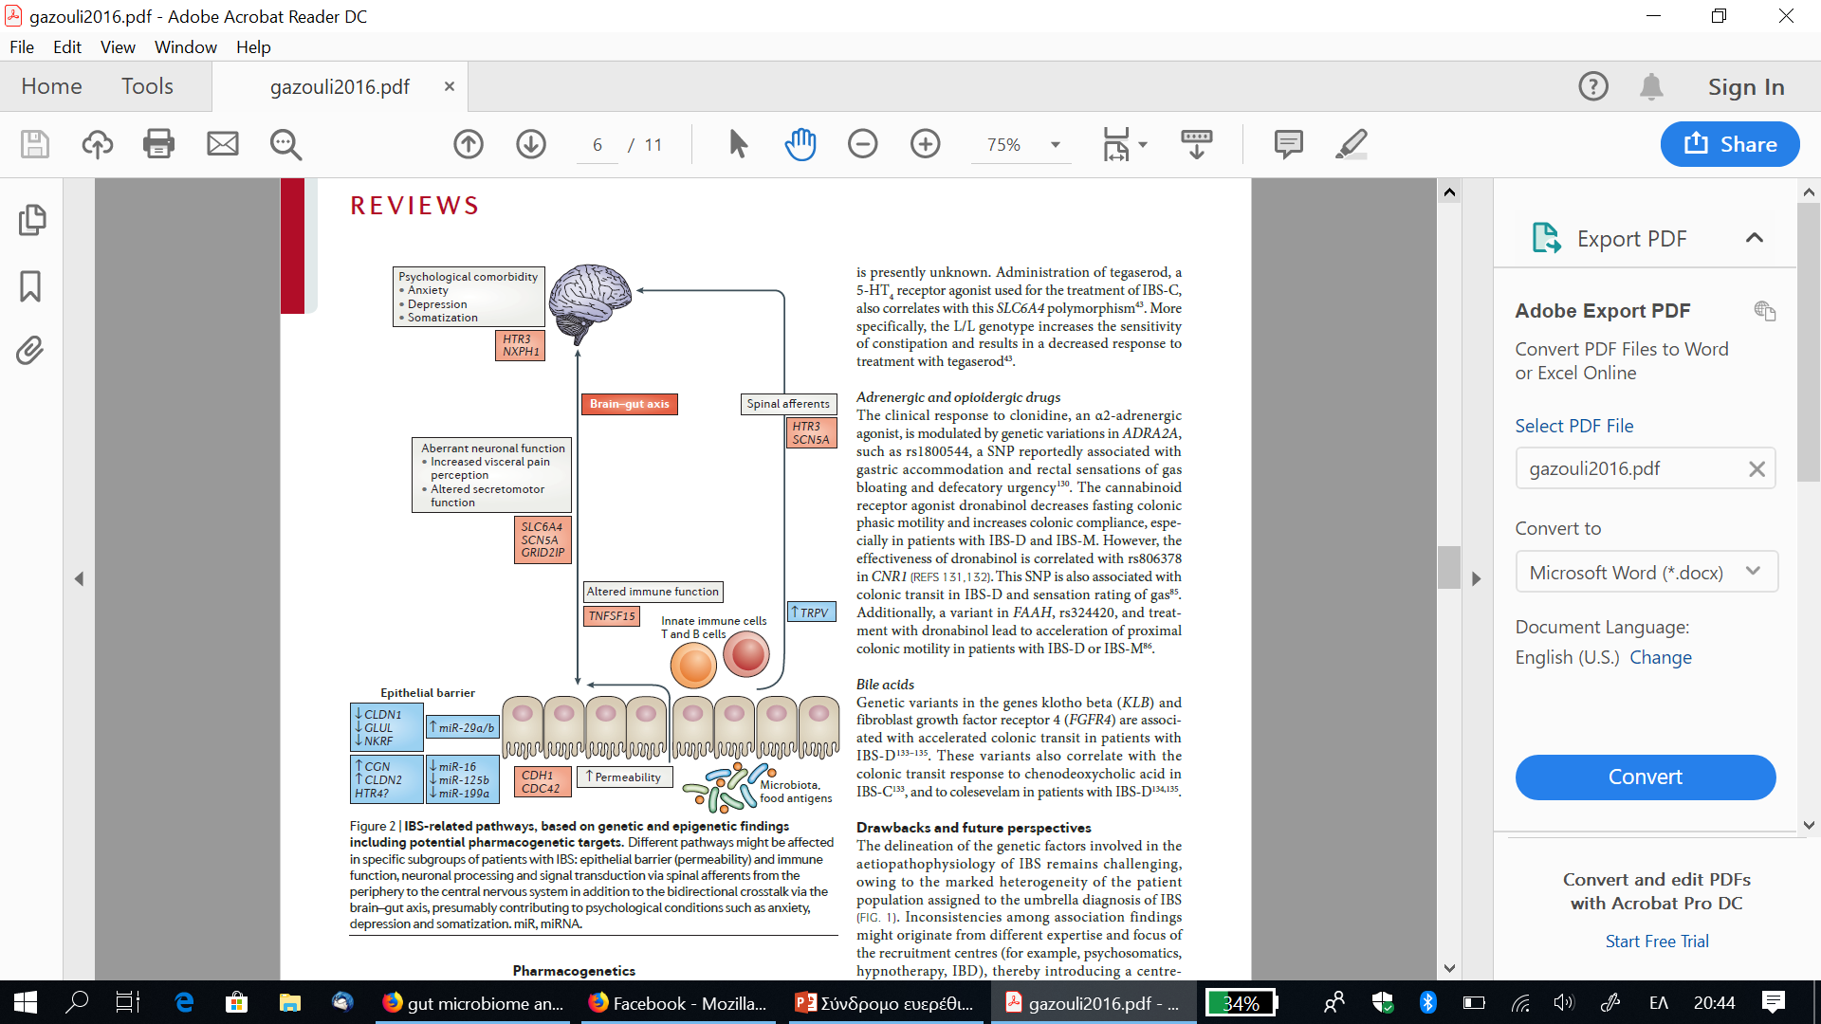

Slide 28
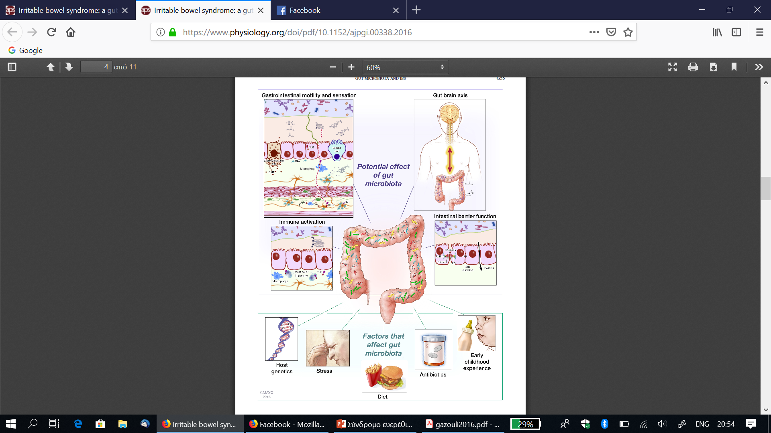
Am J Physiol Gastrointest Liver Physiol312: G52–G62, 2017

Slide 29
Diet
FODMAP ="Fermentable Oligosaccharides, Disaccharides, Monosaccharides And Polyols
Oligosaccharides: fructans and galactooligosaccharides (GOS)
Disaccharides: lactose
Monosaccharides: fructose
Polyols: sorbitol and mannitol
low FODMAP diet improves IBS symptoms

Slide 30
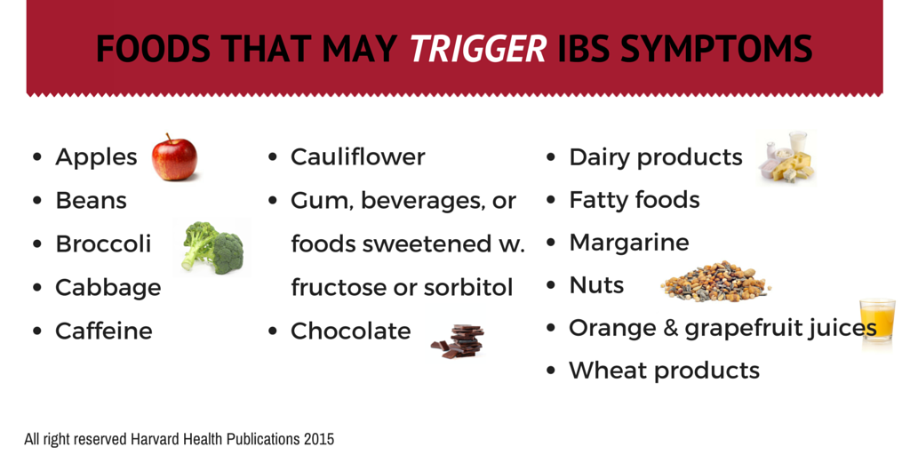

Slide 31
Humans are being characterized at the level of genetic pre-disposition and inter-individual variability in terms of
response to nutritional interventions and direction of health trajectories
epigenetic, metabolic programming at certain life stages with health consequences later in life and even for subsequent generations
acute genomic expression as a holistic response to diet, monitored at gene transcript, protein and metabolite level.

Slide 32
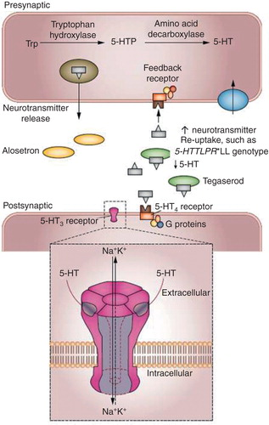
Pharmacogenomics
Genetic variations in drug metabolism, polymorphisms at CYP2D6 affects tricyclic antidepressants and selective serotonin-reuptake inhibitors
5-HTTLPR LL are also less responsive to the 5-HT4 agonist, tegaserod

Slide 33
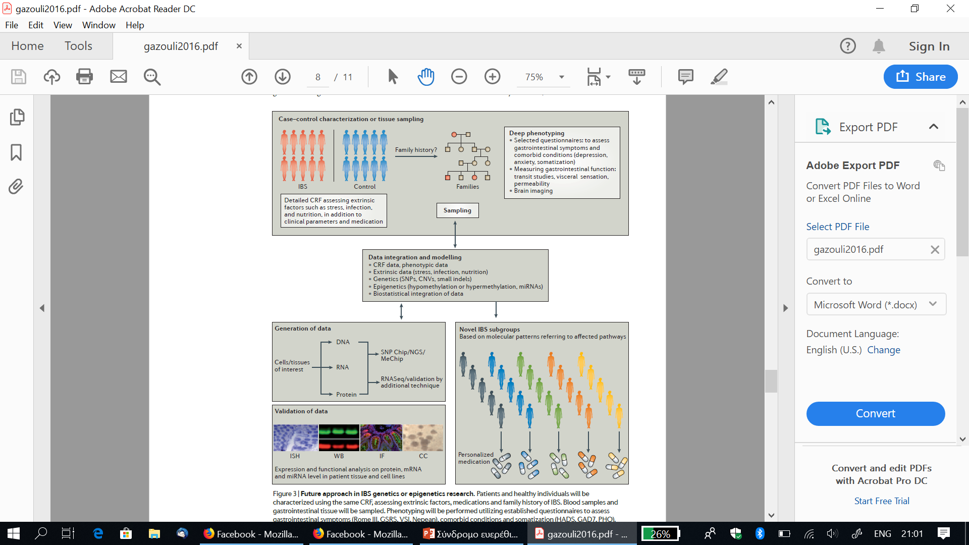
Future approach in IBS genetics or epigenetics research

