Slide 1
George Mavrommatis
Cultural globalization and transnational tourism

Slide 2
Introduction
Today’s lesson will try to touch on the issues of globalization and tourism
There is a lot of talk about globalization these days and this word means different things to different people
The way that we will try to approach globalization is from a standpoint of cultural globalization.
What does cultural globalization means these days? And how can we conceptualize it? Is it about creating a homogenous environment or is it about creating more differences?
Another feature that we will try to refer to is the globalization of the tourism industry that has taken place during the last decades. What does this globalization of tourism does to processes of cultural globalization? Or to put it another way, what are the relationships between cultural globalization and the globalization of tourism?
One possible way to approach this relationship between cultural globalization and the globalization of tourism is through the relationship between the global and the local (tourist destination)
Last but not least, we will refer to the creation of authentic or fused experiences that take place within this new landscape of touristic consumption that is emerging

Slide 3
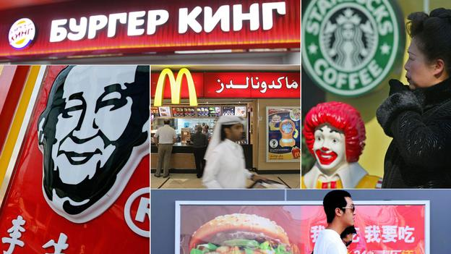
Cultural globalization?

Slide 4
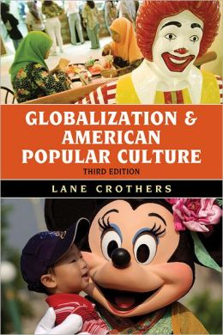
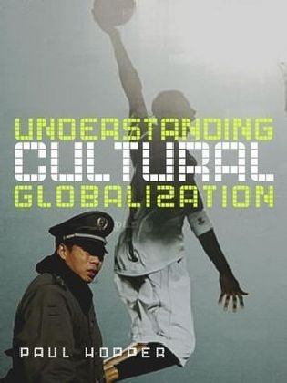
Cultural globalization?

Slide 5



Slide 6



Cultural globalization and socialmedia

Slide 7
The homogenization theory
The first theories about the effects of globalization were arguing that the world was becoming more of the same.
Pelmuter (1991) and the homogenization theory
According to such a view, the world was transforming in relation to the American influence, all the world started looking the same. Mac Donalds, Star-backs, airports.
The creation of a global village that slowly was losing its differences and started looking the same
The destruction of local character.
The role of the media and global consumption patterns

Slide 8
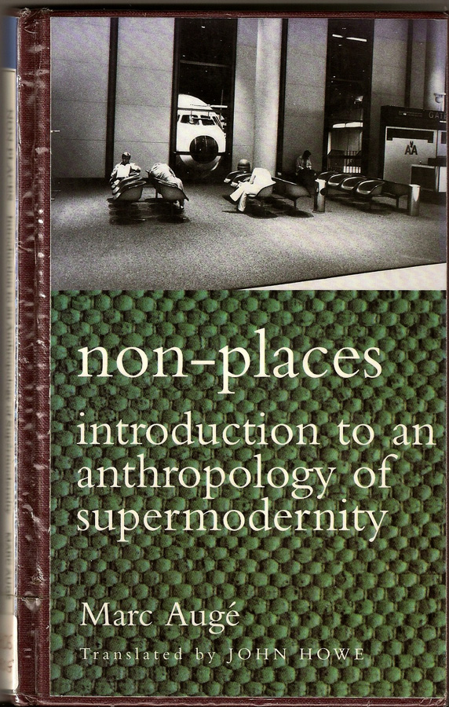
French anthropology

Slide 9
Globalization seems to produce a more differentiated world
The global and the local seem to work together. The global does not necessarily obliterates the local, but instead, it changes it, it transforms it. As a result more differences are produced. This world becomes even more differentiated (Stuart Hall).
The global adjusts to the local and creates a new local, a newly constructed sense of local.
In this sense the local and the global or the different locals under global influences create new versions of these locals, new identities and new characters.

Slide 10

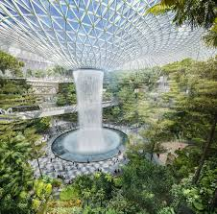
The jewel changi airport Singapore

Slide 11
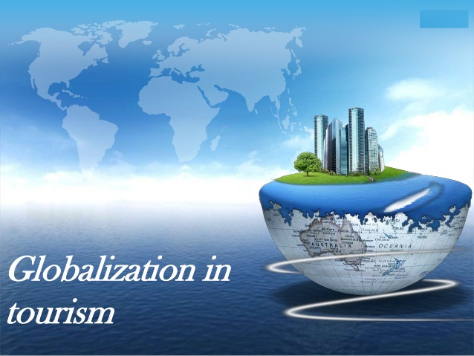

Slide 12
From cultural globalization to the globalization of tourism.
We talked about globalization but we have to refer also to the globalization of tourism that has been taking place
By that again we mean more than one thing.
On the one hand, more countries are getting touristic. New destinations emerge and flows change.
On the other hand, the number or international arrivals increase.
Within these numbers, new categories/ nationalities emerge. New people start travelling.
Probably this is what we mean as the globalization of tourism.

Slide 13
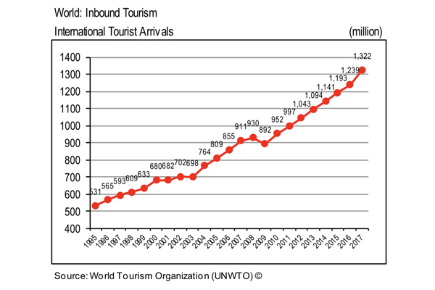

Slide 14
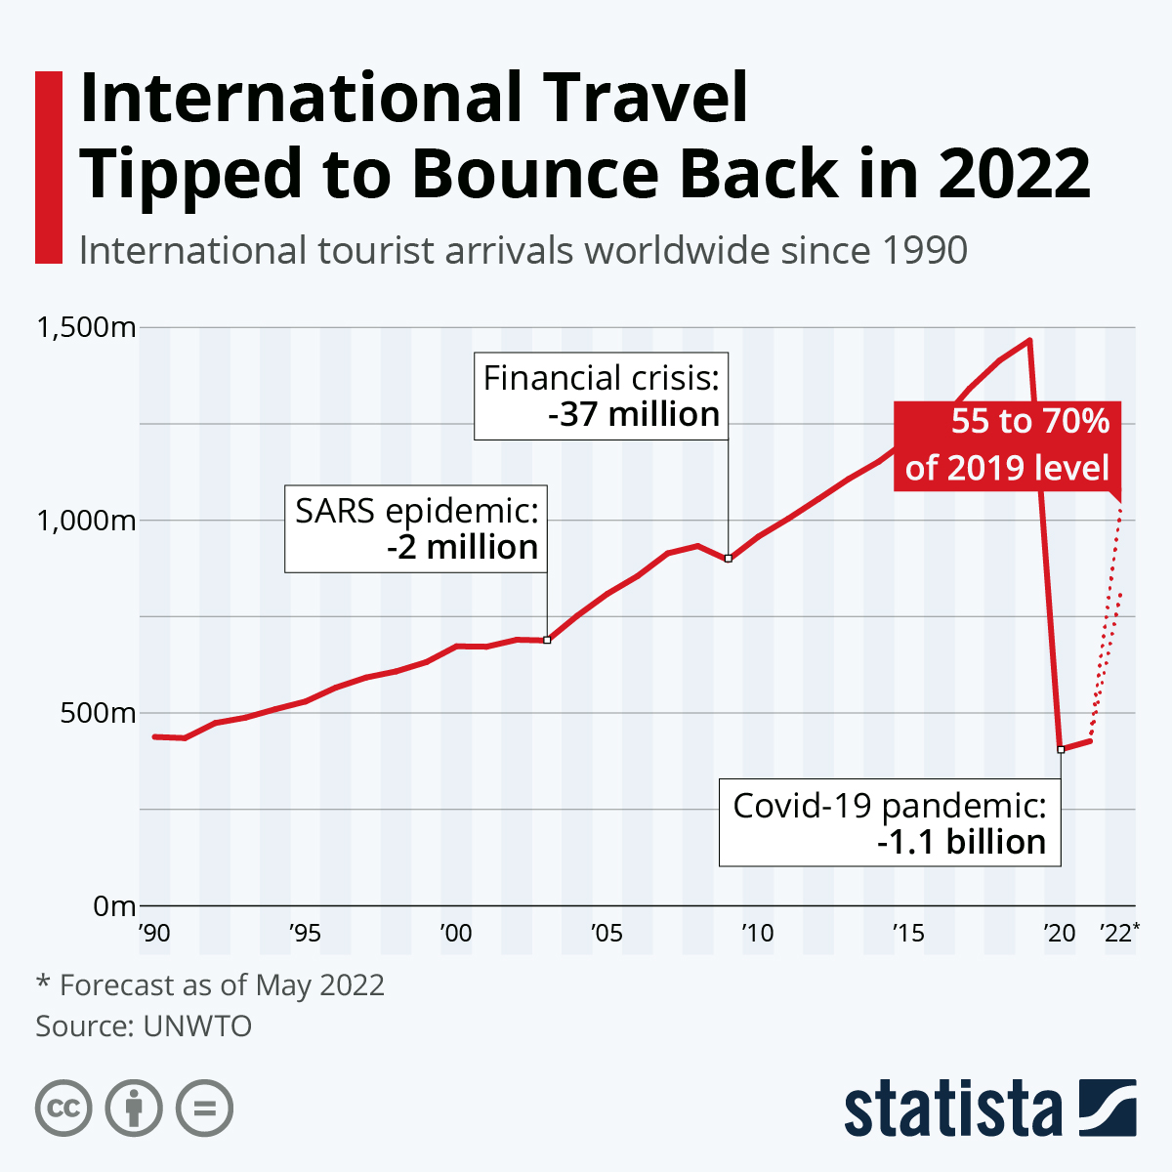

Slide 15
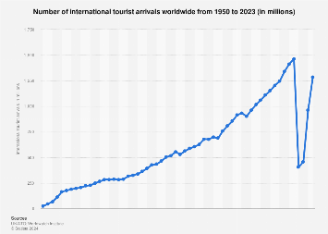

Slide 16
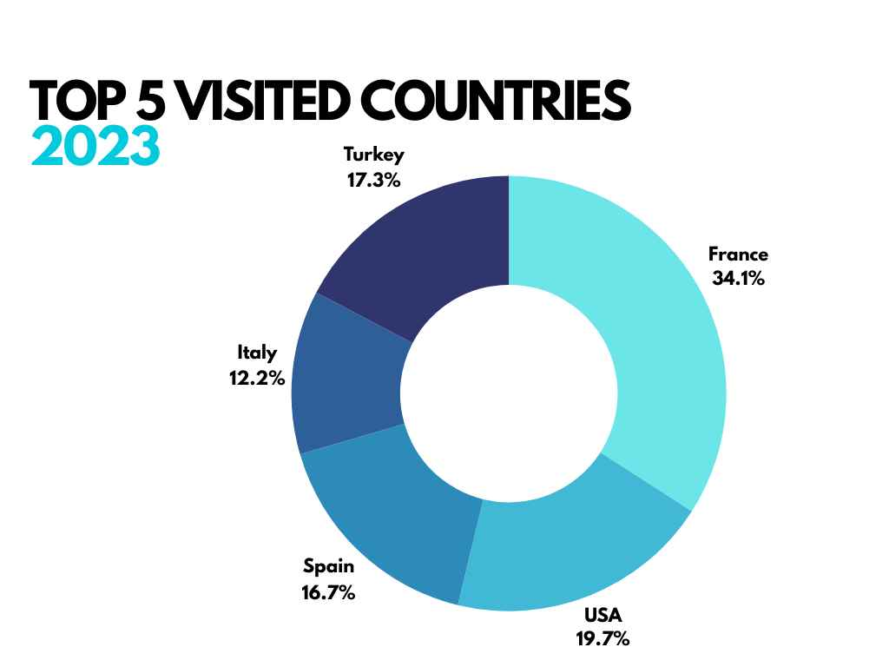

Slide 17
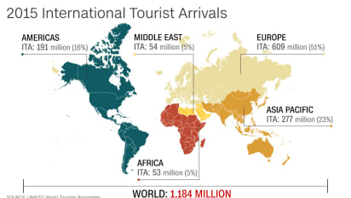

Slide 18
Another way of seeing these things
Can we conceive the relationship between processes of cultural globalization and processes of the globalization of tourism together?
Probably it can be done by shedding light on the dialectical relationship between the global and the local. Global processes of globalization and tourism and its relationships with the local (tourist destination).
These relationships are probably complex as they are conveyed through different prisms: the prism of authenticity and the authentic experience versus the prism of fusion and hybridity.
Probably the best way would be not to view these processes as independent but maybe as in some cases taking place consecutively or even simultaneously.
But let us investigate a little bit more their relationship.

Slide 19
The global as local
In relation to tourism that probably refers to case where the global tourist brands expand and become part of the local/national ecology.
The global does not adjust but instead expands geographically.
This form of developing tourism is probably seen more in the era of mass tourism and not necessarily in the emerging experiential niche tourism of the moment
We can think of many examples of such tends

Slide 20
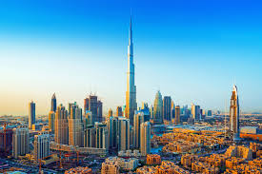
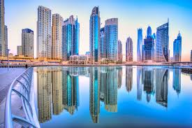
Dubai tourism: gulf modernity

Slide 21
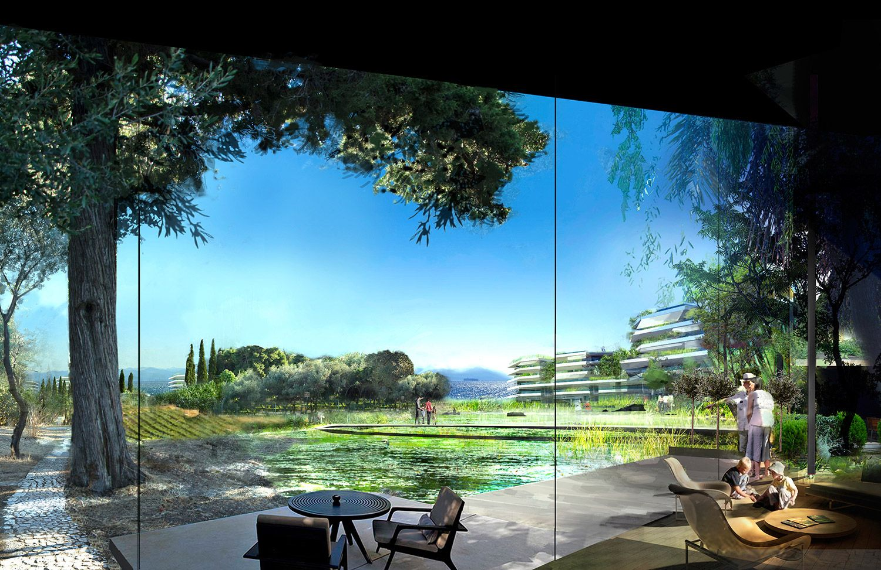
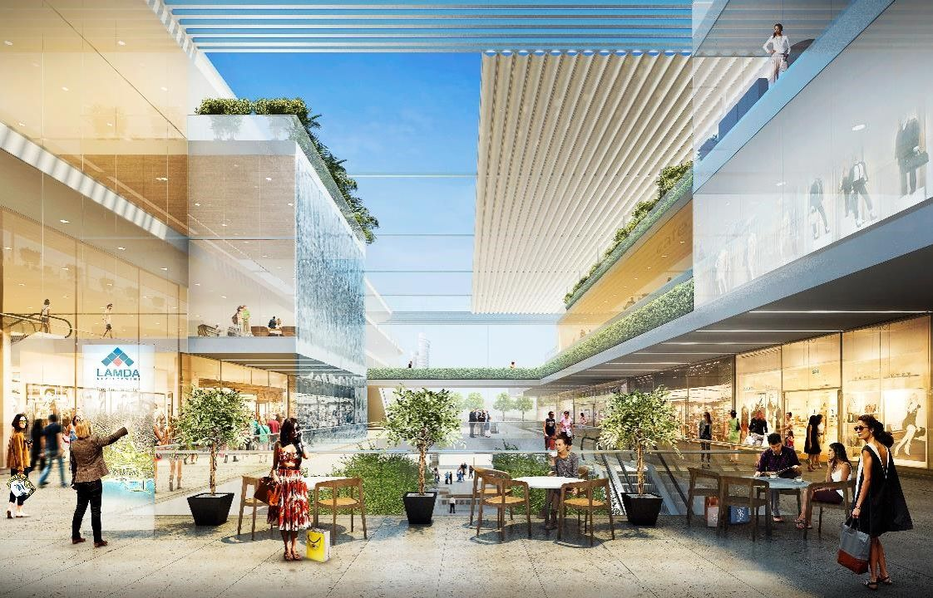
Ellinikon Lamda development

Slide 22
The local against the global: the creation of a totally authentic experience
From slow food to slow tourism?
The slow food movement and the politics of a ‘virtuous globalization’. Good, fair and clean food. Authentic local food that is far away from the practices of the global mass market food industry. Food, identity and culture.
The diversity of places and the creation of ‘authentic experiences’
The change from mass tourism to experiential tourism.
How authentic is the produced ‘authentic experience’?
Local food industries and the building of a culinary tradition. All produce should come from the locality.
New ways of a sophisticated folklorism?

Slide 23

Slow food international chicago 1989

Slide 24
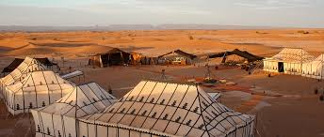
Authentic experiences

Slide 25

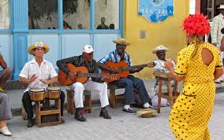

The ‘real’ thing

Slide 26

niche market?

Slide 27
The globalization of the local
This is probably something else in relation to the local and the global. Of course it can also relate to the other processes, too.
I can imagine the globalization of a local destination is when a locality becomes a global brand. A place that is globally recognized as having its own identity and referring to specific characteristics.
I can also imagine that this local branding that became globally recognized in many cases has been the product of intensively organized processes of creating an authentic experience/ identity of the place.
Santorini and the creation of a local cuisine, although the island does not have much local produce.

Slide 28

1982 Santorini

Slide 29
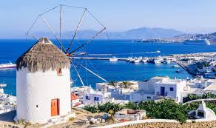
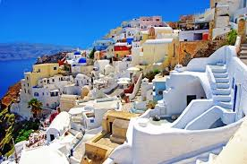
Greek Global tourist brands

Slide 30
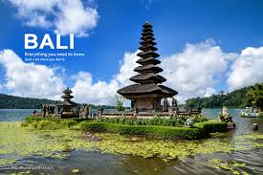
Bali

Slide 31
The localization of the global
This is probably the language of fusion and hybridity.
This is the case where the global adapts to the local and produces more differences
This is another process that is further away from the authentic experience, although someone might argue that the unique coming together of the global and the local produces a new unique difference.
This is a development that takes place extensively in the tourist industry .

Slide 32



Jamie oliver’s multicultural gastronationalism

Slide 33
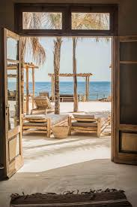

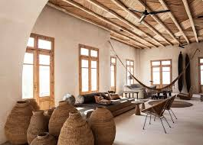
CYCLADES style?

Slide 34

Greek salad amazon prime 2023

