Slide 1
Perplexing the concept of integration? Ethnographic insights from the port of Piraeus refugee camp
George Mavrommatis
Xarokopio University Athens

Slide 2
Refugee crisis and the port of Piraeus
From Turkey to some islands and then to Piraeus
A policy of ‘well-pass’ or simply human rights on the move.
The role of Pampeiraiki in the settlement: from the ‘Greek refugees’ to Syrian, Iraqis, Afghanis and others etc.
Informal camps, people on the move, short stays, unfinished journeys, arrested mobilities

Slide 3
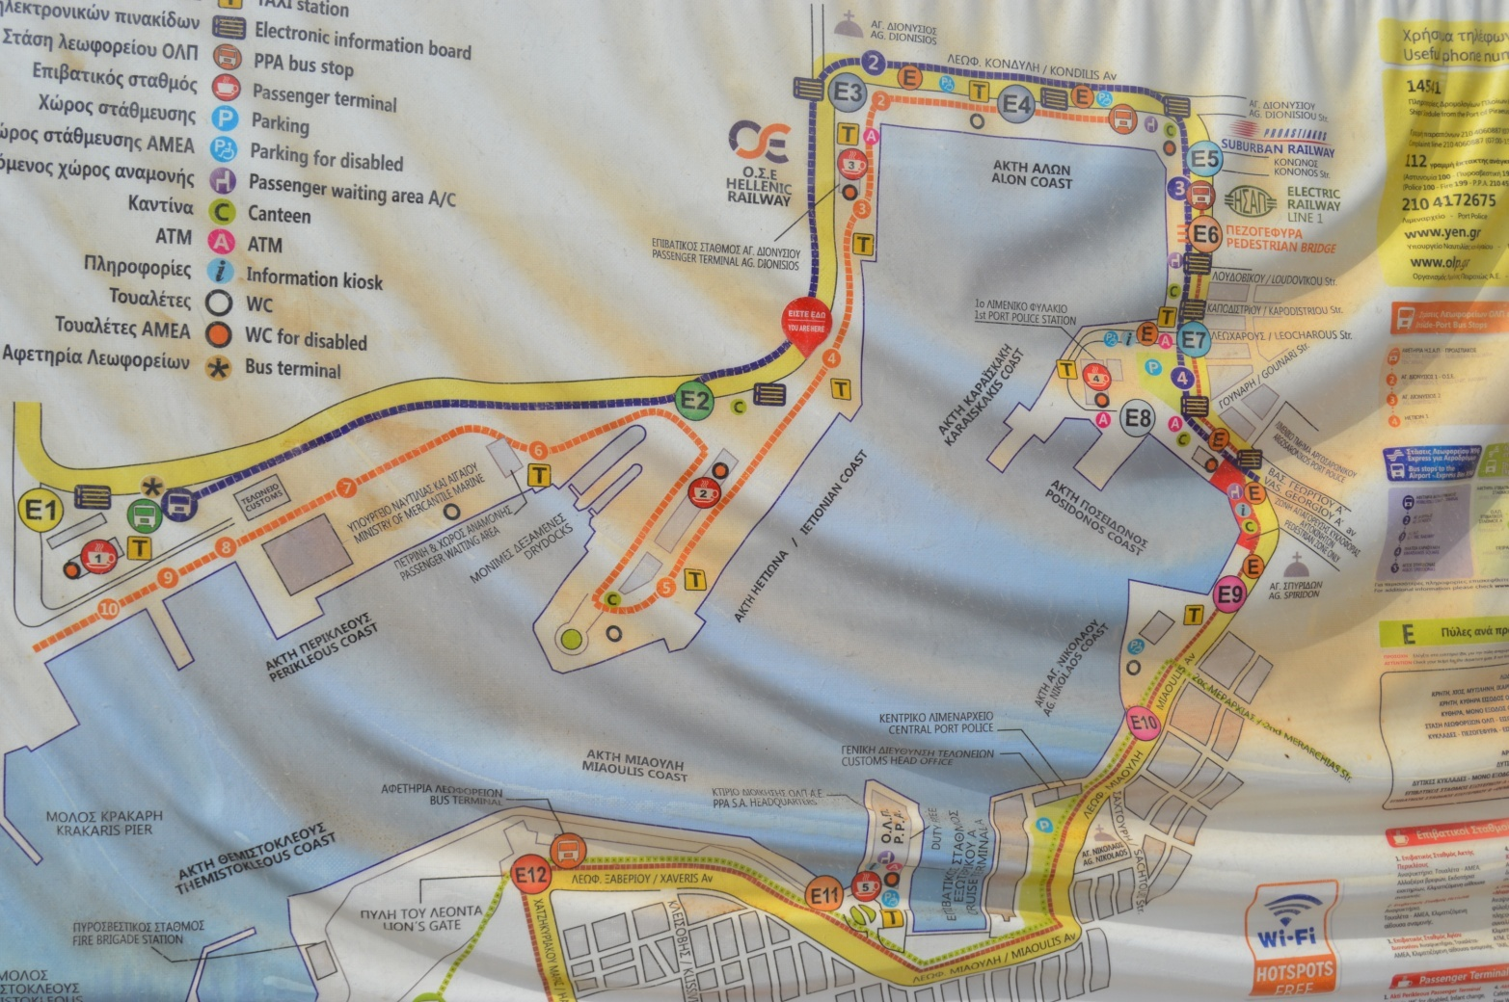

Slide 4
Camp studies
A sociology of the camp (Sigona)
Arendt and the people without the ‘right to have rights’. The camp as a place of extermination and the creation of humans without rights. The fiercest critique of human rights
Agamben, bio-politics and the space of exception
The new ‘camp studies”: Agier ‘can the camp be a city?”. The camp as a political, socialised, lived space. Campzenship
Arendt and the old distinction between the public and the private, the political and the non-political. The camp, or better the tent, as a private space in public view, can it also be political?

Slide 5
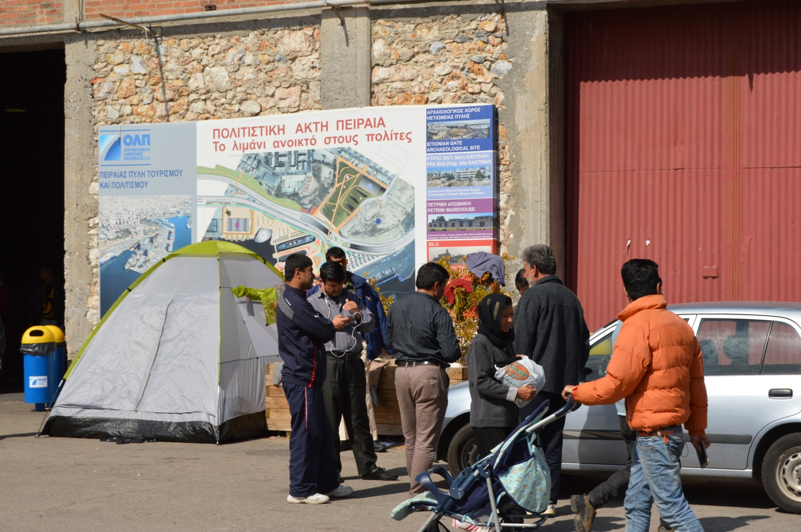

Slide 6
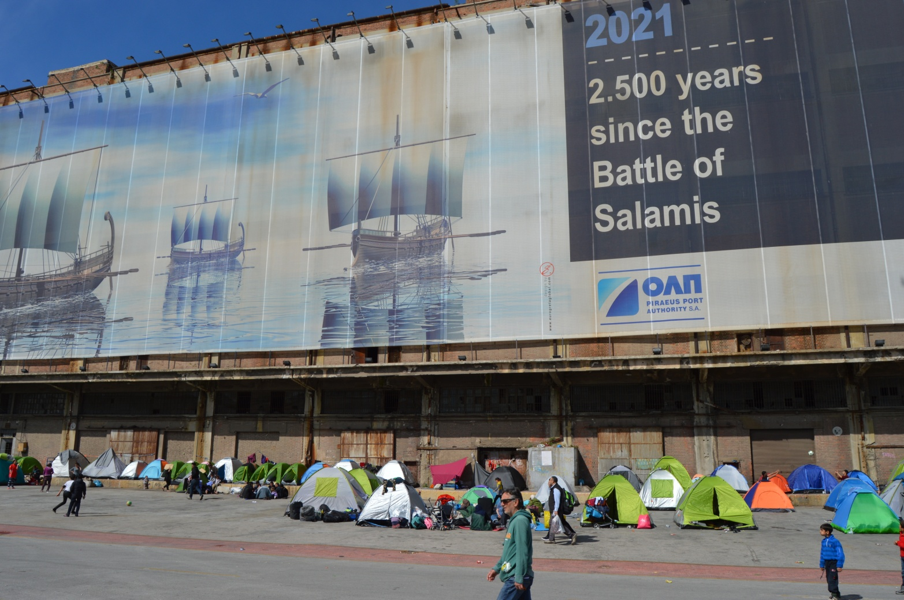

Slide 7
Timeline
Sep, 2015 solidarity members of Pampeiraiki on the port
9/3/2016 Western Balkan route closed
22/3/2016 The EU/Turkey deal implemented- the big bargaining, the ‘oldness’ of the newness of the refugee crisis and its management
From April, port authorities try to empty the port, they distribute leaflets
8/4/2016 Cosco signs a deal with the Greek government for the buy of 67% of the Piraeus Port
Politics of far right discontent, from April onwards you have you far right-groups on the ‘streets’. On the other hand, you have anti-fascist groups too. Rioting takes place.

Slide 8
A truly transnational space?
The concept of trans-nationalism, a confusing concept. From Appadurai to Vertovec, flows of people, money, ideas, images, technology etc. Beyond the nation state?
The trans-nationalism of the port:
Refugees finding shelter
Privatization of the port from Cosco (the first privatization of the second time ‘left’)
Global coverage of the camp, Angelina Jolie and others
(always under the national media scrutiny, intense politicization, fascination with violence in the camp/ interethnic conflicts)
Global or ‘glocalized’ or simply transnational civil society
The tourists on the cruise ships too, just opposite E1, E2

Slide 9
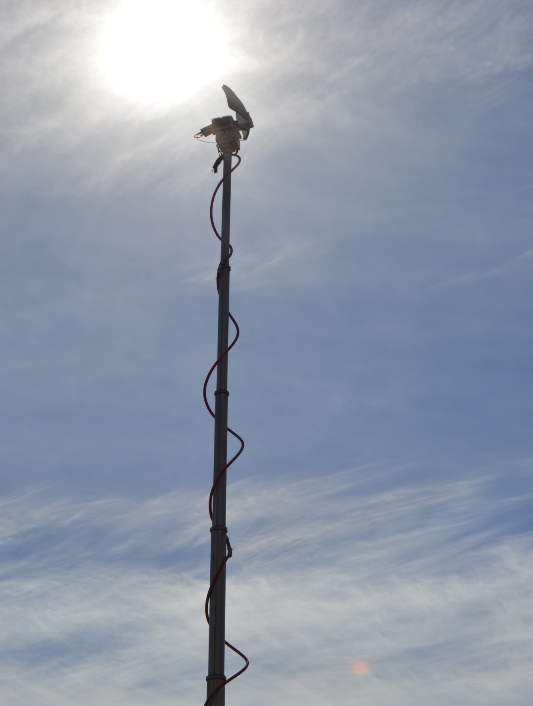


Slide 10
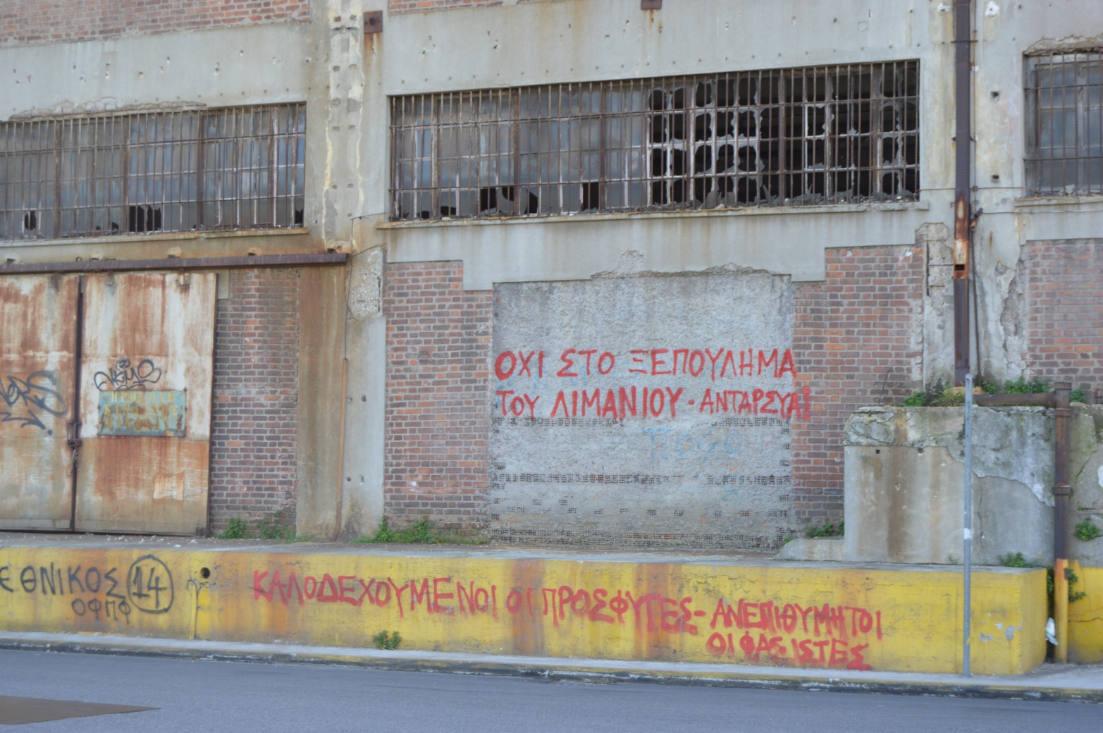

Slide 11
Technology and migration
The role of technology in these movements
The argument that these people if they were poor they would not have ‘fancy’ phones
Translation apps, GPS, facebook and other technological ‘goodies’
‘Globalization from below’ (Portes) and the role of technology
Syrian-Kurd family. I communicated with them through a translation app. The pictures on the mobile as a Pesmerga figther. Technology and identity, your whole life in a memory card
Ali, Iraqi translator who lost his mobile, “I do not care about the future”

Slide 12
The politics and ethics of solidarity and giving
An umbrella civic society: international organizations, NGOs, big ones, small ones, solidarity movements, private companies, athletic clubs (Olympiakos got many new fans)
Emblematic weak statism
English is spoken here, a truly global bunch
Mr. Giannis, Levinas and the face of the other
A sea of volunteers: an ethnic division of work. Foreign mostly creative play, cultural fiestas etc.
Once authorities started to try to empty the port, you had further politicization of the place. Volunteers gave away leaflets, they projected their own ideas on refugees. The politics of staying. Many things written on the walls “no borders” “assembly or volunteers”

Slide 13
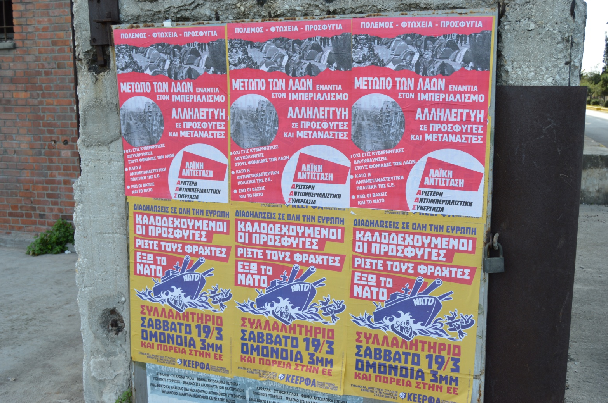

Slide 14
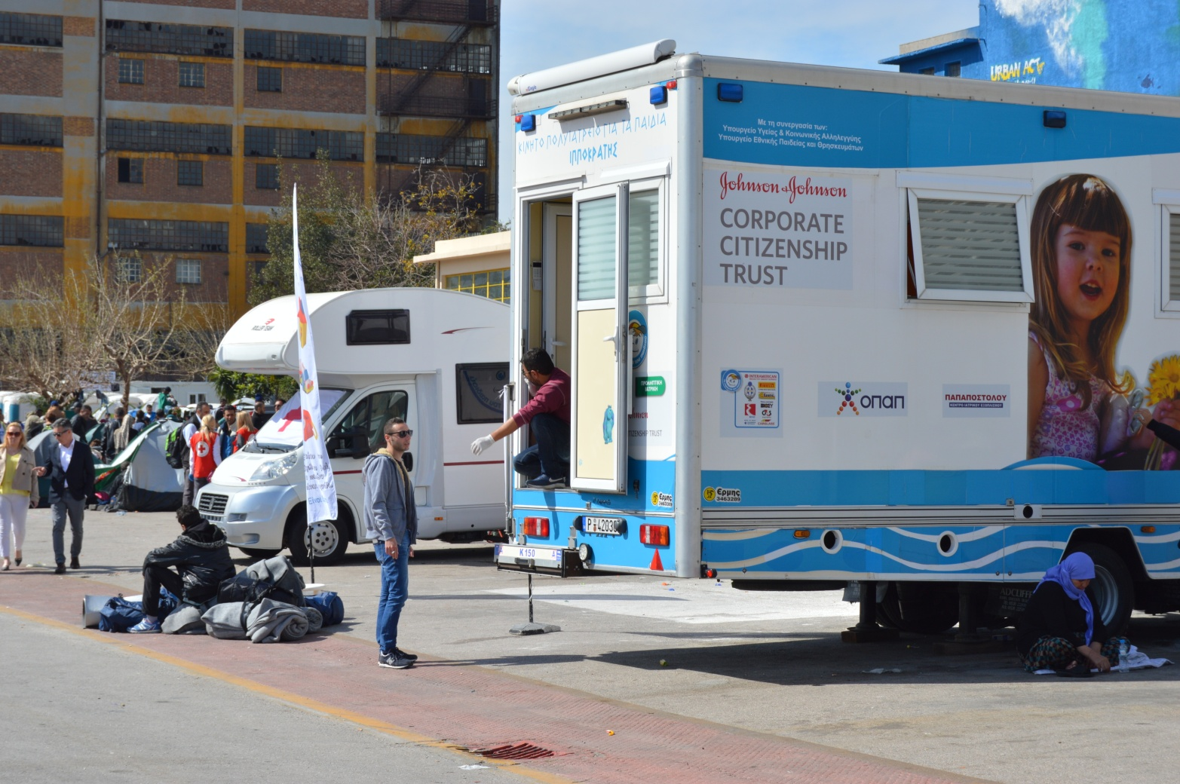

Slide 15
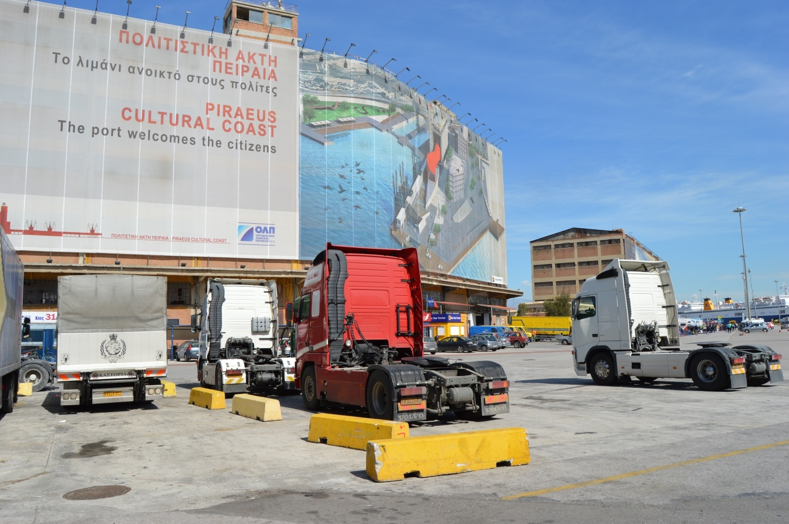

Slide 16
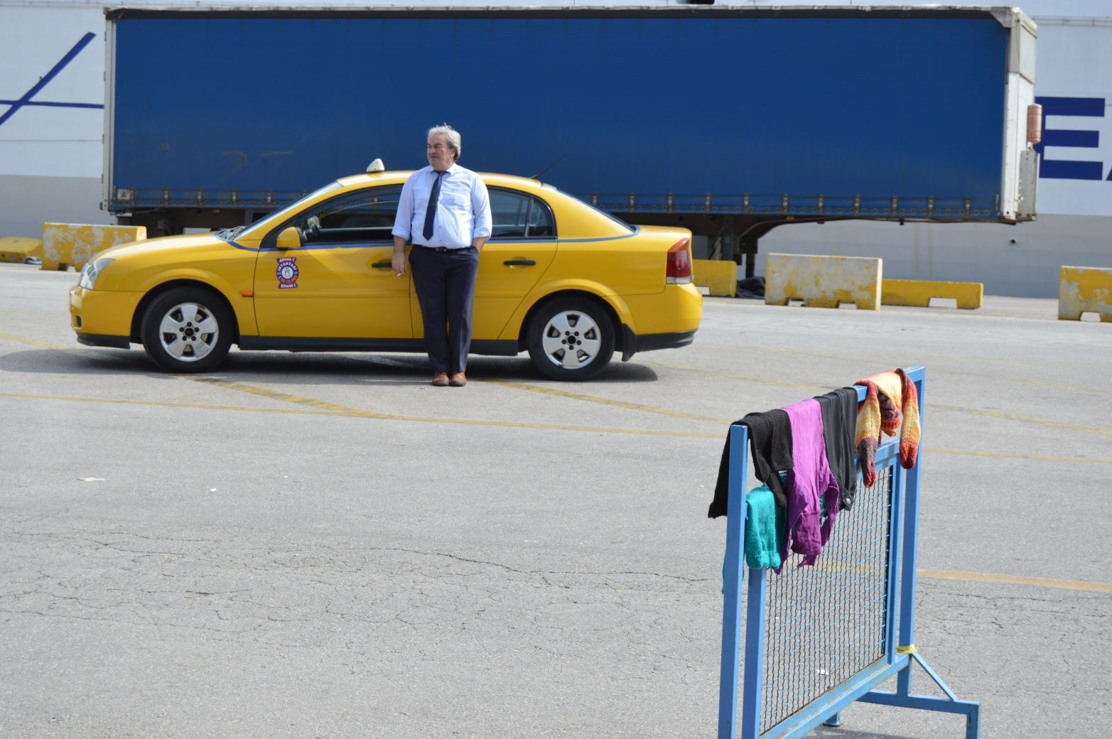

Slide 17
‘Finding my way around’ or gaining access
What could I do? I am used to do interviews
Not a suitable methodology
Ethnography, participant observation, more observation than participation, not really a ‘carnal sociology’ (Wacquant)
Approaching people, the canteen, meeting the translators, meeting more people, getting a friend of mine who spoke Arabic
Omer, Bashar, Remy, Ali, Safi and others
Ethics of research (but just research): I am not Mr. Giannis . Remy (another Syrian) who was helping out. When he asked me if his wife and his small child could come to my house to stay (instead of spending their money in cheap hotels), I was caught unguarded, I did not know was to say as my philosophy of ethics evaporated in thin air.

Slide 18
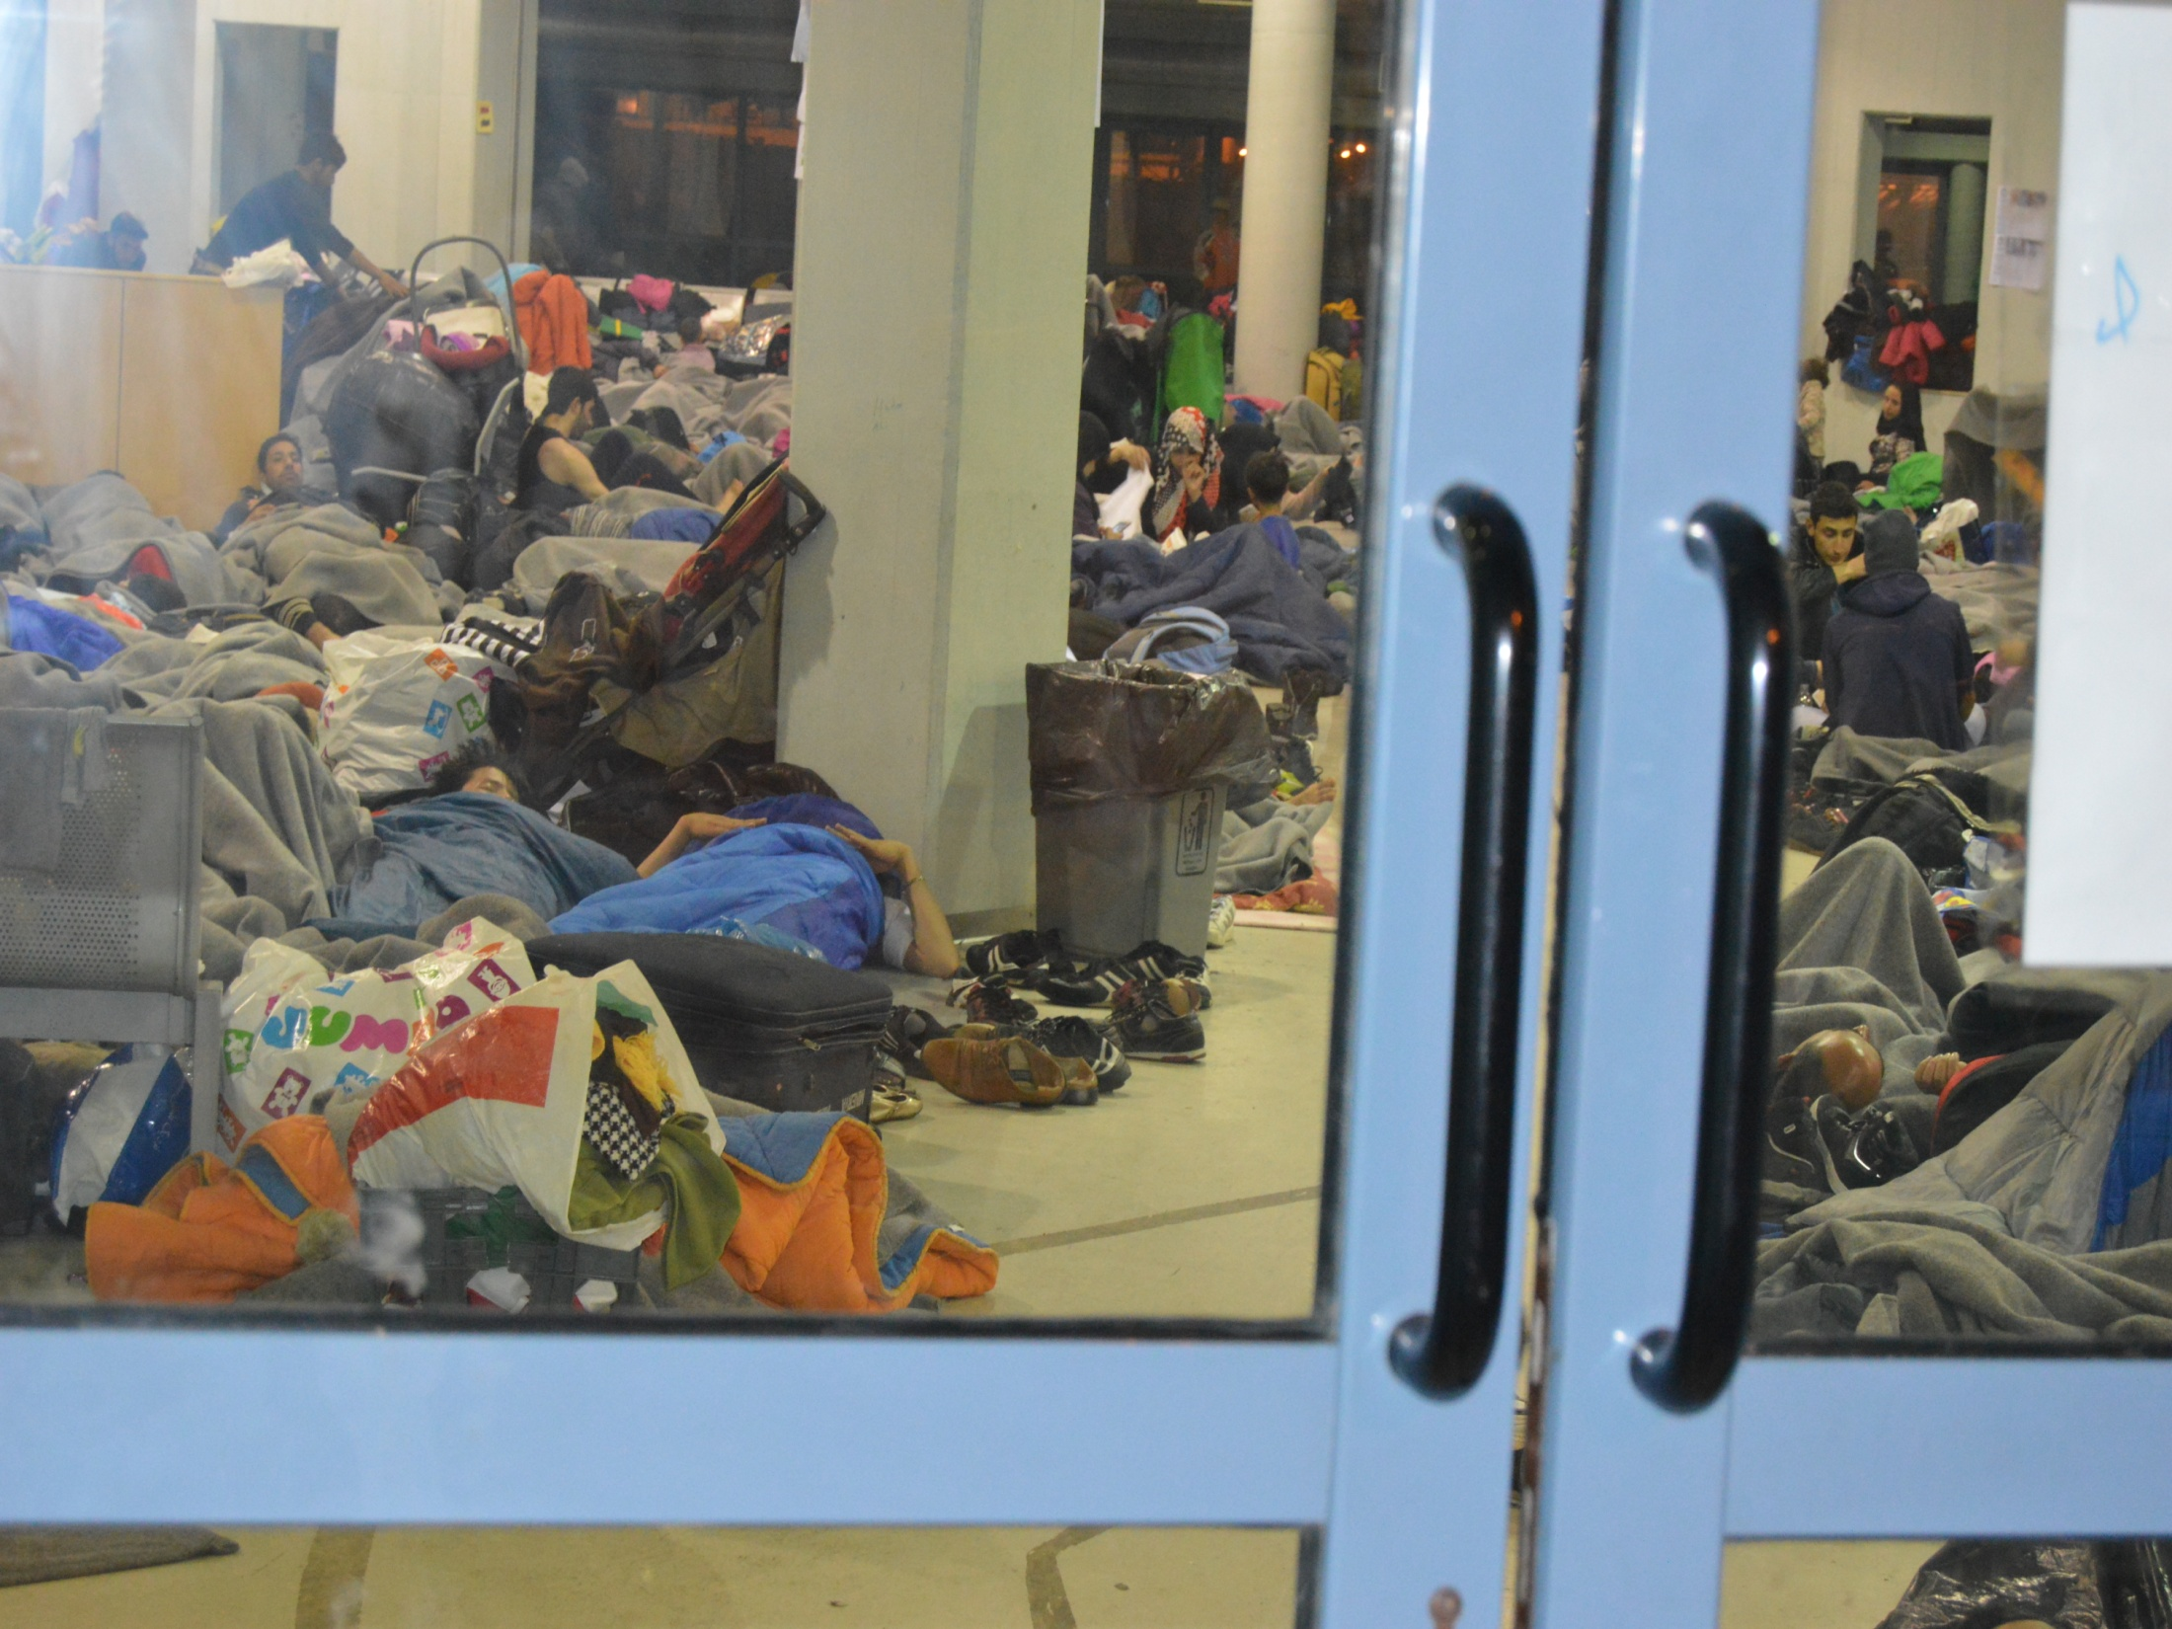

Slide 19
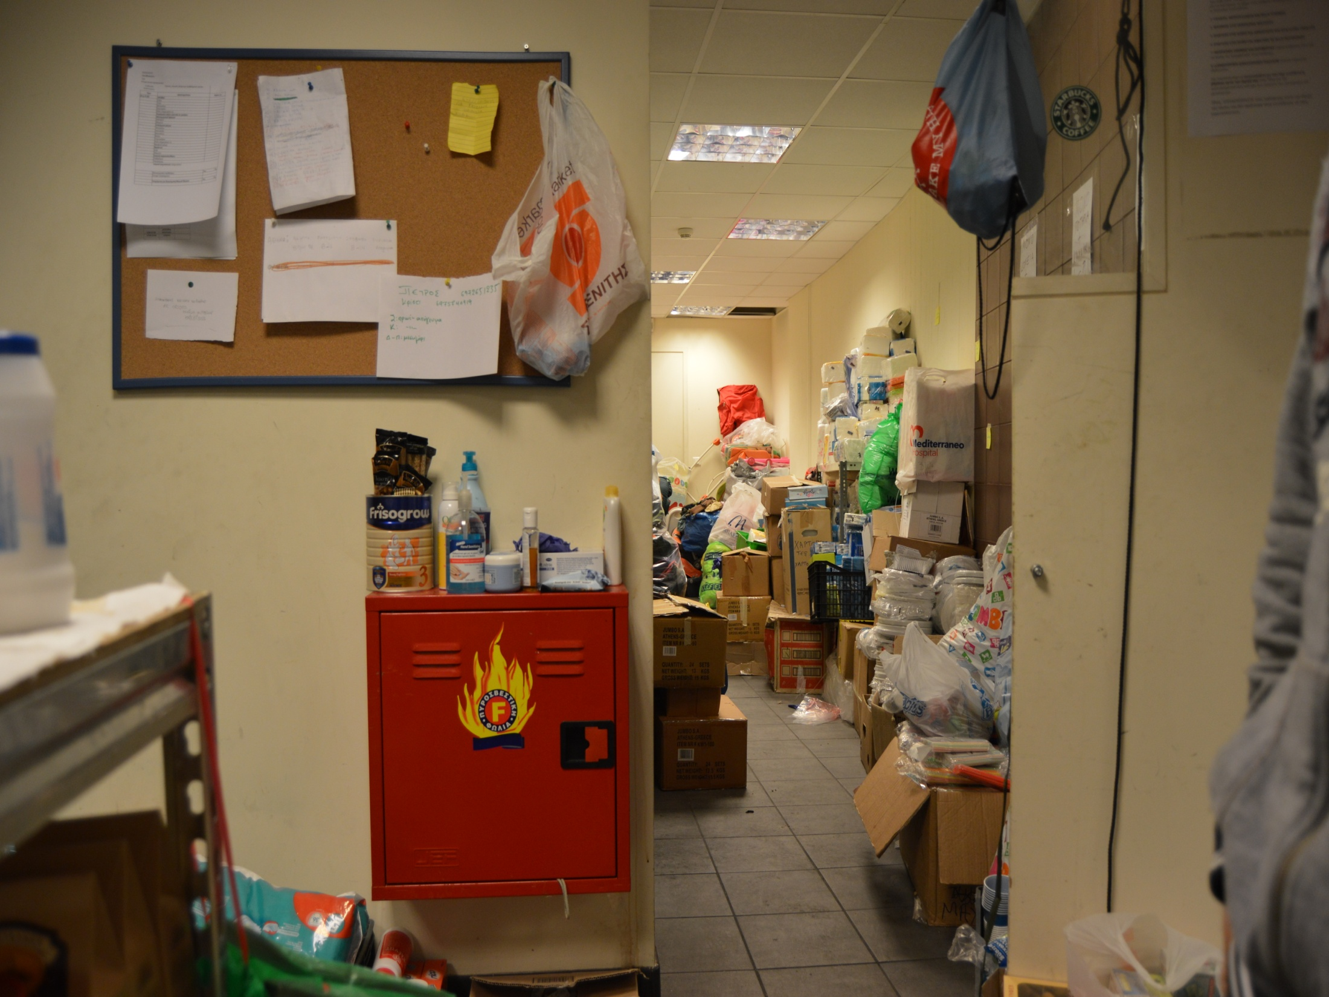

Slide 20
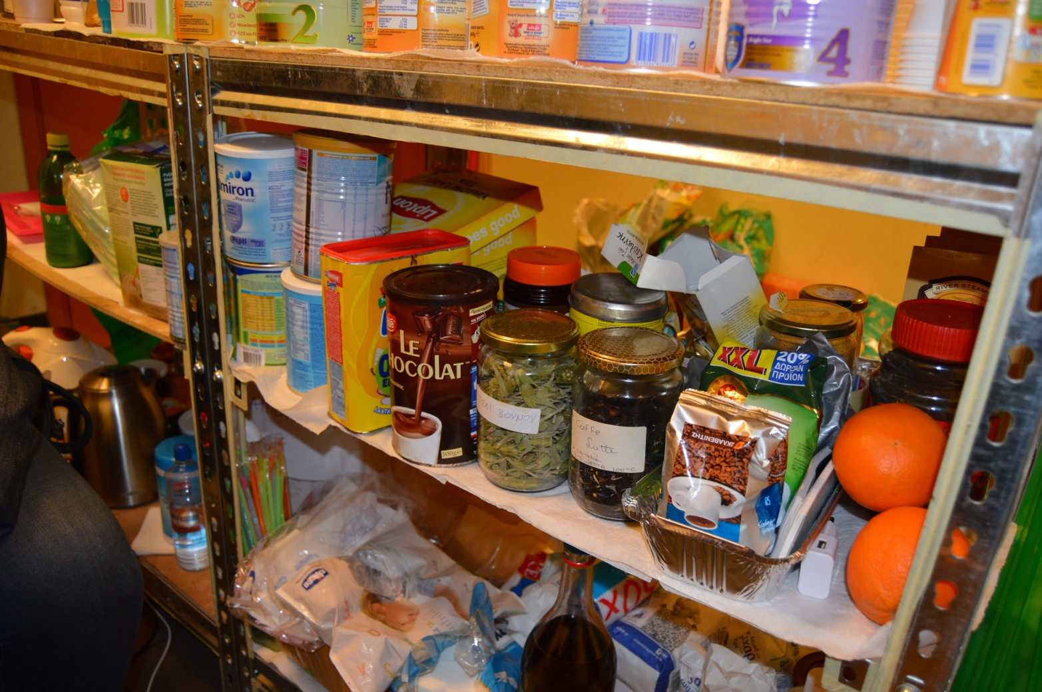

Slide 21
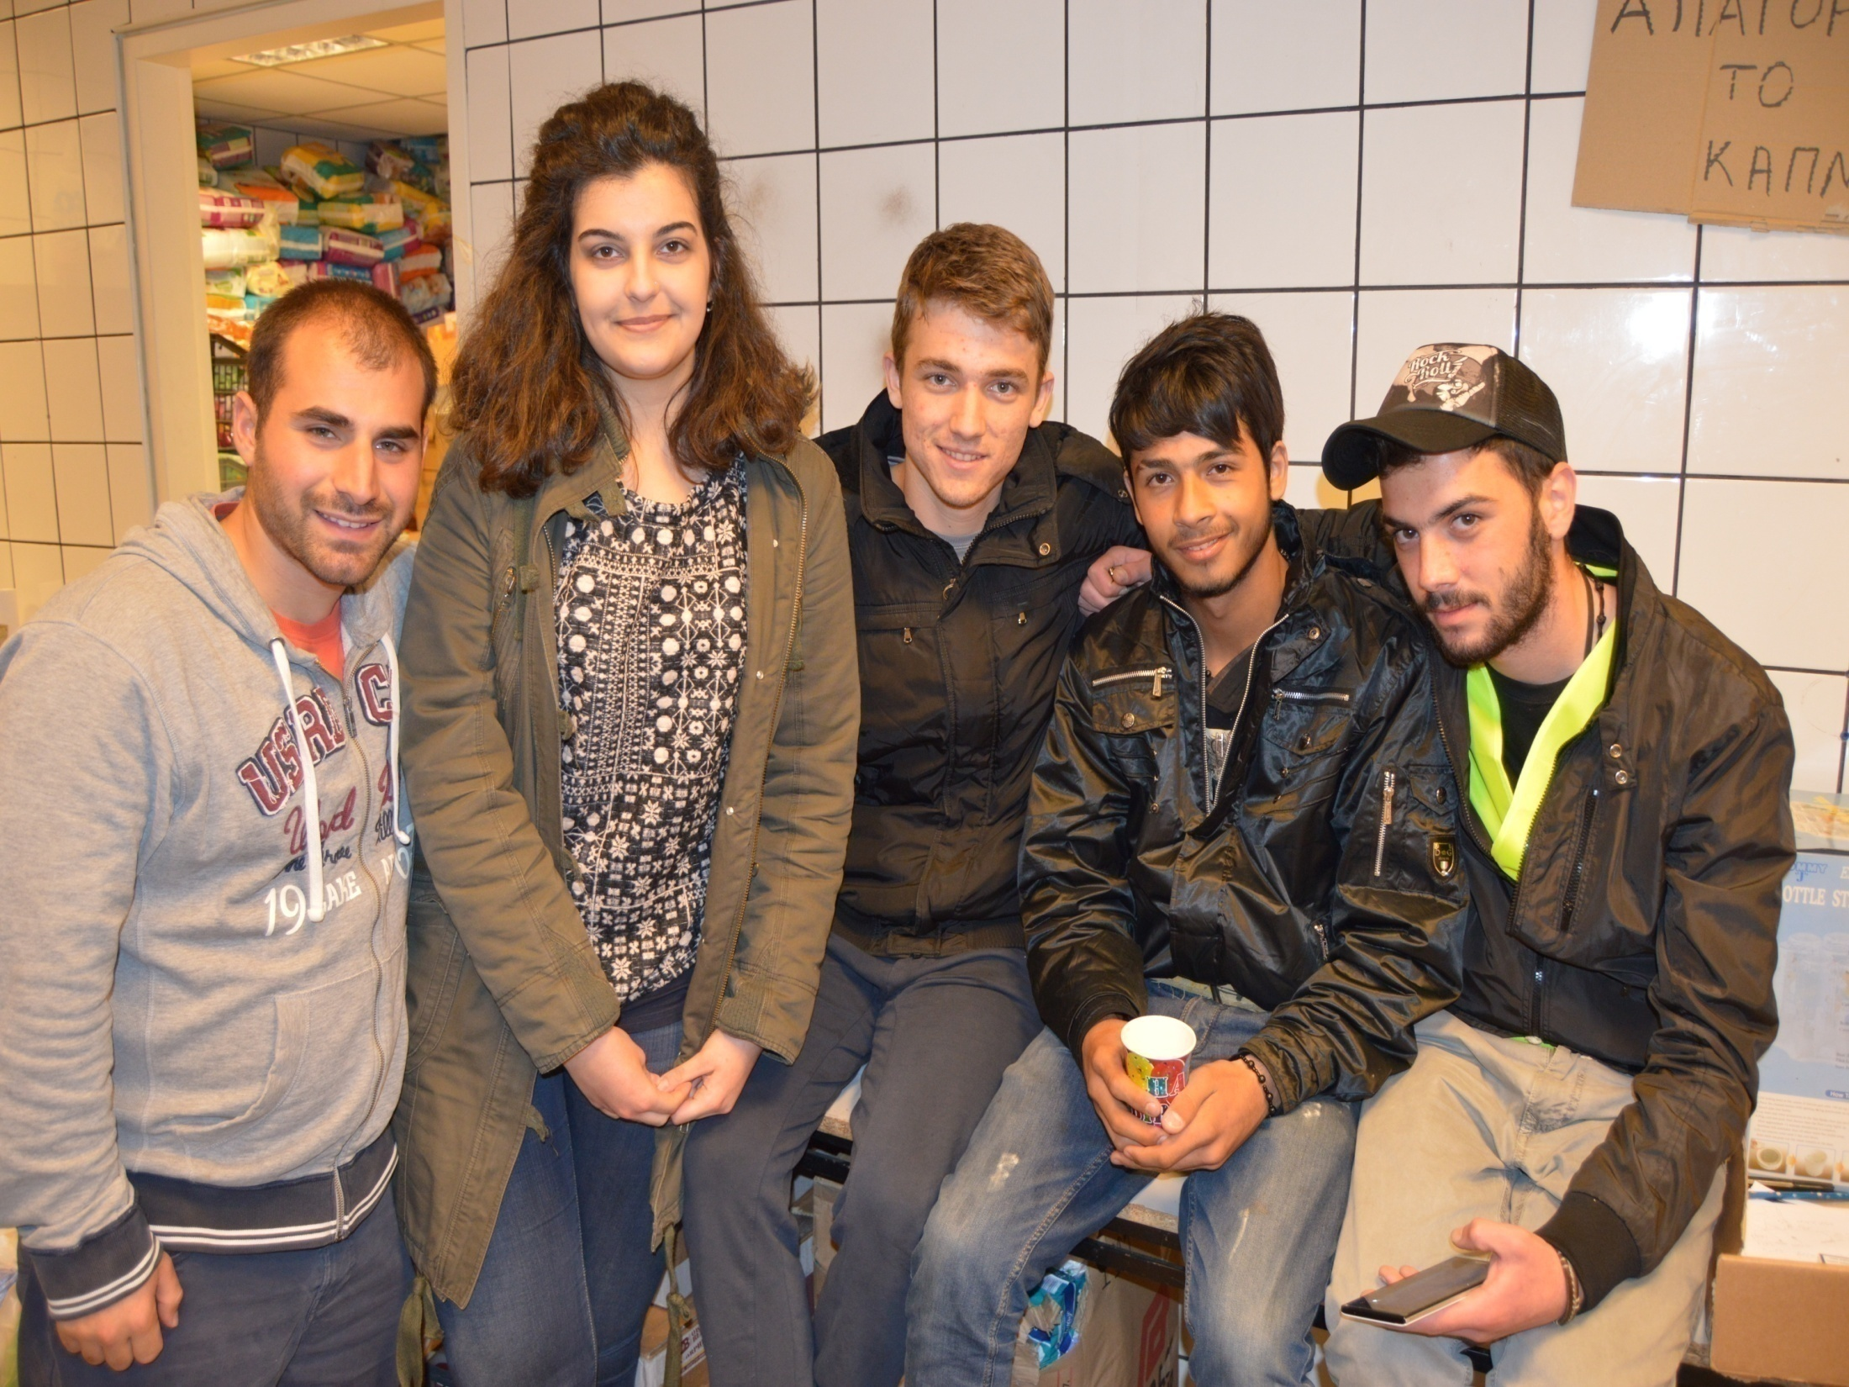

Slide 22
A very differentiated bunch?
Social, educational, economic differentiation between groups and within groups.
Syrians, Iraqis, Afghanis, Kurds, Yazidis, Palestinians. The two important groups: Syrian/ Afghanis.
I was not able to approach Afghanis (they stayed a mystery to me).
Markers of difference between Syrians: English, French, dressing, mobiles etc.
Mr. Giannis and his observations on the habitus of Syrians (one gets a sugar, another one fills the bag with croissants)
Aspirations and capabilities of movement. The poorest stayed behind probably.
Ways of seeing the journey: the young ones as slightly adventurous, for family adventure is not a good thing
All types of psychological states: from depression (the guy I met at the dock that he couldn’t speak) to people seeing the journeys with optimism or ‘false optimism’
An axis between migrant and refugee, with most of people in-between.
Theoretical accuracy and the dangers of ‘bogus asylum seekers’ discourse

Slide 23
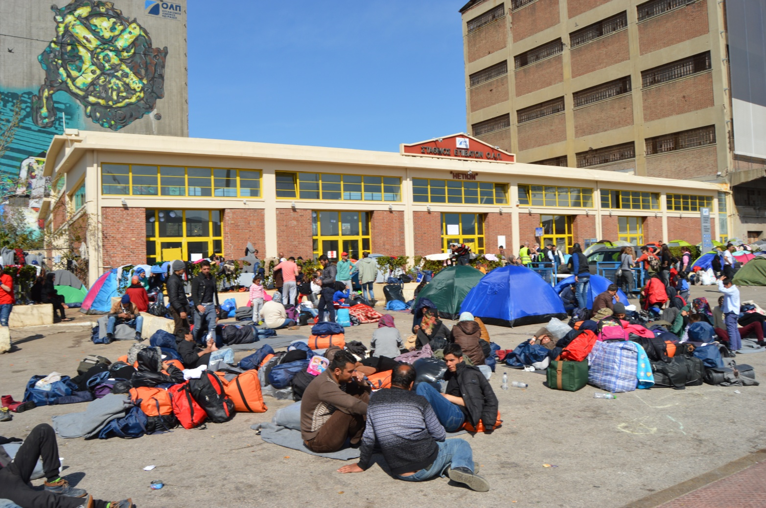

Slide 24
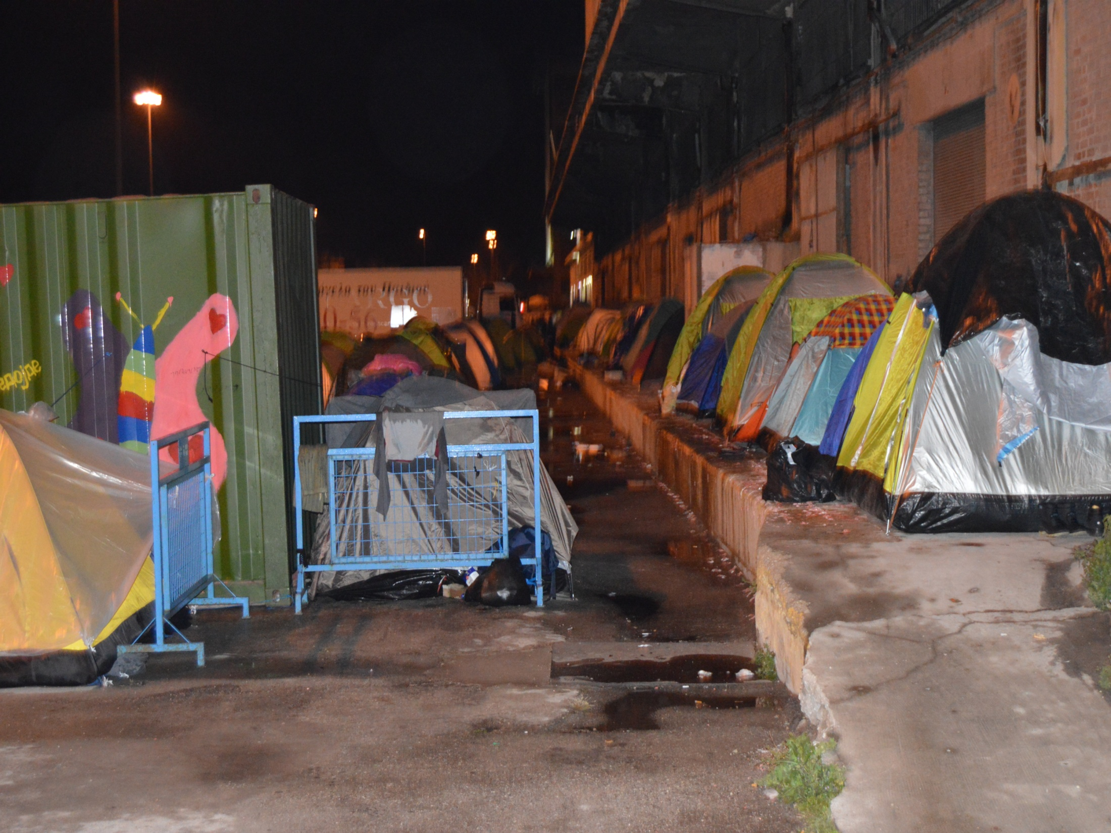

Slide 25
Interrogating integration
On a theoretical level, migrant/refugee integration literature is mostly characterized by a strong analytical bias to structure than agency and by focusing on a single geographical scale and space (one country/region/city/neighborhood etc.).
In most cases, integration becomes depicted as static and singularly place/scale bound and not related to geographical movement. Can we think of another supplementary way to theorize integration? Can we conceptualize it not only as stasis, but also, as a fragmented process on the move, too? Can we think of integration as an agentic and in-transit process during these periods of treacherous movement or even arrested mobilities?

Slide 26
The hegemonic narrative of integration
As Penninx has suggested integration processes begin when people have arrived in a society and “they have to acquire a place in that new society” (Penninx 2003:1).
Refugee integration, a subfield of migrant integration analysis, also exemplifies such tendencies by focusing on settlement, resettlement, local integration etc. instead of mobility and journey (see for instance Jacobsen 2003, Campbell 2006a, 2006b, Strang and Ager 2010). Nevertheless gives more space to agency
When this analysis gets surpassed, as in the case of transnational theory fusing into integration thinking, then the emphasis is simultaneously in two places: country/city/spatiality of origin and host society (see for instance Mazzucato 2008, Binaisa 2013, Erdal 2013).
To cut the long story short, the dominant paradigm in integration thinking, with some exceptions of course to verify the rule, has not been analytically expanded to accommodate the realities of erratic mobility, transit migration (Duvell 2012, 2014) and other complicated forms of geographical movement.

Slide 27
Policy driven categories
This focus on migrant integration as a static category has probably resulted from an emphasis on structures than agency; on policy than people. Following from this, and as Hein de Haas (2014) has argued about migration being flooded by policy driven categories, one could argue that integration has also been dominated by structural views and policy driven terms and thinking. Is there a possibility to think of integration away of such policy driven categories and boxes?

Slide 28
Aspirations as structuration theory reaching in migration studies
social and critical theory have been investing on the role of the imaginary in forming individual and collective actions (see for instance Appadurai 1990, Lefebvre 1991, Castoriadis 1997, Anderson 2006).
In migration studies, an emphasis on the imaginary as aspirations of mobility has been the analytical Trojan horse to break the strict distinction between ‘structure’ versus ‘agency’ explanations. Through the innovative work of Carling (2002, 2014) and Hein de Haas (2014) a robust combined theoretical model emerged that took account of both: choices and constraints, aspirations and capabilities.
In a way, it was like ‘structuration theory’ had finally reached migration studies as migration allegedly took place as a result of a functioning human agency in the midst of limitations, obstacles and constraints.

Slide 29
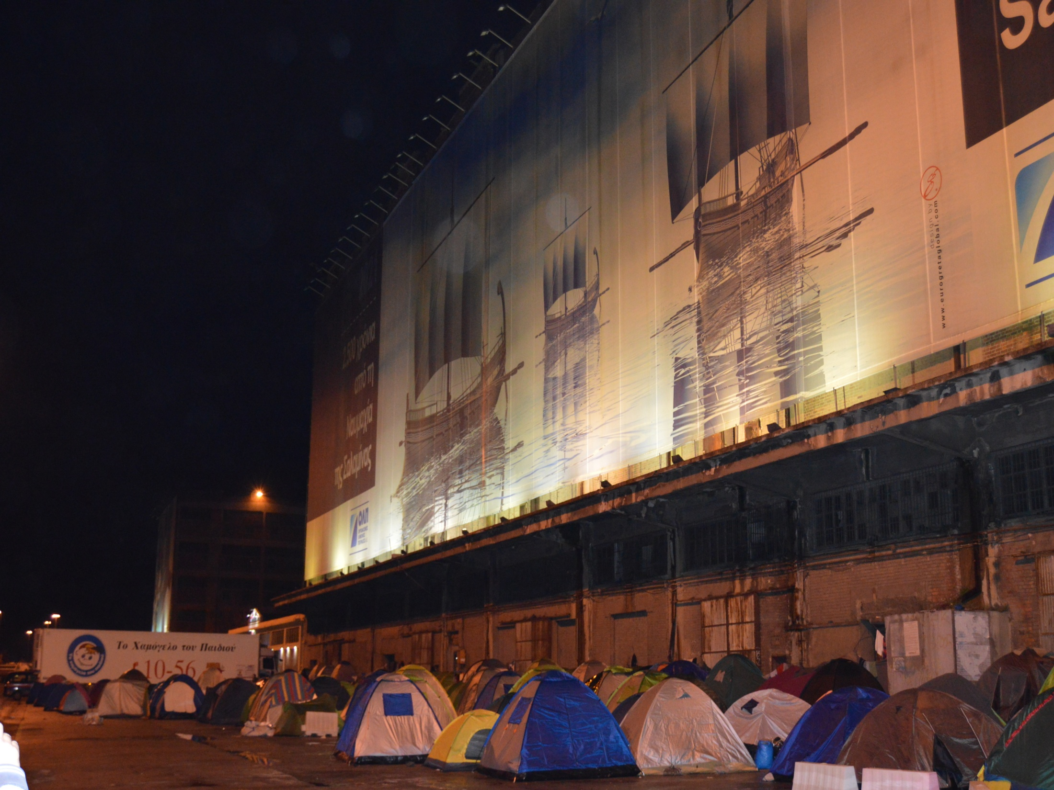

Slide 30
But what about integration?
this aspirations/imaginary approach to migration has not really entered into integration thinking and writing
these aspirations are exclusively discussed in relation to migration, but not, integration. Maybe this gap has emerged because migration literature has created space for agency while integration mostly remains under the hegemony of policy considerations and structural approaches.
By taking an aspirations’ approach to integration, among others, we focus on migrants/refugees as human agents on the move, although the constraints and limitations they face on the ground, aspiring to reach and integrate into their imagined communities of settlement; we come closer to a conceptualization of an en route integration, a multi-stage process or simply an integration in-transit.
Of course, this imaginary of integration can take different forms and does not equate with normative integration policy thinking; it can be more socio-economic than ‘civic’ or cultural.
The point I want to bring to the fore is that the aspirations’ model of migration can easily enter into the integration paradigm and enhance our understandings about real and imagined processes on integration along the route.
This is a part of the literature that is not adequately investigated

Slide 31
Enough with theory going back to ethnography
most refugees maintained dreams of reaching other EU member states. Most imagined European journeys were related to the presence of family members or friends in specific countries. Among Syrian refugees in E1, the most popular countries to be reached were Germany, Austria, Sweden, France etc. When I met with Bashar, a young refugee from Damascus who spoke good English and terminated his business administration studies to escape forcefully joining the Syrian army, he said from the outset that his 'dream' was to go to France and live and work with his uncle, who owned a small business there.
Omer’s imagined community of settlement was Sweden. His aspirations of reaching and settling in Sweden were mostly fed by culminating media stories around generous welfare state provisions, and why not, beautiful women. Omer was with his whole family and any act of mobility would probably have to include all members. At the same time, he was one of the few that did not have any family member already settled in another EU country. It felt that his imaginary society of integration and settlement was more imagined than real compared to other ones.

Slide 32
Aspirations, but also, local integration attempts, too
when the western Balkan route closed down many of my informants began asking questions whether there were any jobs in Greece, how easy was it to rent a flat, at what kind of price etc. From these questions, it became evident that 'dreams’ of European mobility and settlement had (temporarily) subsided whilst alternatively urgent needs for local integration had un-cheerfully emerged.
There was a widespread perception that "Greece is a beautiful country, Greeks are nice people, but to get work here is very hard, life here is very hard." Nevertheless, the closing of the northern borders, forced many of my informants to seek ways to inaugurate a process of "local integration" by leaving the camp behind to look for work, to rent with others a cheap flat, etc. These initial efforts of local integration failed and people came back to the "safety" of the camp.
Many a times, their disappointment was great and the fatigue was evident on their faces. At some time, Omer said to me: "I do not care where I go, all I want is some stability in my life, a house for me and my family, a job for me and my father, I do not care where I go, I even stay here, I even go back to Syria, or elsewhere, all I want is a bit of stability in my life.”

Slide 33
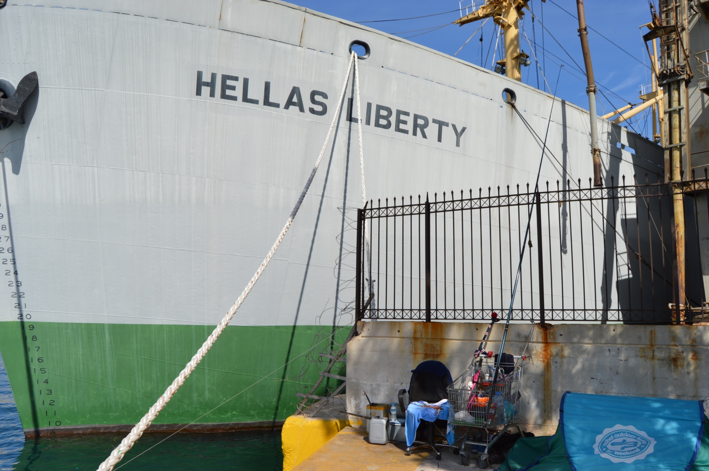

Slide 34
The liberty of the camp
The camp signified a sense of freedom for my informants as they could leave or enter it without having to go through checks or controls. This freedom of movement was paramount to them for both persevering with their local integration (mostly unsuccessful) efforts, but also most importantly, for maintaining their European imaginaries of migration and settlement; this freedom of movement was vital if their unfinished journeys were to become realities.
For instance, when the Port authorities tried to persuade them to leave the camp and resettle in state facilities, many of them were not willing at all to lose their ‘freedom’, refusing relocation for a long time. Mostly, people were scared to leave the camp and move to other facilities in case that they lost freedom and got trapped into state apparatuses restricting logic.
One afternoon, I saw Omer again as I was walking through the camp with my Arabic speaking friend at me side. Omer referred to my friend and asked him in Arabic: “What would you do if you were standing somewhere and you saw a camel passing by? Would you ride it or would you let it go?” This was an indirect way of expressing his double mindness about staying or leaving from the camp. Many people had already left and were housed in the nearby Skaramangas state facility.

Slide 35
In the care of the state?
What should he and his family do?The thing that made him really confused was that if they really wanted to apply for asylum (as the northern border was by now hermetically sealed) they had to move to a state facility to do so.
By applying for asylum they had three choices: apply for asylum and stay in Greece, apply for asylum and join the European resettlement program once activated, or apply for asylum and family reunification together in case a close relative was already settled in another EU state.
The idea of getting asylum had already entered into Omer’s brain: the reality was that applying for asylum as an instrument to continue their European unfinished journeys and subsequently reach and settle in the imagined communities of the North was the new popular strategy for the Syrian camp’s residents.
Towards the end of April, I heard that Bashar had left Greece. A few days later, Omer told me that he and his family were seriously considering of leaving the camp to resettle in the nearby state facility (Skaramangas). As he said, there they will be able to seek asylum and to join the EU resettlement program. Later this day, Omer told me that he still wanted to go to Germany. When I asked him where, he replied to any German city. The port of Piraeus was quickly emptying as its residents were leaving it behind to resettle in state facilities. Although the Piraeus port had not totally emptied, as it still provided shelter to around 1, 300 refugees, I felt that my short ethnography had come to an end, too.

Slide 36
From ethnography to theory
As the dominant paradigm of integration, mainly refers to state actors, policies, normative thinking etc., little is written on the part of subjects that seek to temporally integrate, or even go by, along the route of their unfinished journeys and the aspirations that keep these journeys alive during such treacherous movements.
Maybe it is time to start empirically looking for more grounded theories of integration that bring to the fore perplexed takes on the process as unfolding through countries, regions, cities, neighborhood, camps etc., as part of unfolding journeys and temporary arrested mobilities guided by the role of the imaginary.
The unfolding European refugee ‘crisis’ probably urges us to do so more than ever.

Slide 37
