Slide 1
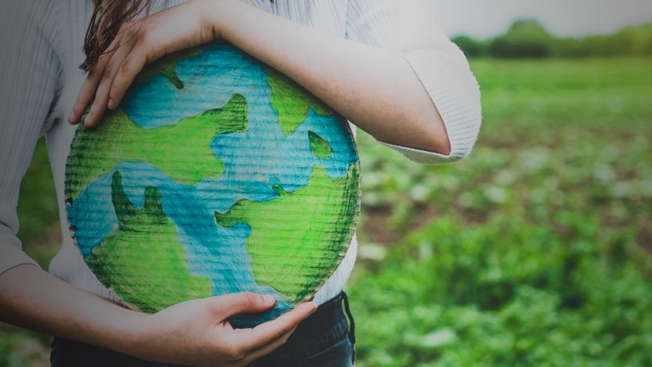
Mediterranean Diet and Sustainability
Vassiliki Costarelli
Associate Professor, Department of Economica and Sustainable Development
costarv@hua.gr

Slide 2

Nutrition challenges ahead of us!!!!

Slide 3
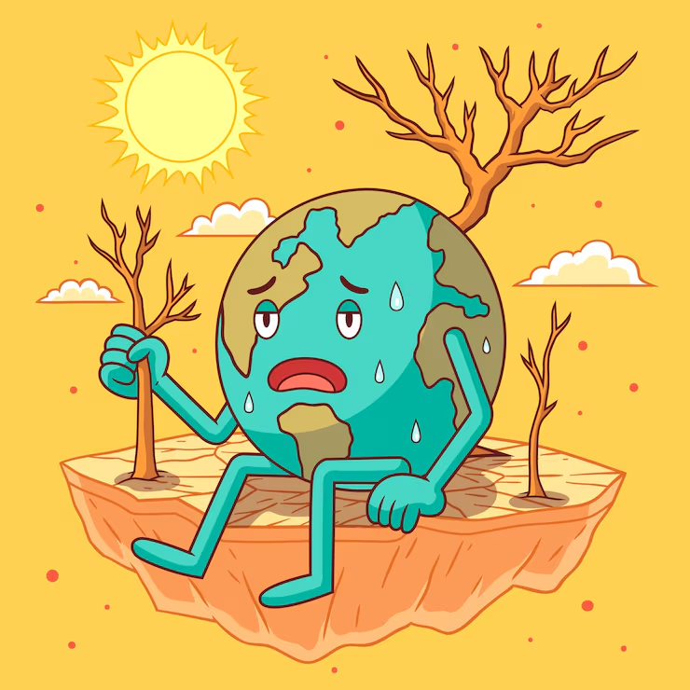

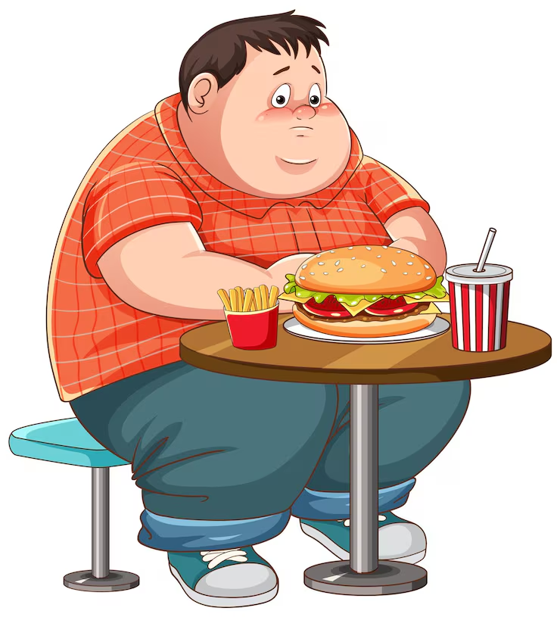
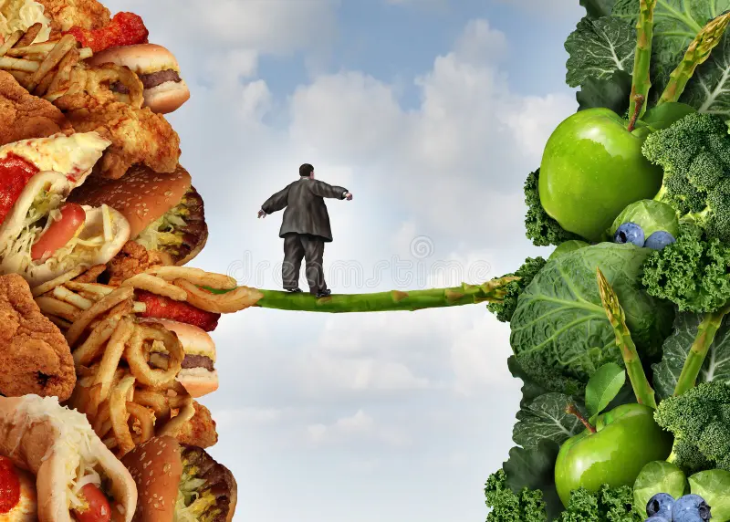
Nutrition challenges ahead of us!!!!

Slide 4
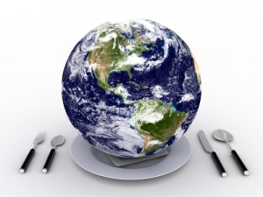
Basic Questions
What is the current state of the planet?
Does our diet affect the environment?
How is sustainable food consumption defined?
What is the role of the Mediterranean Diet?
What are the recommendations of the EAT-Lancet Commission on Food, Planet, Health?

Slide 5
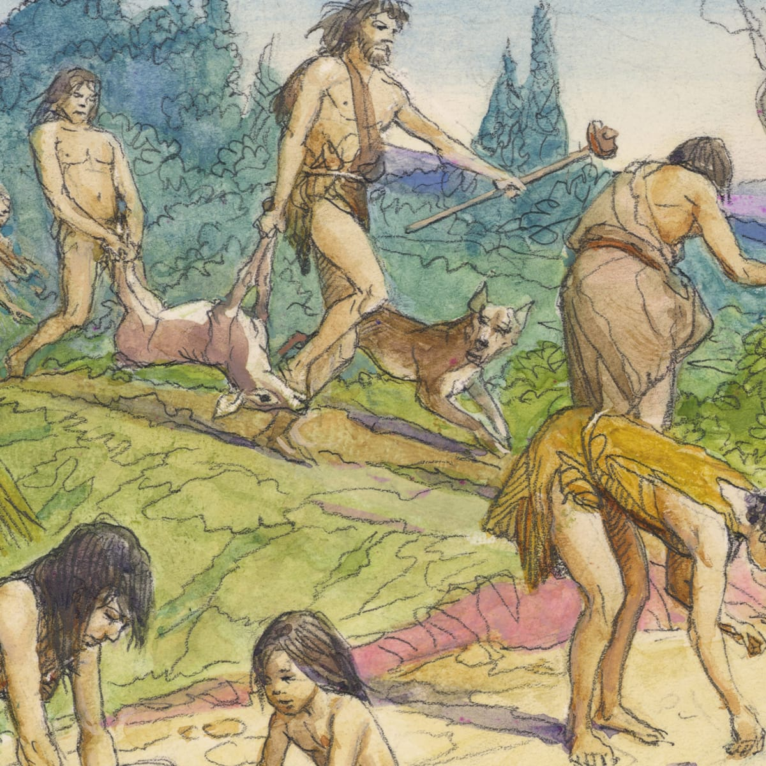
History
10,000 generations of humans on Earth.
The last 3 generations, more changes.
  In the last approximately 60 years, we have polluted or depleted two-thirds of the planet’s ecological systems on which life depends.

Slide 6
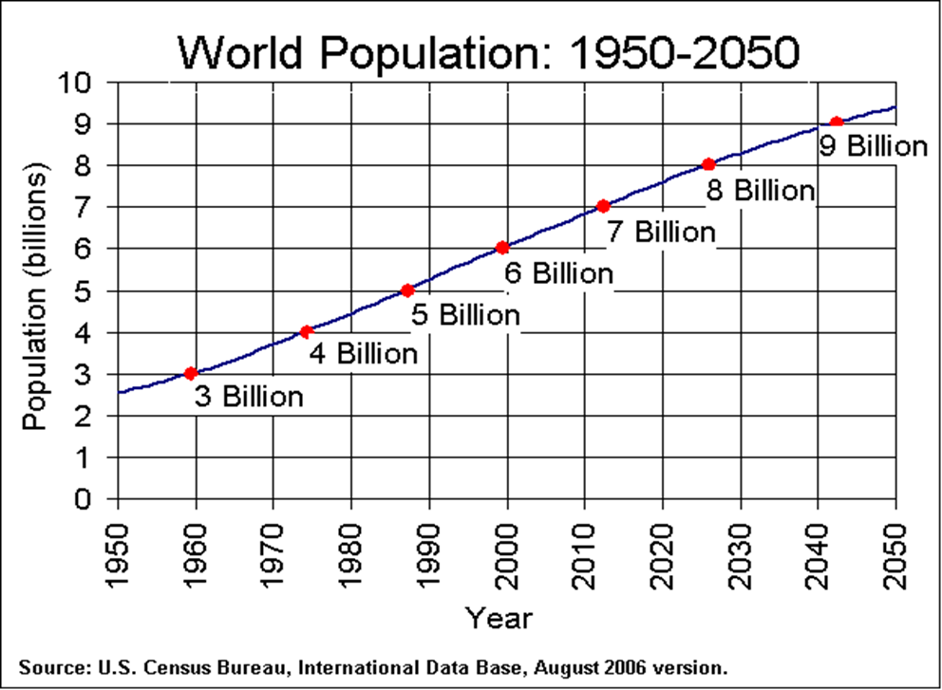
Drastic Changes over the past 60 years….
The world’s population has doubled.
Food consumption has tripled.
Water consumption has tripled.
The use of fossil fuels has quadrupled.
In the last three generations, humanity has changed more than ever before….

Slide 7
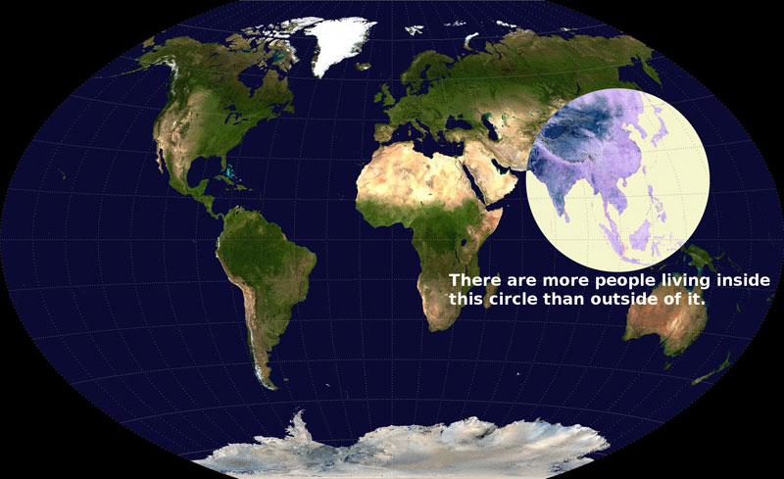
The Earth’s population is increasing at a rate of 75 million per year

Slide 8
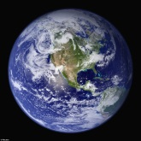

Model of living in the Western World
Resources
UK
North America
Resources

Slide 9
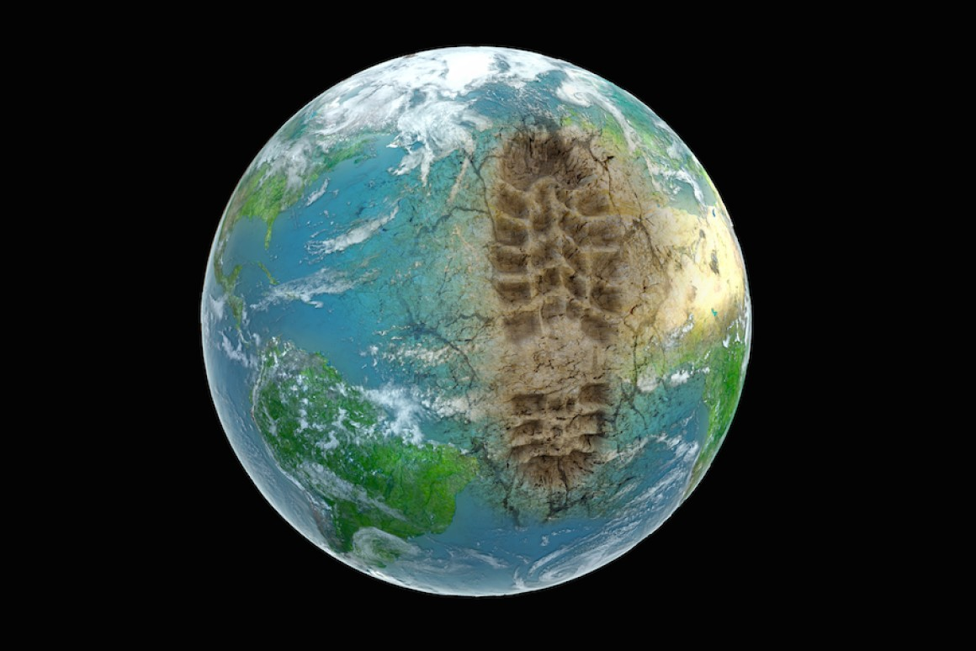
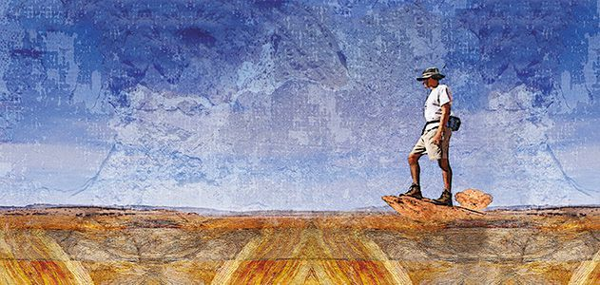
Anthropocene era
"A new geological period, defined by the impact of humans on the planet
The geological age of humans

Slide 11
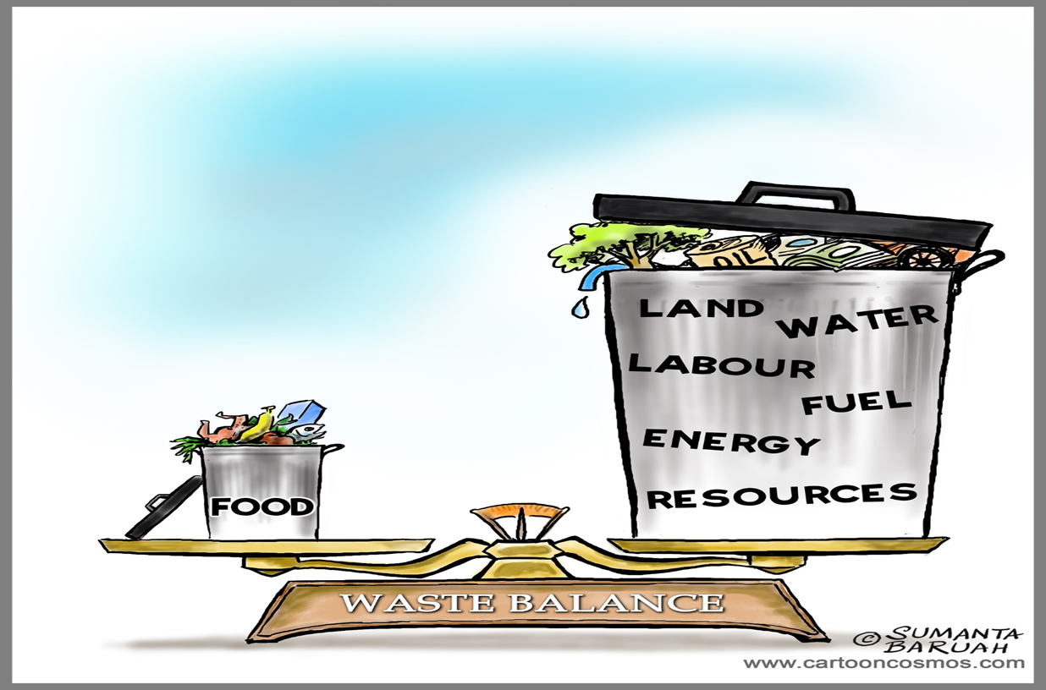

Slide 12

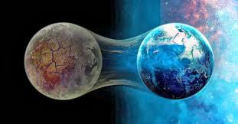
We are living in the most critical moment in the history of the planet
The decisions that will be made will determine the future

Slide 13

Eco-anxiety
The American Psychology Association (APA) describes eco-anxiety as “the chronic fear of environmental cataclysm that comes from observing the seemingly irrevocable impact of climate change and the associated concern for one's future and that of next generations”.

Slide 14
Basic questions
Ποια είναι η κατάσταση στον πλανήτη αυτή τη στιγμή;
Πως ορίζεται η βιώσιμη κατανάλωση τροφής;
Does our diet affect the environment?
Πως μπορώ να αυξήσω την παραγωγή τροφής χωρίς να καταστρέψω τον πλανήτη ;

Slide 15
The consequences of dietary behavior
Dietary habits significantly burden the environment, more than any other behavior.
In 2008, food systems contributed 19%–29% of global anthropogenic greenhouse gases (GHG),releasing 9,800–16,900 megatons of CO₂ equivalents (Sonja J. et al., 2012).
In comparison, transportation (cars, trains, airplanes, ships) accounts for only 13% of emissions (FAO, 2006)."

Slide 16
Our dietary habits affect the environment more than any other behavior

Slide 17
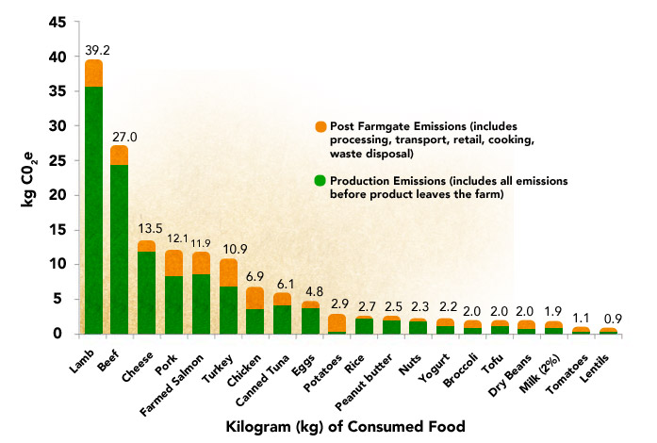
Greenhouse Gas Emissions from Food
www.ewg.org/meateatersguide/a-meat-eaters-guide-to-climate-change-health-what-you-eat-matters/climate-and-environmental-impacts/#sthash.lI0tPg1m.dpuf

Slide 18


Slide 19
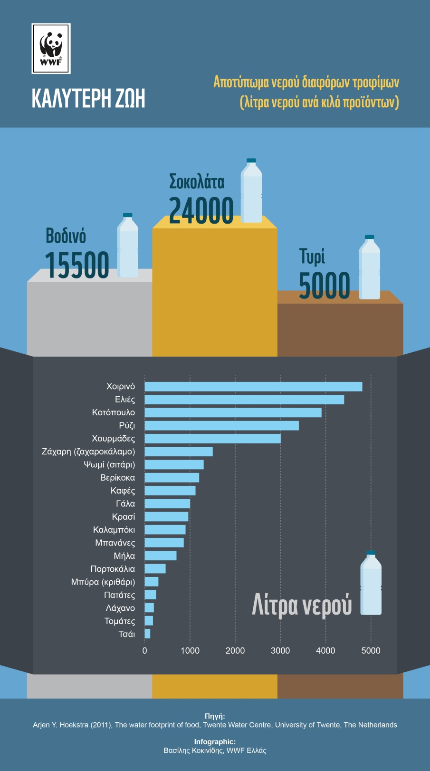
Water footprint
(lt / kg food)

Slide 20
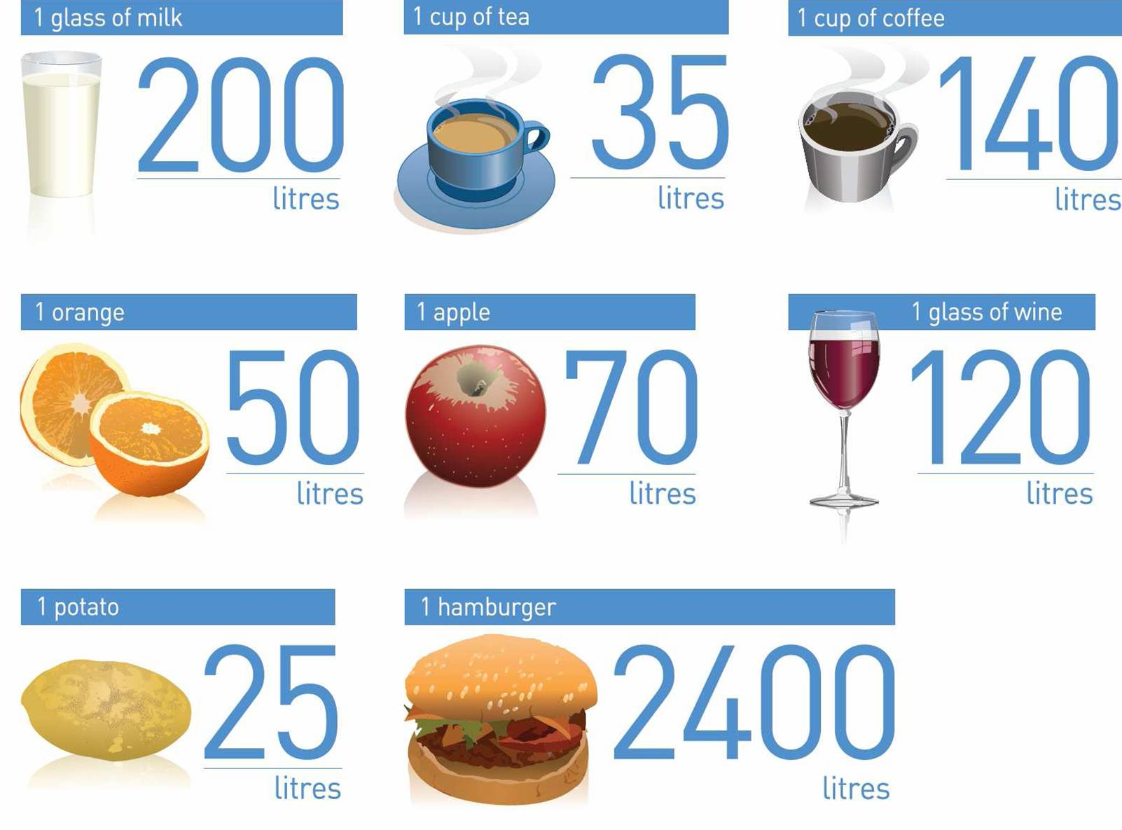

Slide 21
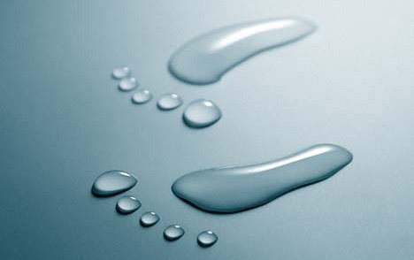
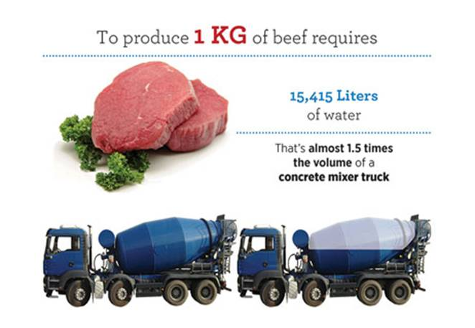

Slide 22
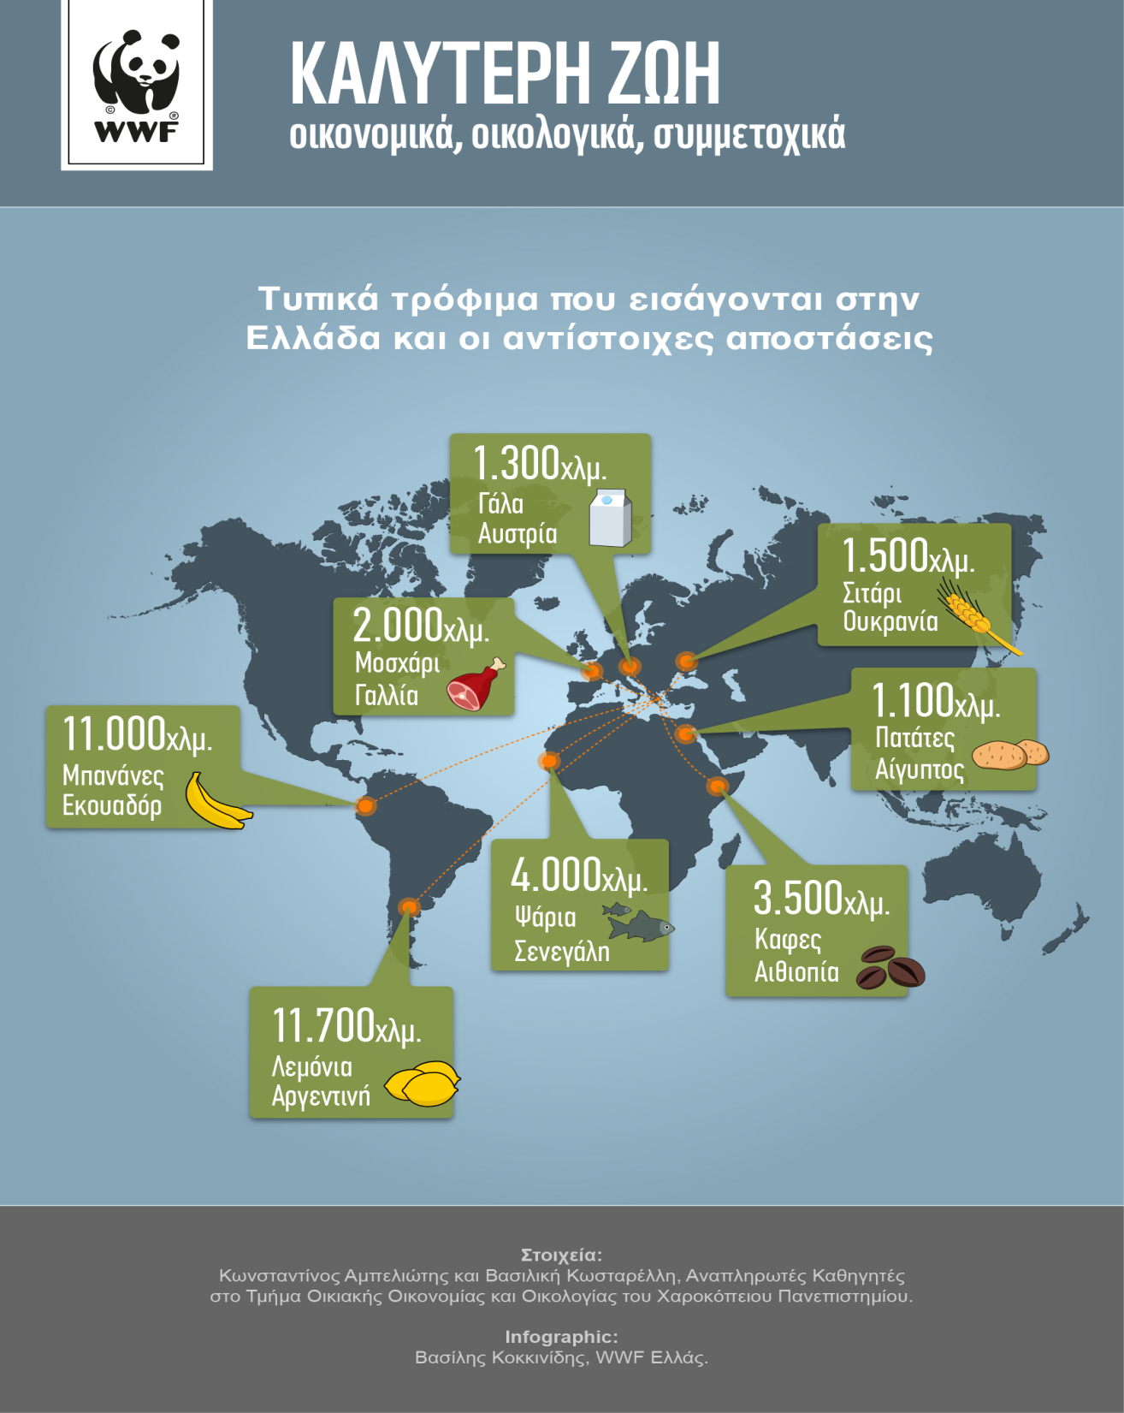
Food miles

Slide 23
Βασικά Ερωτήματα
How is sustainable diet defined?ει η

Slide 24
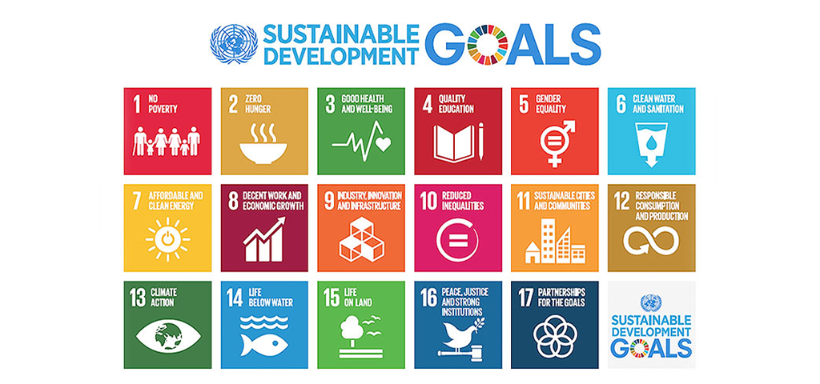

Slide 25
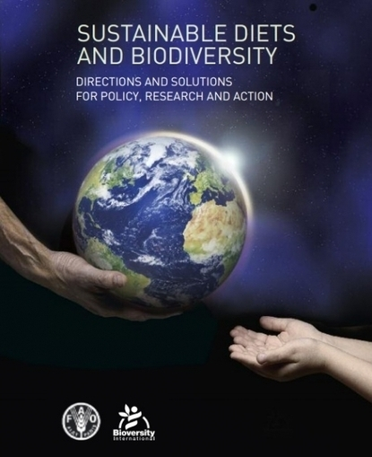
Sustainable Diet
The FAO (2010) definition of a sustainable diet is:
“Sustainable diets are those diets with low environmental impacts which contribute to food and food security and to healthy life for present and future generations. Sustainable diets are protective and respectful of biodiversity and ecosystems, culturally acceptable, accessible, economically fair and affordable; nutritionally adequate, safe and healthy; while optimizing natural and human resources.”
Minimizes environmental impact (less greenhouse gases, water, and land use)
Supports health and nutrition
Respects biodiversity and ecosystems
Is culturally acceptable and economically fair
Ensures long-term access to food for future generations

Slide 26
The characteristics of a sustainable diet
Protects and respects biodiversity & ecosystems
Culturally acceptable
Accessible
Economically fair
Nutritionally adequate, safe & healthy
Optimizes natural and human resources
Source: FAO, 2010

Slide 27
Food Security
Food security is the economic, physical, and social access to an adequate quantity of safe and nutritious food that meets the dietary needs and preferences of all people for an active and healthy life.

Slide 28
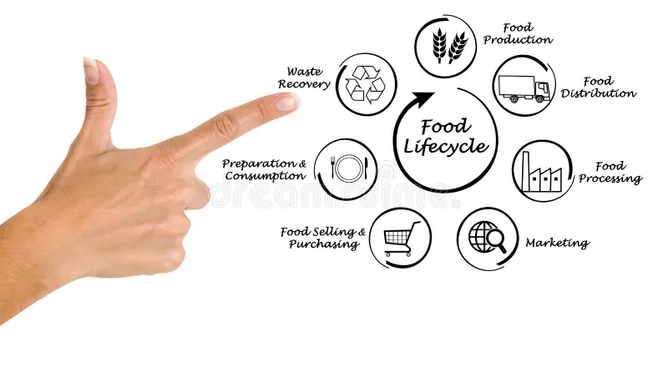
Food life cycle

Slide 29
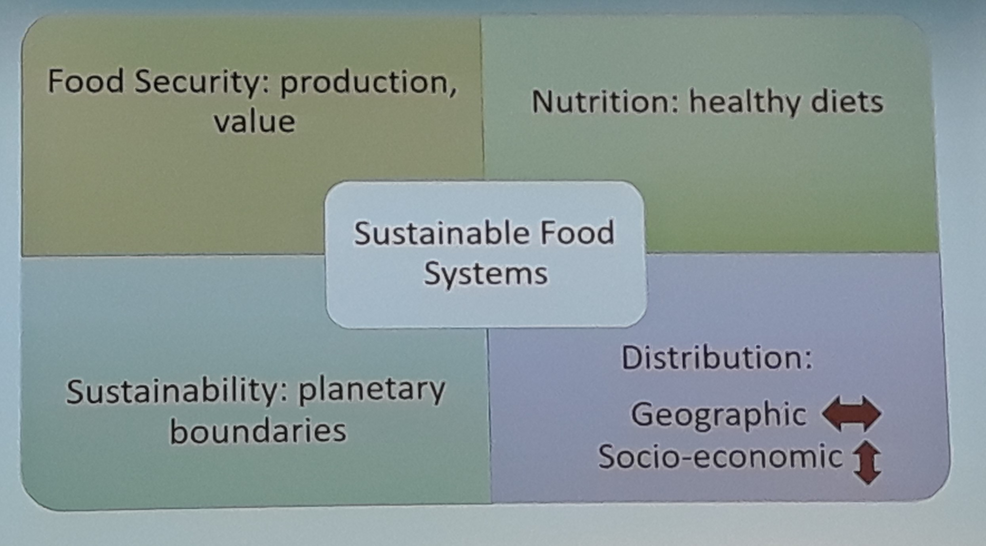

Slide 30
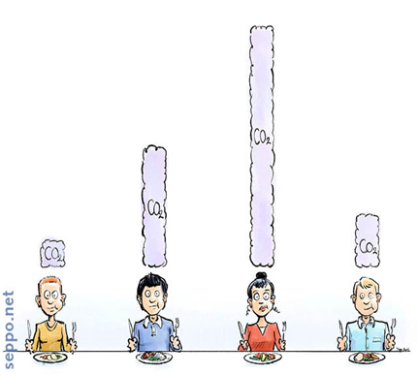
Greenhouse Gas Emissions in Greece Following Different Diets
Anagnostopoulos K., Kalogeropoulos N., Costarelli V. & Abeliotis K.
Harokopio University, Athens Greece

Slide 32

Methodology
Conventional Diet
Lacto-ovo-vegetarian Diet
Replace beef with pork and chicken
Replace rice with potatoes

Slide 33
Results
Υποκαθιστούμε ρύζι με πατάτες
(1% μείωση)
Συμβατική Δίαιτα
Υποκαθιστούμε το μοσχαρίσιο κρέας με χοιρινό και κοτόπουλο
(40% μείωση)
Γάλακτο-ωο-φυτοφαγική δίαιτα
(48% μείωση)

Slide 35
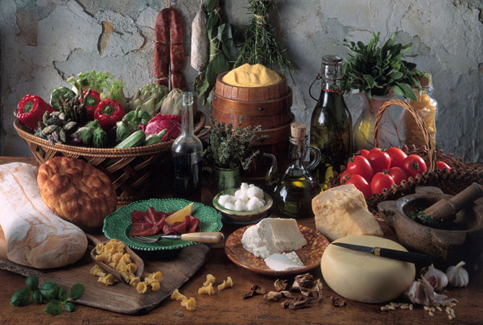
The Mediterranean Diet

Slide 36
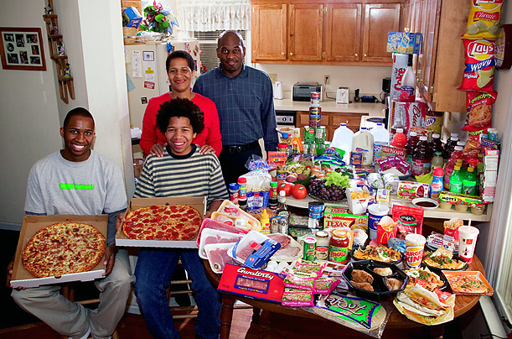
Western Diet
Peter Menzel, from the book, "Hungry Planet: What the World Eats."

Slide 37

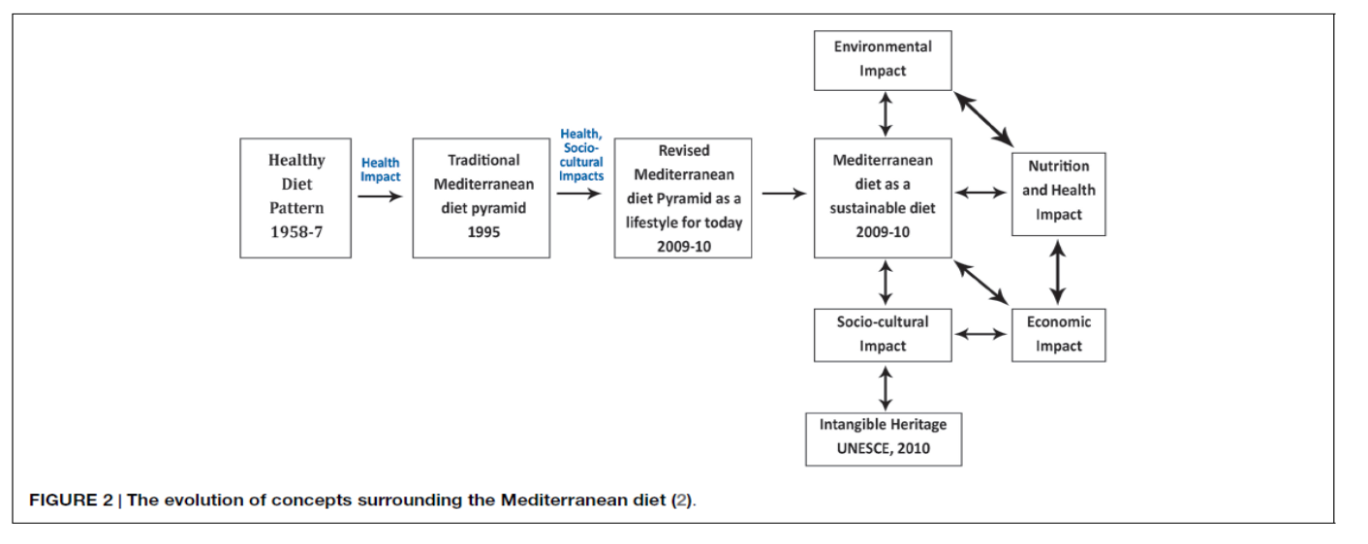

Slide 38
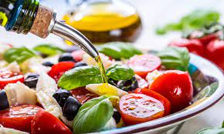

The Mediterranean Diet is associated with longevity
Lower mortality from:
  Cardiovascular diseases
  Various forms of cancer and overall mortality

Slide 39
According to UNESCO (2010), the Mediterranean Diet is defined as:
The Mediterranean Diet is the dietary pattern traditionally followed by people in countries bordering the Mediterranean Sea. It is characterized by a high consumption of plant-based foods (fruits, vegetables, legumes, nuts, and cereals), olive oil as the main source of fat, moderate consumption of fish and poultry, low consumption of dairy products, red meat, processed meats, and sweets, and regular but moderate consumption of wine during meals. It is more than a set of foods; it is a cultural model that includes culinary traditions, social practices, and a lifestyle that promotes physical activity and communal meals.
The practices, representations, expressions, knowledge, skills – as well as the instruments, objects, artifacts, and cultural spaces associated therewith – that communities, groups, and, in some cases, individuals recognize as part of their cultural heritage. This intangible cultural heritage, transmitted from generation to generation, is constantly recreated by communities and groups in response to their environment, their interaction with nature, and their history, providing them with a sense of identity and continuity, thus promoting respect for cultural diversity and human creativity.

Slide 40
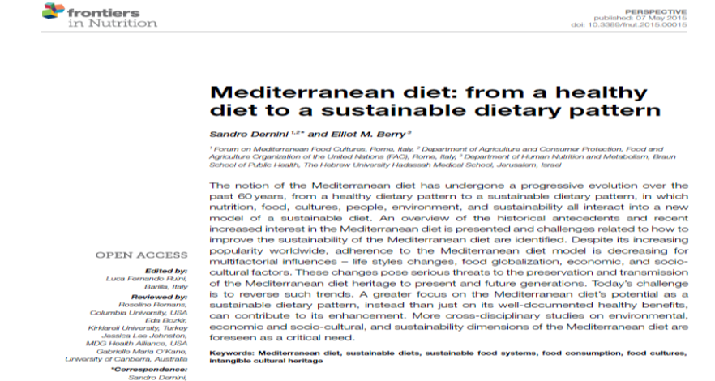

Slide 41
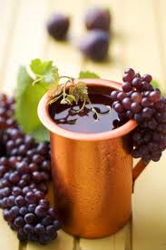
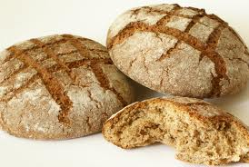
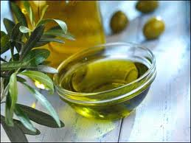
Mediterranean Diet
Bread Olive oil Wine

Slide 42
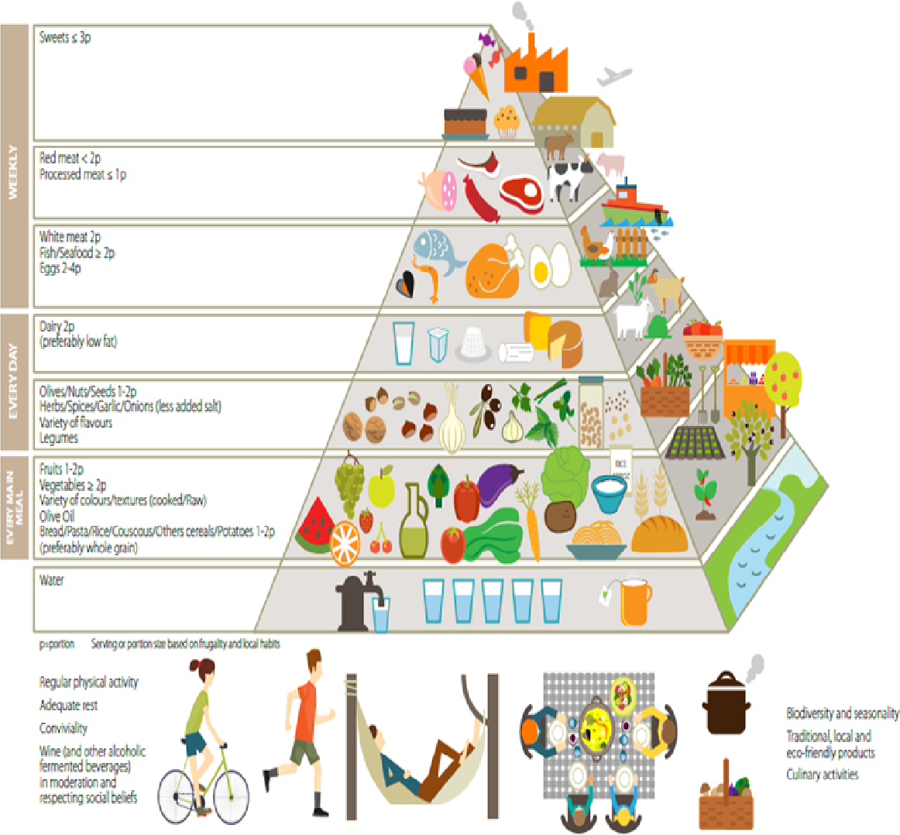
New pyramid for
sustainable Mediterranean diet.
Source: IFMED Consensus document. The First World Conference on the Revitalization of the Mediterranean Diet, 6-8 July 2016, Milan.

Slide 43
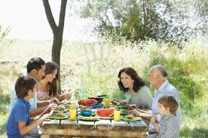
Med Diet
Balance / moderation
Fresh foods
Eat at the table with family
Satisfaction from food
“Value” of food

Slide 44
The pyramid of the Med Diet
Environmental footprint

Slide 45
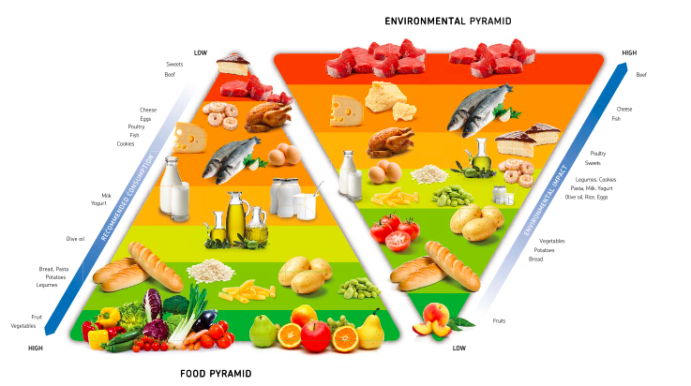
The Environmental Pyramid

Slide 46
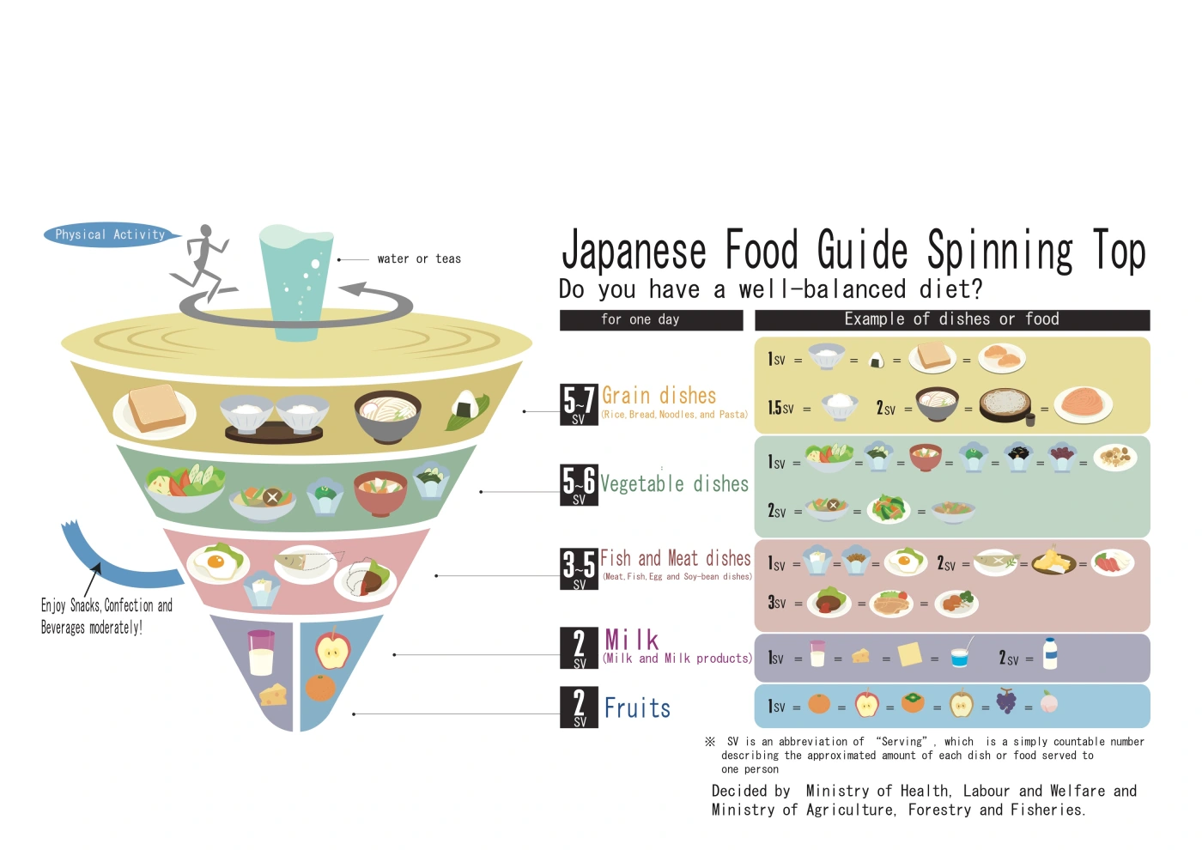
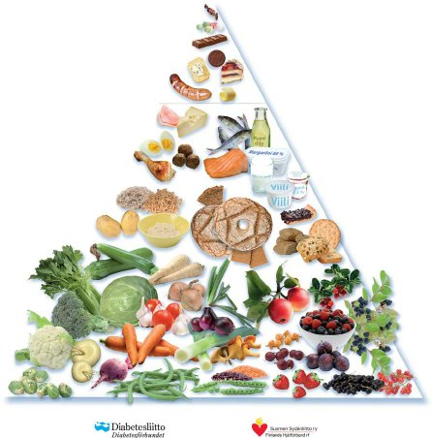
The Baltic Sea Diet Pyramid
(created by the Finnish Heart Association, the Finnish Diabetes Association and the University of Eastern Finland)

Slide 47
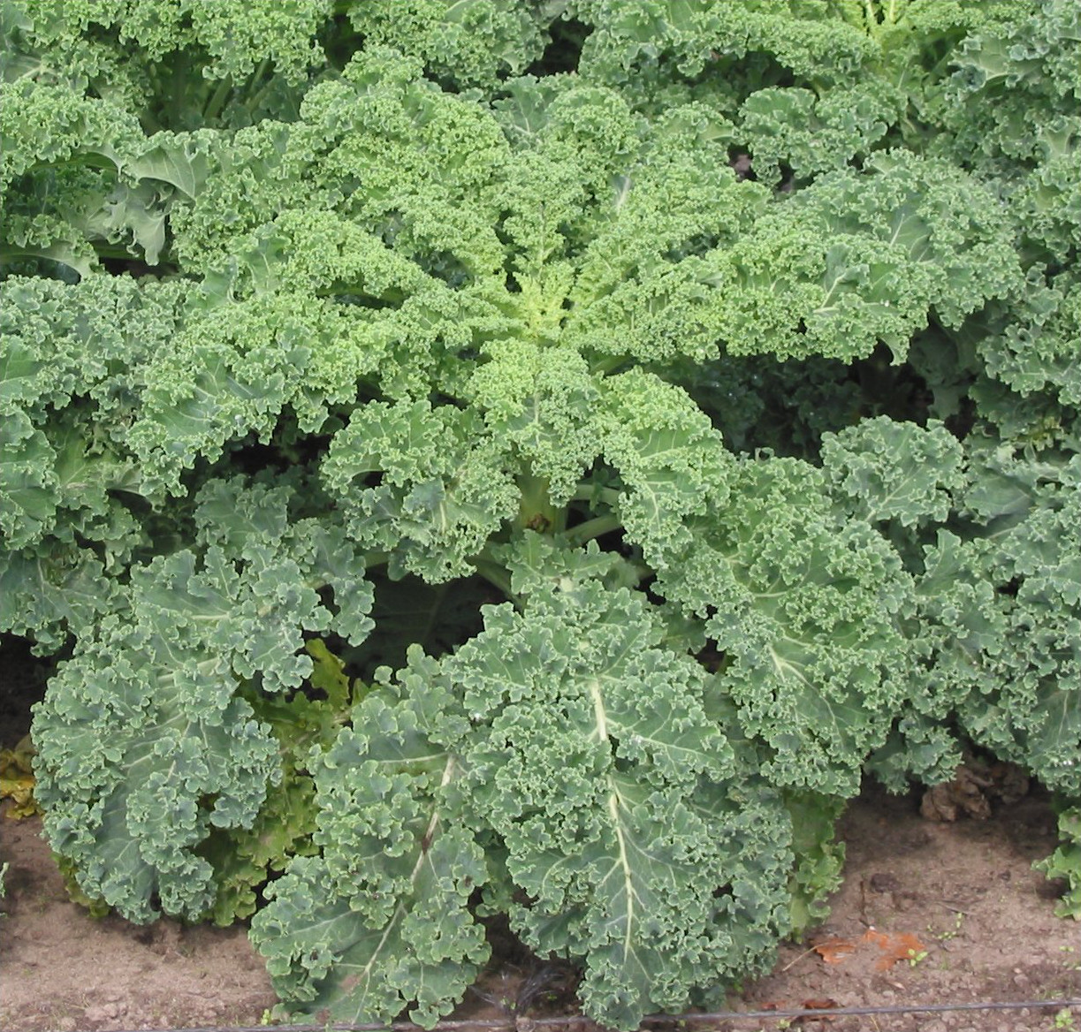
The example of kale in Denmark

Slide 48
EAT-Lancet Commition
Achieve Planetary Health Diets for nearly
10 billion people by 2050
Willett et al., 2019

Slide 51
"How can I increase food production without destroying the planet?"

Slide 52
We need to focus on….
Increasing the efficiency of cultivating specific crops using less water and agrochemicals
  Opportunities exist in: Mexico, Africa, Eastern Europe
Reducimg the amount of food that is thrown away
Stoping deforestation
Modifing our diet (reduce and substitute)

Slide 53
What can I do to be a more sustainable food consumer?
I do not consume unnecessary calories
I limit beef consumption
I choose seasonal fruits and vegetables
I choose local products
I do not throw away food
I recycle packaging

Slide 54
How easy is it to follow these guidelines?

Slide 55
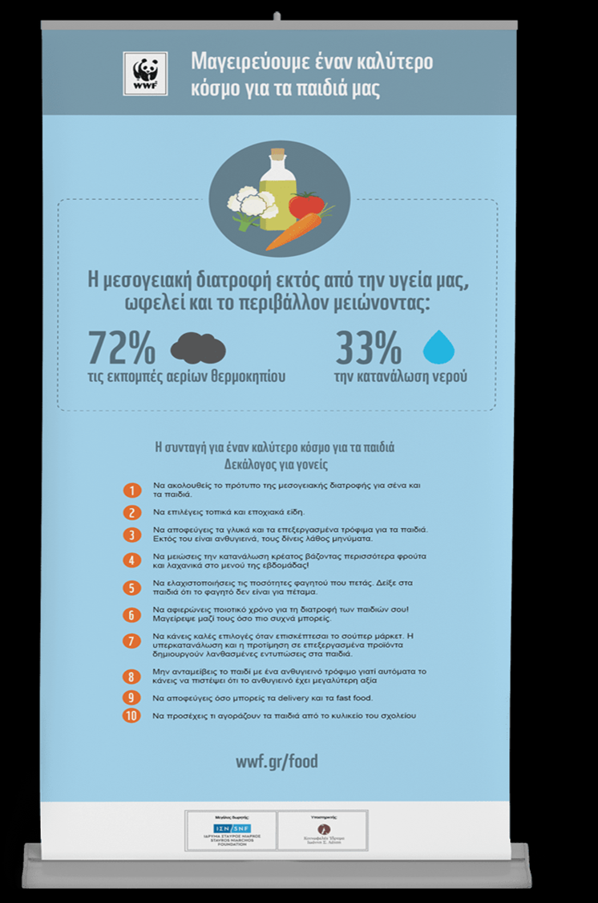
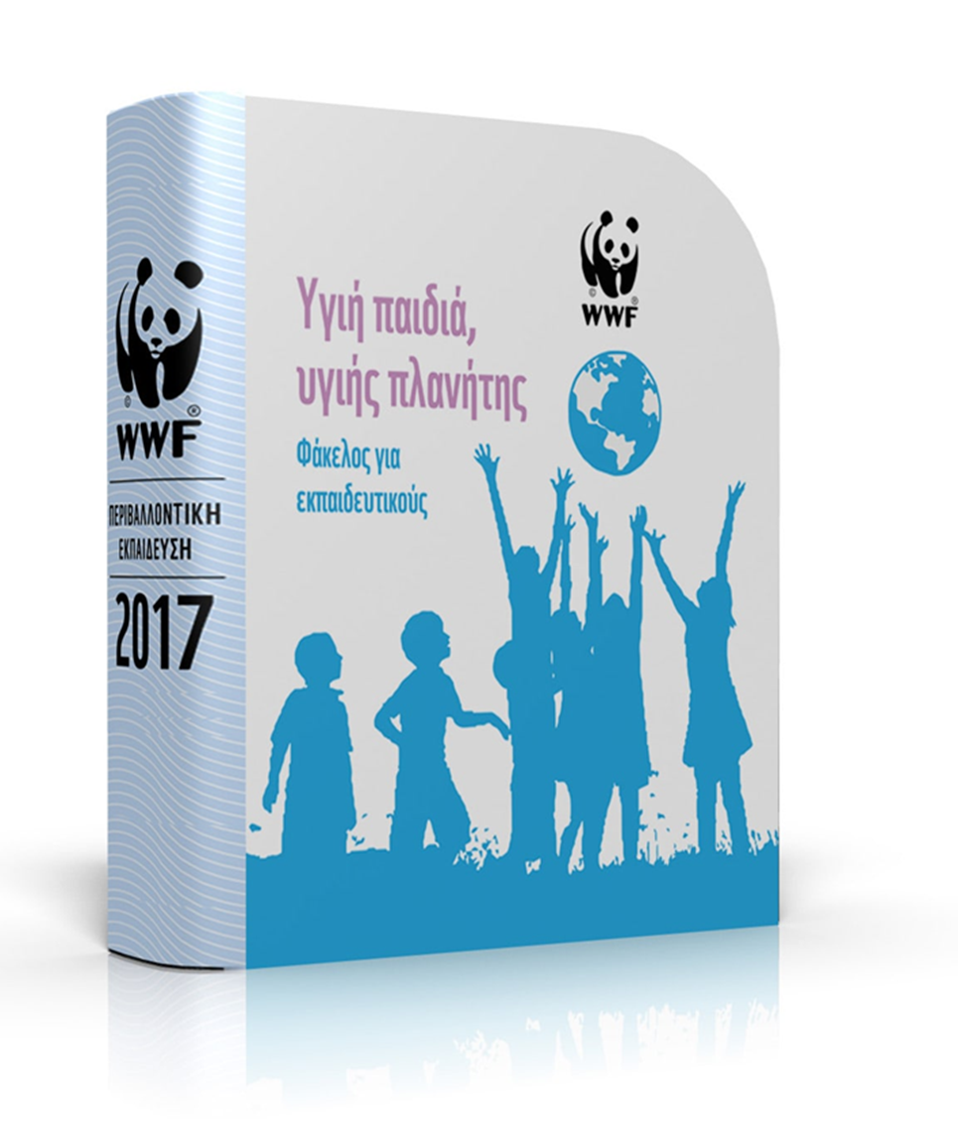
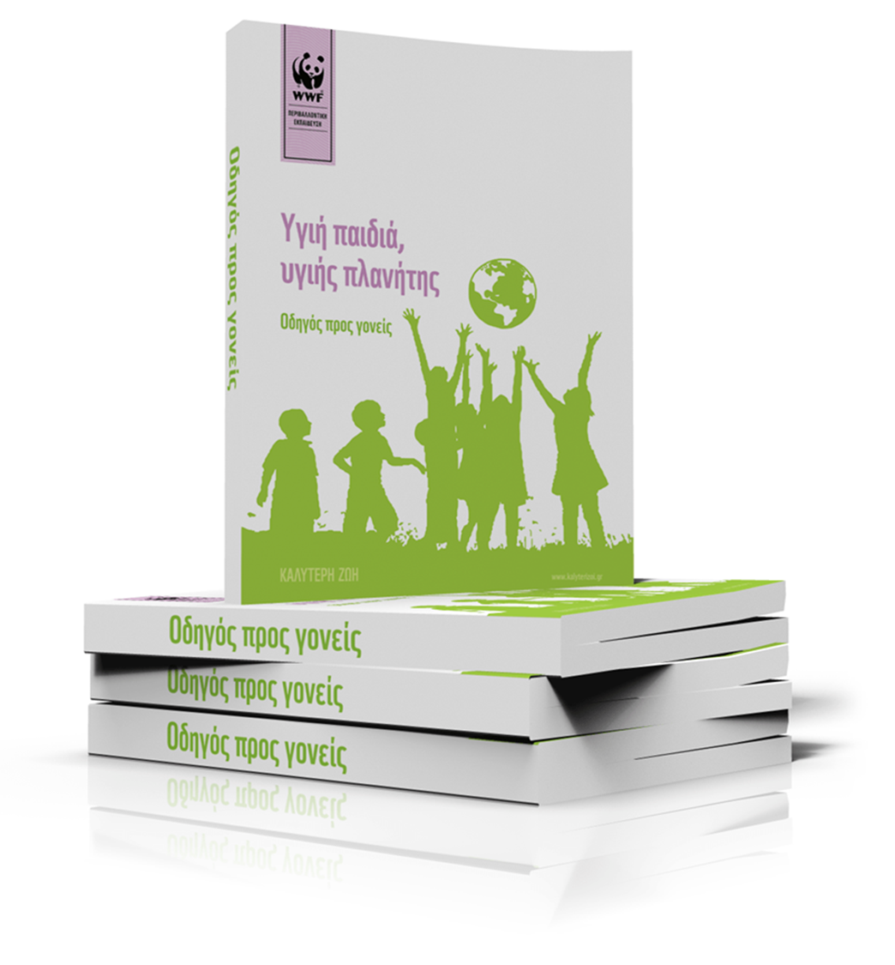
Health Education Journal
2022, Vol. 81(2) 183– 195
DOI: 10.1177/00178969211062479

Slide 56
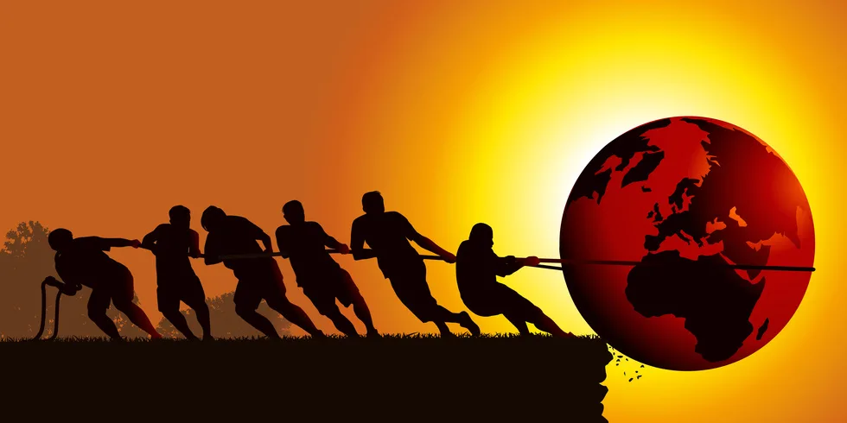
Συμπεράσματα

Slide 57
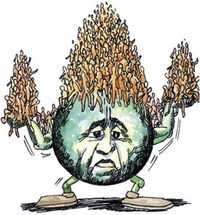
We are running out of planet
Shifting to a diet that is both planet-friendly and healthy is imperative.
The Mediterranean diet can and should be promoted as a sustainable way of eating.
Education on sustainable food consumption from childhood is essential."

Slide 58
The EAT-Lancet Commission on Food, Planet, Health
https://eatforum.org/eat-lancet-commission/

Slide 59
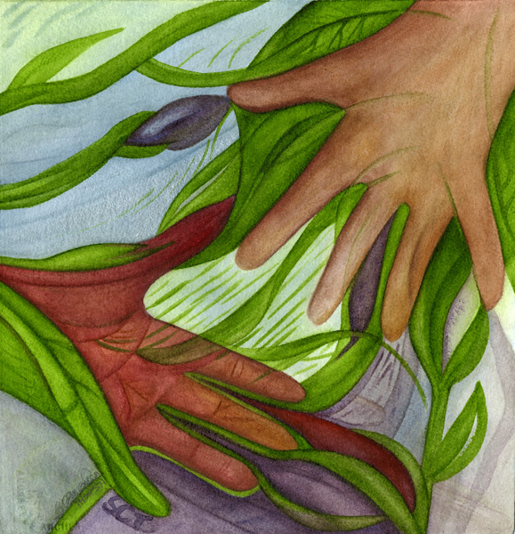
The sustainability of our planet concerns everyone because it is interconnected with our very existence
https://thompsonartstudio.com/human-nature-paintings/

Slide 60
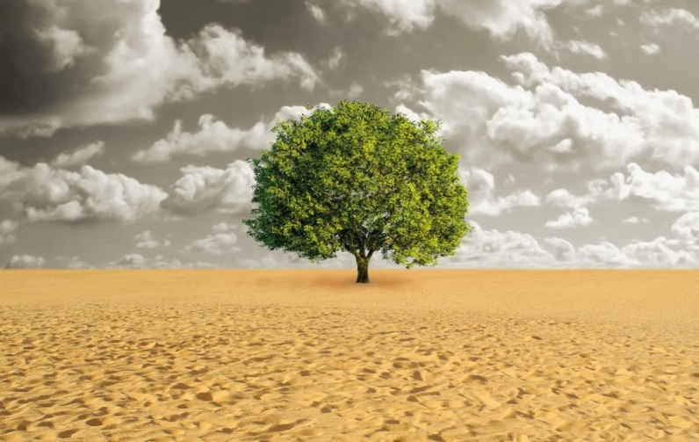
The first best time to plant a tree was twenty years ago....the second best time is now
A West African proverb

Slide 61
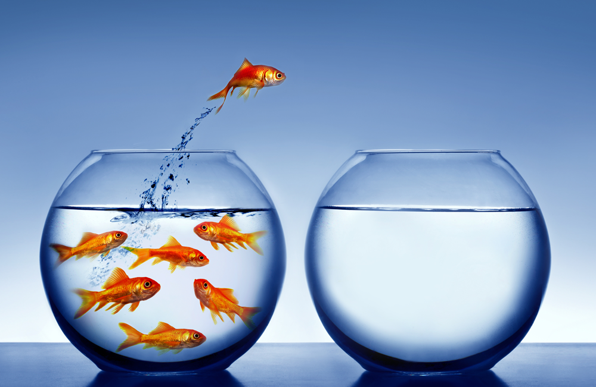
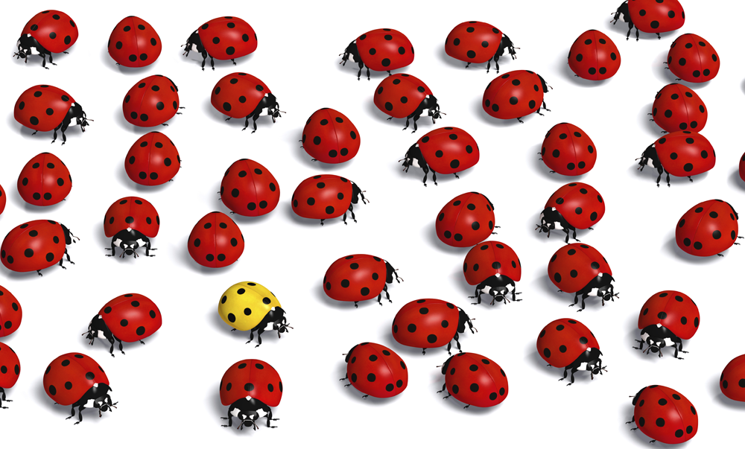
Positive Deviance

